Slide 1
State of Play
Wim Hugo
South African Environmental Observation Network/
World Data Centre for Biodiversity and Human Health

Slide 2
State of Play
National Platform funded directly and indirectly by Department of Science and Technology and National Research Foundation
SAEON (South African Environmental Observation Network)
SAEOS (South African Earth Observation System)
Contribution to GEO and GEOSS
Risk and Vulnerability Atlas
World Data Centre for Biodiversity and Human Health
CSIR CoGIS
… etc.

Slide 3
Solution
“Shared Implementation”
a framework containing architecture guidelines, abstract specifications and user requirements, recommended interoperability standards, and reference implementations.
a directed open source community that contributes to, extends, and maintains the shared implementation.
National funding provides a baseline of operations and activity.
not domain-specific, but function-specific.
Almost all knowledge portals share a base set of functions that are re-usable.

Slide 4
Solution
“Shared Meaning”
meta-data standards selection
crosswalks (inter-standard translations)
controlled vocabularies, thesauri, and ontologies associated with standards – these are often region-specific
semantic interoperability as an ideal
process and workflow preservation/ automation
knowledge

Slide 5
Solution
“Shared Processes”
coordinated training and awareness creation on the importance of meta-data
data sharing and meta-data provision policies / guidelines to be implemented at research institutions and as a condition of funding
coordination of and assistance with contributions to national infrastructure
creation of forums for the validation of decisions and guidelines

Slide 6
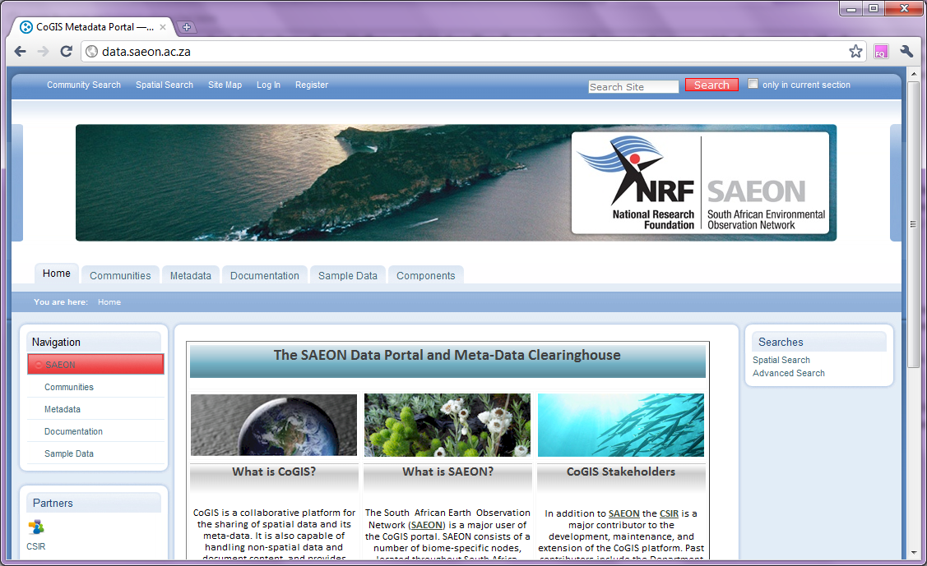
SAEON Data Portal

Slide 7
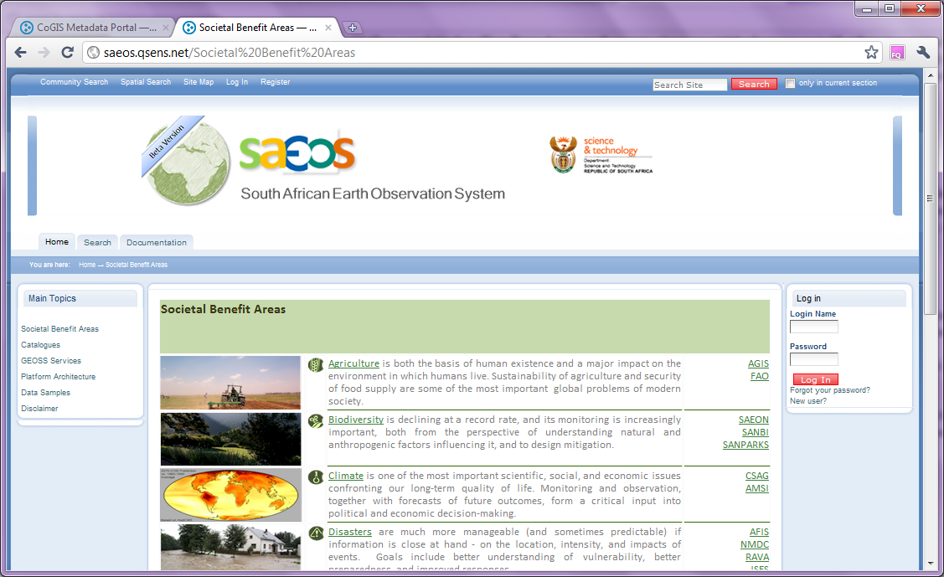
SAEOS

Slide 8
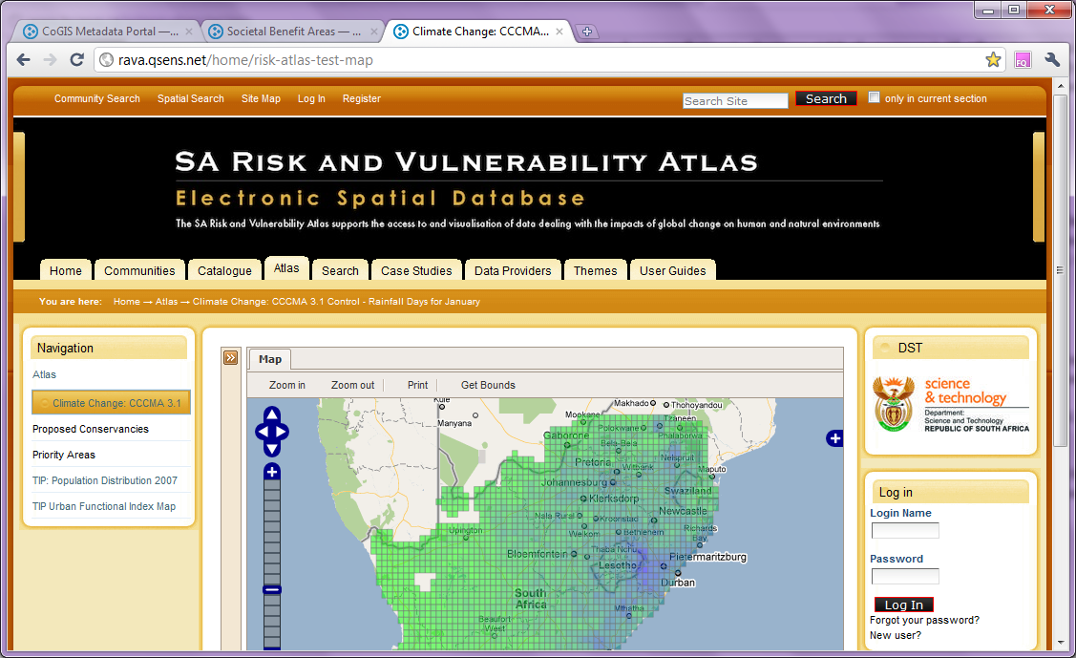
Risk Atlas

Slide 9
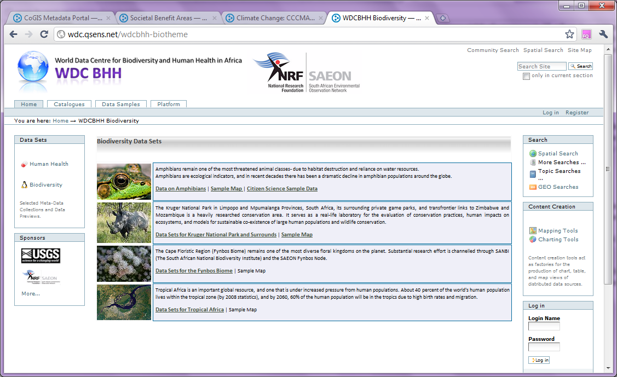
WDCBHH-Africa

Slide 10
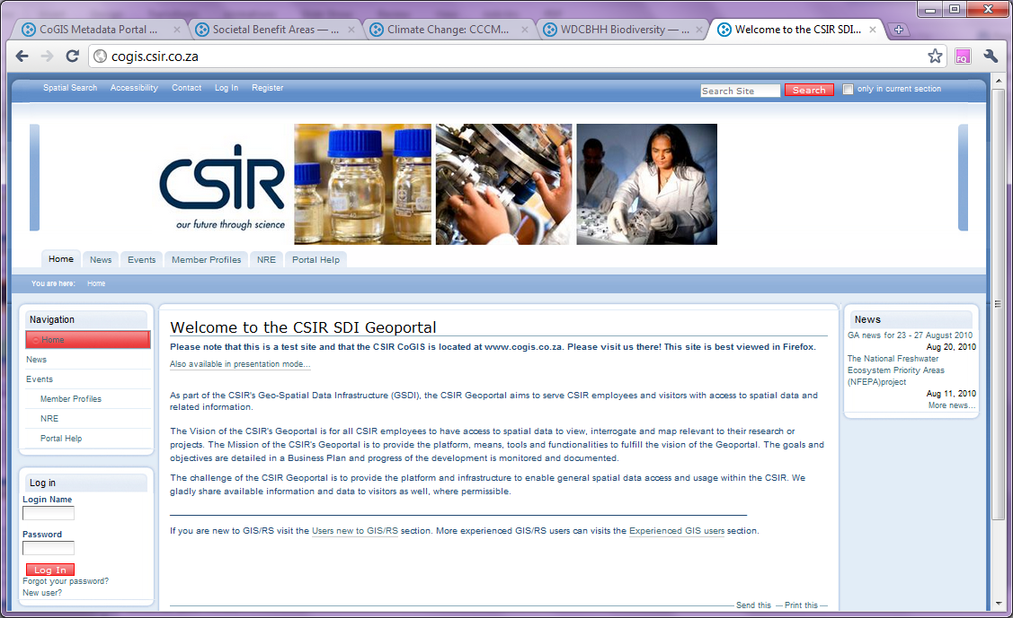
CSIR-CoGIS

Slide 11
Positives
Economy of Scale and Reduction of Duplication
Multiple Development Threads
Improved Visibility
Snowball Effects from Meta-Data Contributions
Willingness to be inclusive w.r.t. Africa
Strong support from international partners
Established Information Governance Framework
Platform: strong synergy and incipient collaboration with Centre for High Performance Computing

Slide 12
Broad Issues
Even though funding is concentrated and more focused than before, it is still
Low in international terms (total approximately ZAR 5m 2009-2012)
Uncoordinated from a policy perspective – leads to duplication of effort and unnecessary expenditure
Medium-term viability is unpredictable
Participation is Voluntary and Not Linked to Performance Management Frameworks
Open Source is a double-edged sword
Initial reduction in development risks
Open source resources are limited and expensive
Support is often informal and not conducive to mission-critical systems

Slide 13
Constraints
Financial
Depth of implementation
Critical Mass
Often overtaken by well-funded international initiatives
SAEON has an express strategy of small contributions to large projects
Resources
Quality resources are thinly spread and overcommitted
Specialists cannot spend all their time on specialisations
Assimilation Capacity
Full-time occupation to stay abreast of international initiatives
Unit vs Team Transitions – small projects isolate knowledge

Slide 14
Funding/ Collaborators

