Slide 1
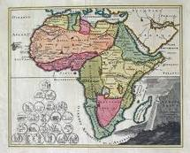
CSIR GSDI GeoPortal Awareness
Pretoria Workshop
24/25
January
2011

Slide 2
Scope of Workshop
Part 1: Meta-Data
Part 2: Software Platform: Walk-through
Part 3: Current and Future Data Sets
Part 4: Future Views

Slide 3
PART 1 Meta-Data
The New Mining Resource

Slide 4
Part 1.1
The ICT Age …

Slide 5
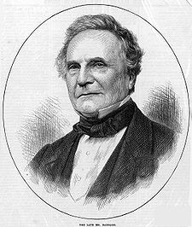
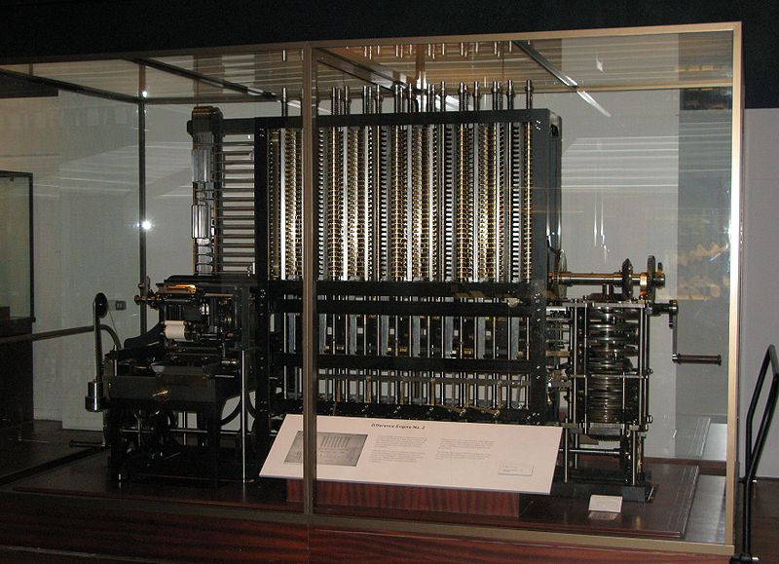
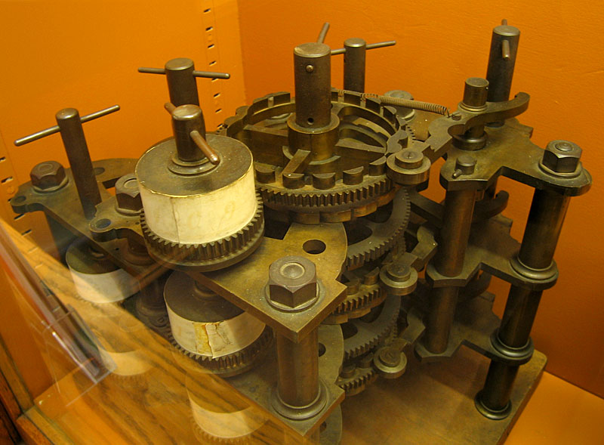
CHARLES BABBAGE (1791-1871)

Slide 6
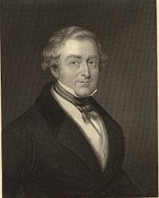
SIR ROBERT PEEL (1788-1850)
The British Government, after investing £ 20,000 in the Difference Engine project, was treated to a demo.
“Can you set the machine to calculate the time at which it will be of some use???”

Slide 7
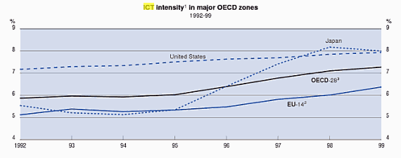
Expenditure on ICT: 5-7% Of GDP …
Estimated US$ 2.6 Trillion in 2008

Slide 8
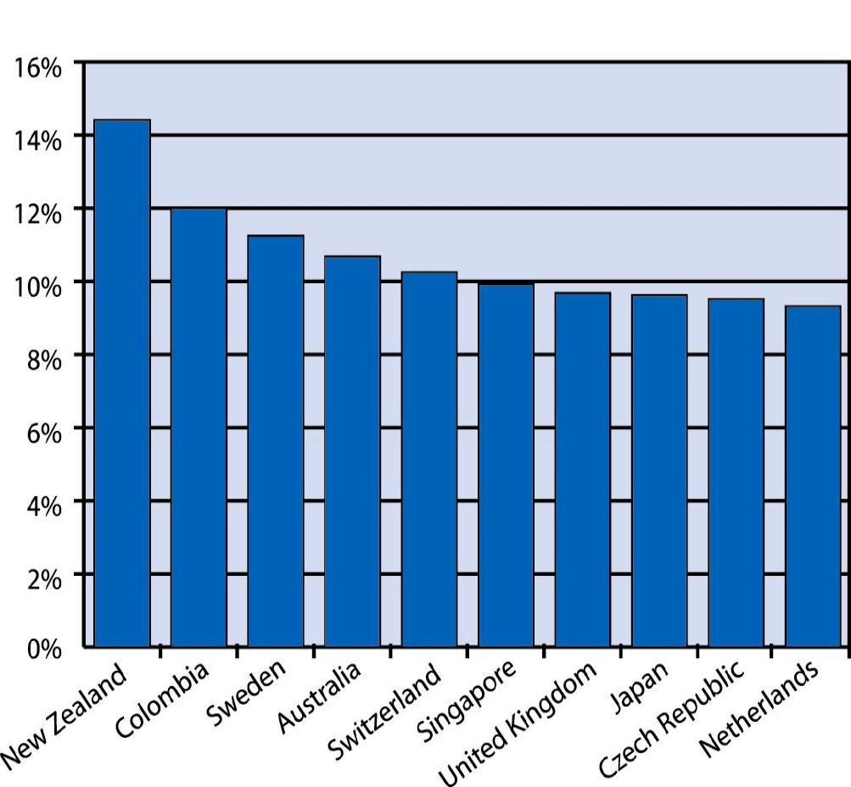
Expenditure by Country (2002)
http://www.witsa.org/presentations/DP02-GlobalMobile.pdf

Slide 9
© ANGUS MADDISON: 1926-2010
http://www.ggdc.net/MADDISON/oriindex.htm

Slide 10
© ANGUS MADDISON: 1926-2010
http://www.ggdc.net/MADDISON/oriindex.htm

Slide 11
ALL THAT MONEY …

Slide 13
Part 1.2
What exists?
The World’s Data

Slide 14
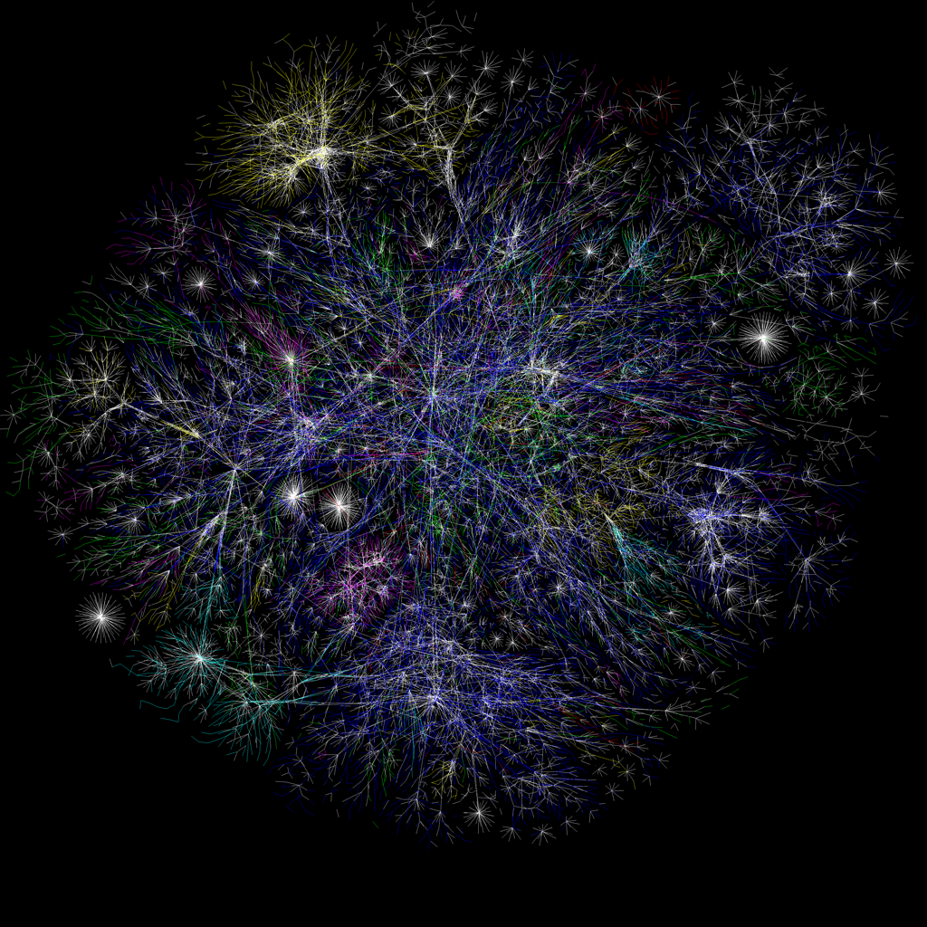

Slide 16
The OPTE Project 2005
LUMETA
Continuous IPv4 and IPv6 mapping
Roughly 30% of all known IP addresses

Slide 17
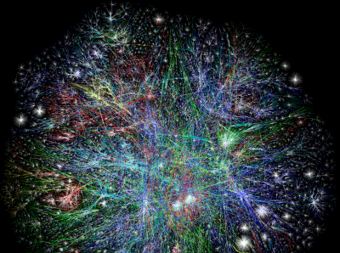
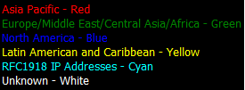
Geographic Spread

Slide 18
We can say that …
There is an emerging global scientific data infrastructure
Driven by changes in the way we work
Opens up new possibilities in research methods and approaches
Also contains information on scientific endeavour and the supporting fabric of that endeavour

Slide 19
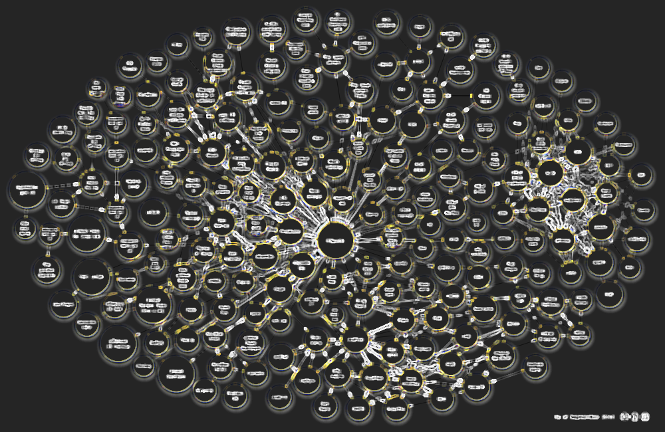
Open, interlinked scientific data cloud

Slide 20
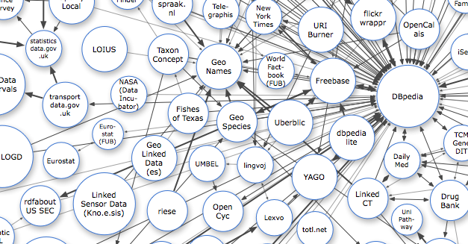
GROWING OBSERVATION SCIENCES LINKS ...
http://richard.cyganiak.de/2007/10/lod/imagemap.html

Slide 21
Global Scientific Data Infrastructure…
Activities and Initiatives
Domain-Specific Clusters of Excellence
GEOSS and IODE
ILTER
Climate Change Modelling Community
World-wide efforts: CoDATA/ ICSU
World Data System and World Data Centres
GRDI 2020
Governments: DataOne, Data.GOV.UK
Private: Wolfram Apha, DBpedia, FreeBase, …
and many more …

Slide 22
Components
Infrastructure
Architecture and Enabling Standards
Meta-data Standards and Tools
Interoperability Standards
Assertion/Syntactic
Structure/Schematic
Usage/ Semantic
Mediation and Collation Standards
Knowledge Standards
Decreasing discoveries >>>
Increasing orderliness >>>

Slide 23
Part 2 Software Platform

Slide 24
Solution
“Shared Implementation”
a framework containing architecture guidelines, abstract specifications and user requirements, recommended interoperability standards, and reference implementations.
a directed open source community that contributes to, extends, and maintains the shared implementation.
National funding provides a baseline of operations and activity.
not domain-specific, but function-specific.
Almost all knowledge portals share a base set of functions that are re-usable.

Slide 25
Solution
“Shared Meaning”
meta-data standards selection
crosswalks (inter-standard translations)
controlled vocabularies, thesauri, and ontologies associated with standards – these are often region-specific

Slide 26
Solution
“Shared Processes”
coordinated training and awareness creation on the importance of meta-data
data sharing and meta-data provision policies / guidelines to be implemented at research institutions and as a condition of funding
coordination of and assistance with contributions to national infrastructure
creation of forums for the validation of decisions and guidelines

Slide 27
Part 2.1 Architecture and Planning

Slide 28
The Bigger Picture
CoSAMP
(SAEON, CSIR)
2005
CoGIS
(SAEON, CSIR)
2007
Open Source
Local
Capacity
Meta-Data I
(SAEON, CSIR)
2008/9
URS I
Spatial Extensions
(SAEON, SAEOS, WDC, R&VA)
2009/10
Structured Data
(SAEON, SAEOS, WDS)
2009/10
URS II
URS III
Image Extensions
Admin Extensions
(SAEON, SAEOS)
2010/11
Citations
Service Orientation
(SAEON, SAEOS, R&VA, WDC) 2010/11
Meta-Data II
(SAEON, SAEOS, WDS, R&VA)
2009/10
Process
(CSIR, SAEON)
2011
Knowledge
(CSIR, SAEON)
2011

Slide 29
Broad Concept
Meta-Data Driven Catalogues
Rely on widely adopted standards
Describes data for discovery and future application
Search and Discovery
Advanced Search Capabilities
GEO compliance
Mapping, Charting, and Visualisation
Rely on web sources (WMS, WFS, KML, GeoRSS, …)
Allows map composition and persistence (Web Context)
Allows integration with portal search facilities
Visualisation and Informal Correlation
Admin
Usage Statistics
Registration
Structured Data
Visualisation and Informal Correlation

Slide 30
Portals and Platform
Main Stakeholders
and Initiatives
Main Platform
Services
Documents
and Publications
Spatial
Data
Other
Data
SAEON Nodes and Initiatives
SAEON
SAEOS
Portal
Data Analysis and Processing
SAEOS
World Data Centre for BHH
Content Visualisation and Presentation
WDC
Risk and Vulnerability Atlas
RAVA
Meta-Data and Data Management Functions
CSIR
CSIR
Meta-Data and Data Services
Limpopo GeoEconomic Portal
LGEP
NSIF
Application
NSIF Portal
NSIF

Slide 31
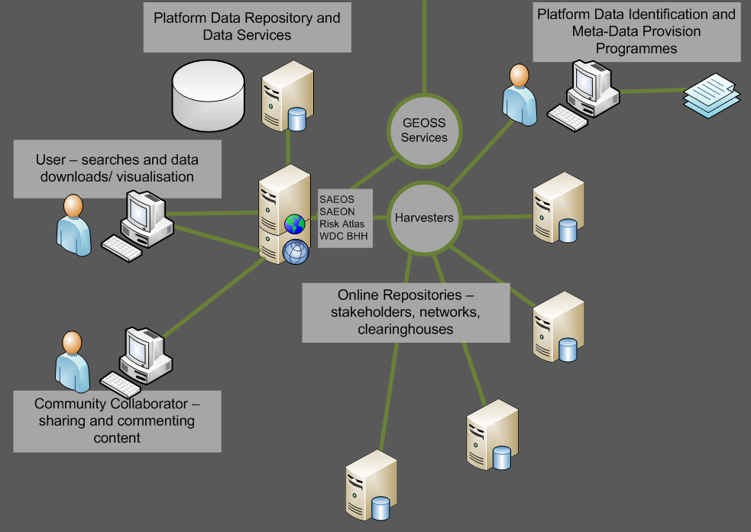
Main Use Cases Phase 1: DISCOVERY AND VISUALISATION

Slide 32
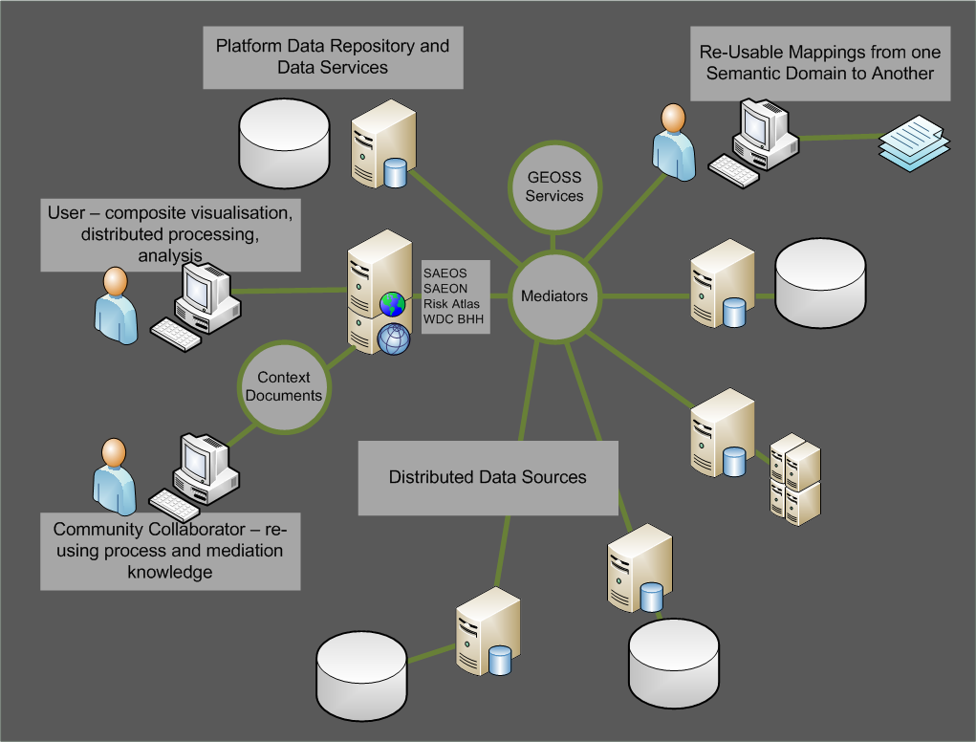
MAIN USE CASES Phase 2: Mediation and Collation

Slide 33
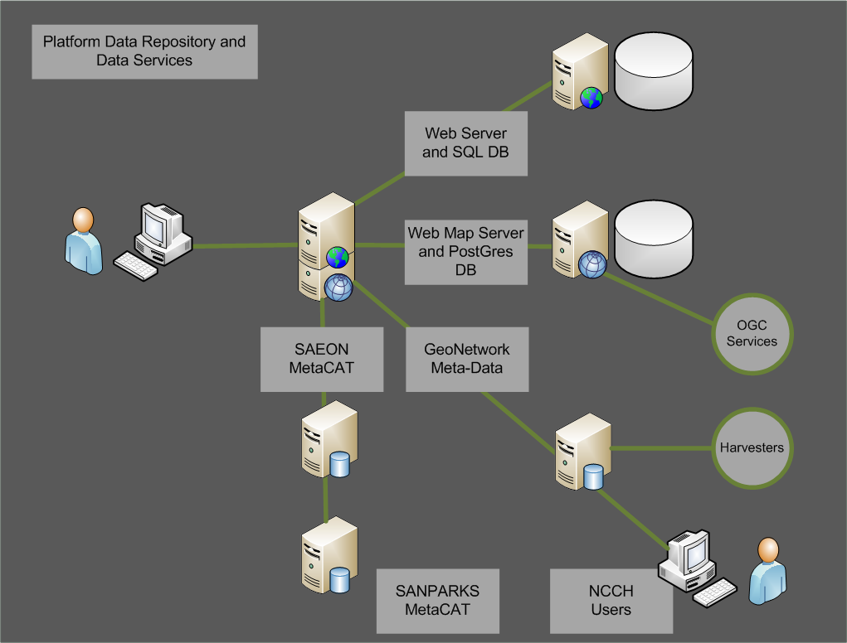
Supporting systems and infrastructure
Physical Platforms
Support Platform: Egagasini
Live Platform: CSIR
Test Platform: CHPC
Development Platforms
Egagasini/ SAEON
3 Service Providers

Slide 34
SUPPORT INFRASTRUCTURE

Slide 35
Technology Platform Architecture: 2009-11
Data/ Primary Services Layer
Application Layer
Client Layer
Meta-Data Repository
Catalogue and Related
Services
Meta-Data Result
Meta-Data View
Home/
Static Links/
Guides
Search Capabilities
Meta-Data Search Result
Search Result View
Themes and Predefined Searches
Data Referral
Data Acquisition View
Resources
Partner Links
Publications
Data Repositories
Exchange/
Query Services
Structured Data View
Maps and Data
(Browse, Gallery, …)
Data Result
(Spatial/ Structured)
Aggregation Services
Spatial Data View
“Packager”
Processing Services
Analysis Result/ Synchronisation
Analysis Request
Large Variety of Services (RSS, CSW, …)
Dynamically Linked Content
Medium Client

Slide 36
The Case for META-DATA Management
Scientific Data is an ASSET
OECD/G20 Governments and Public Companies spend 1.8% of GDP on average on R&D
Translates to approximately $ 600 billion a year on R&D (GERD)
3% Management and Preservation Fee: $ 18 billion per annum.
Publishing Industry: $ 19 billion per annum (2008)
http://www.oecd-ilibrary.org/sites/factbook-2010-en
McGuigan GS, Russell RD. (2008).

Slide 37
Information Entropy
Time of data creation
(From Michener et al 1997)
Specific details about problems with individual items or specific dates are lost relatively rapidly
General details about data set are lost through time
Usefulness
Retirement or career change makes access to “mental storage” difficult or unlikely
Accident or technology change may make data unusable
Death of developer results in loss of remaining info
Time
Notes:
When we start building a dataset, we know the most about what steps we are taking to create it. Over time, memory of the detail begins to fade. Circumstances in life can intervene, and eventually the knowledge about the dataset is gone. Without a metadata record, this data might be unusable.

Slide 38
Meta-Data Standards Overlap
A: Translation between FGDC and ISO19115 / SANS 1878 (Spatial Meta-Data)
B: Translation between FGDC Biological Profile and EML
C: Translation between FGDC and EML ‘Spatial Coverage Element’
D: Translation between ISO 19115/ SANS 1878 and EML ‘Spatial Coverage Element’
ISO 19115
SANS 1878
A
D
FGDC
Bio
Profile
FGDC
EML
Dublin Core
C
B

Slide 39
Meta-Data Elements
Formats/ Language
Citation/ Abstraction
Authors and Collaborators
Relationships
Organisations
Publishing Vehicles
Management/Curation
Meta-Data
Dataset/Extent/
Coverage
Attributes and Units
Spatial
Temporal
Topic
Rights and Distribution
Lineage/ Protocols/
Methods/ Provenance
Process Knowledge

Slide 40
Meta-Data: Implicit Relationships
Formats/ Language
Citation/ Abstraction
Relationships
Authors and Collaborators
Relationships
Organisations
Publishing Vehicles
Management/Curation
Infrastructure
Meta-Data
Structure
Dataset/Extent/
Coverage
Coverage
Attributes and Units
Spatial
Temporal
Topic
Rights and Distribution
Lineage/ Protocols/
Methods/ Provenance
Knowledge
Process Knowledge

Slide 41
Part 2.2 Walk-Through
Meta-Data
Searches
Themes
Maps
Services

Slide 42
Main Functions
Sharing of Data and Publications
Discovery and Visualisation of Data
Content Management
Collaborative Development and Value Addition

Slide 43
PART 3 Data Status
CSAG
BGIS
TIP
External Sources

Slide 44
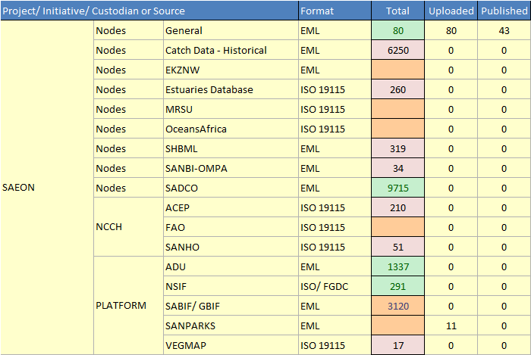
State of Meta-Data

Slide 45
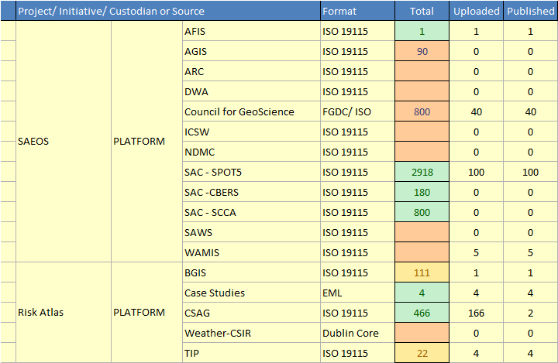
State of Meta-Data (2)

Slide 46
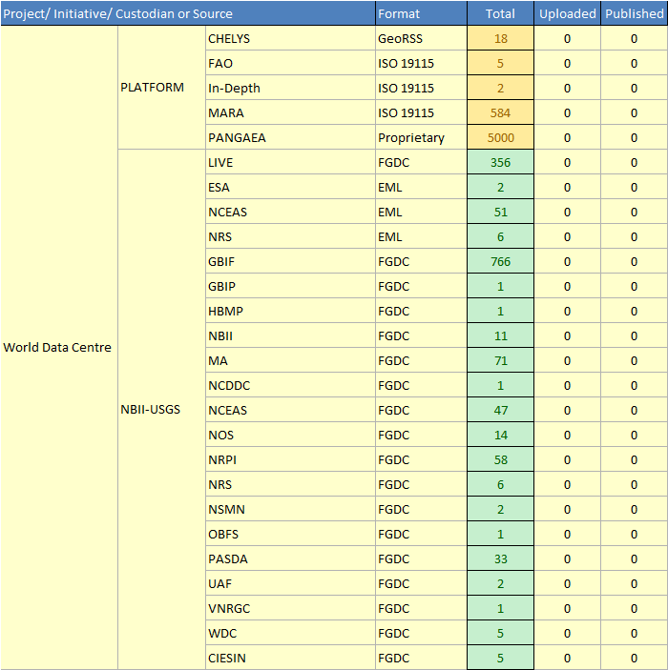
State of Meta-Data (3)

Slide 47
Meta-Data Sources

Slide 48
Meta-Data Resolution Problem
GOAL:
Relatively even granularity in respect of temporal, spatial, and topic resolution
Large Number of Sources contribute a few Records
A Few Sources contribute a large Number of Records

Slide 49
Some Perspectives …
… or opinions:
Availability of historical data and large anthropogenic/ natural impacts and resulting anomalies determine study areas.
Variability determines required sampling frequency.
Meta-data populates a multidimensional space containing at least
Spatial coverage,
Temporal coverage,
Topic coverage (natural and anthropogenic drivers, responses)
This space can be pre-defined from the perspective of a science plan.
Some meta-data is better than nothing at all.

Slide 50
Meta-Data and Data Management Strategy
Pointers to Services
Obtain Meta-Data (M)
Obtain Data
Meta-Data Catalogues
Automate Meta-Data
Standardise Formats and Structures
Assess Data Risks
Optimise and Improve
Meta-Data
Transfer to Archive

Slide 51
Data Initiatives
SAEON
All SAEON-Related Data Sets on an ongoing basis
All SADCO/ NCCH Data Sets on an ongoing basis
All SANPARKS data sets
All GBIF Data Sets
SAEOS – Currently Targeting
All SAC Data Sets
AFIS/ Fire Services/ WAMIS
ICSW Data Sets / ARC Data Sets
Water, Agriculture, Disasters, Health, Climate, Energy, Weather, ...
RISK AND VULNERABILITY ATLAS
Climate Systems Analysis Group
BGIS
CSIR Weather Forecasts
World Data Centre
All USGS/ NBII Data Sets for Africa in fields of Biodiversity and Health
All PANGAEA Data Sets
Selected Health-Related Data Sets

Slide 52
PART 4 FUTURE VIEWS
What does it mean?

Slide 53
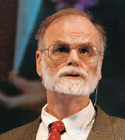
The “FOURTH PARADIGM”
Deterministic Science
V:
Virtual Reality?
II:
Theoretical
Increasing Understanding >>>
III: Computational
IV:
Data-Centric
I:
Empirical
Increasing Data Availability>>>
Probabilistic Science

Slide 54
The “FOURTH PARADIGM”
Optimisation/
Caching
???
Increasing Frequency of Use >>>
Non-Issue
Download/
Sub-setting
Increasing Data Set Size >>>

Slide 55
A New Virtuous Circle?
Synthesize
Publish
Discover
Collate/
Mediate
Analyze
Infrastructure

Slide 56
Or Maybe a Virtuous SPIRAL …
Increasing Value to the Community >>>
Publish
Synthesize
Collate/
Mediate
Analyze
Discover
Increasing Semantic Linkages >>>

Slide 57
CHallenges
Describing the World’s Data
Schema and Interoperability
Self-Maintaining Semantic Web
Mediation
Petabytes of Data
Optimisation
Centralisation, Caching, and Distribution
Parallel and Distributed Computing
Meta-data redundancy
Visualisation and Conceptualisation of Massive, Multidimensional Meta-Data and Data

Slide 58
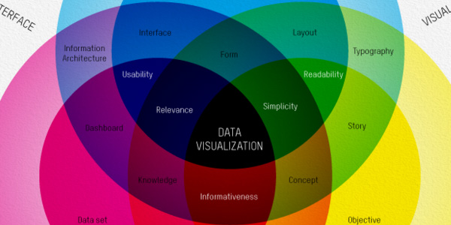
DATA VISUALISATION: SOME EXAMPLES
http://infosthetics.com

Slide 59
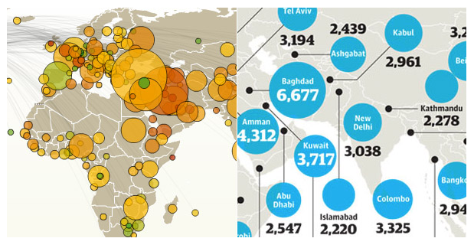
LINKED GEOSPATIAL DATA
WIKILEAKS – 250,000 Diplomatic Cables

Slide 60
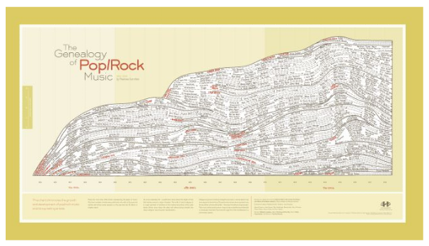
CREATION OF TREES AND DENDOGRAMS
GENAEOLOGY OF POP AND ROCK

Slide 61
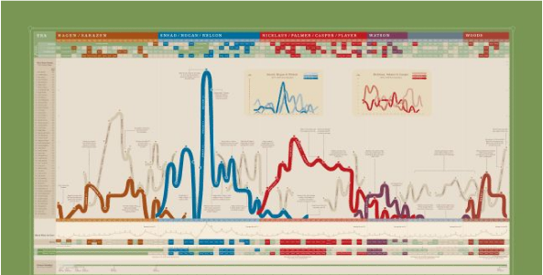
CLUSTERING OF TEMPORAL CYCLES
US PGA TOUR DOMINATION CYCLES

Slide 62
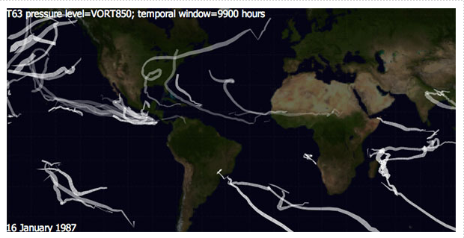
TEMPORAL AND SPATIAL DATA PRESENTATION
LONG-TERM HURRICANE ACTIVITY

Slide 63
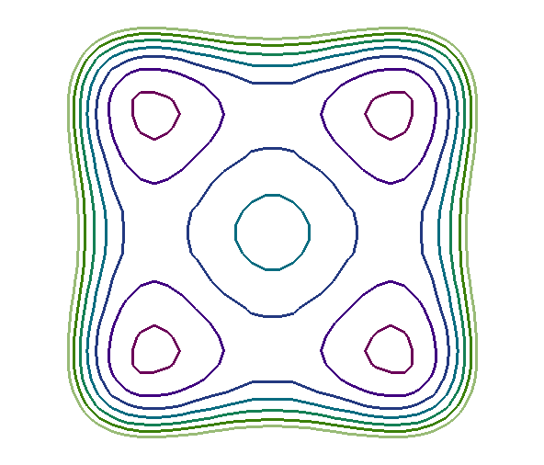
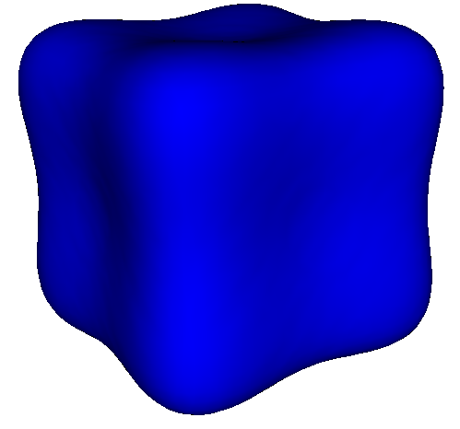
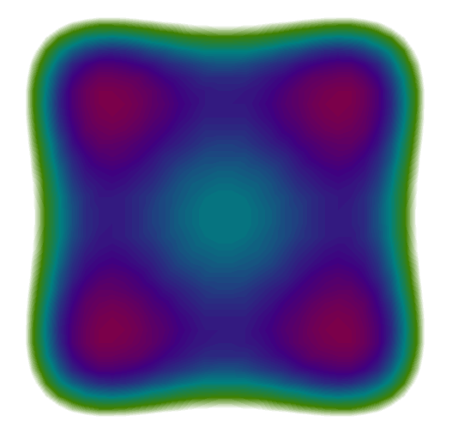
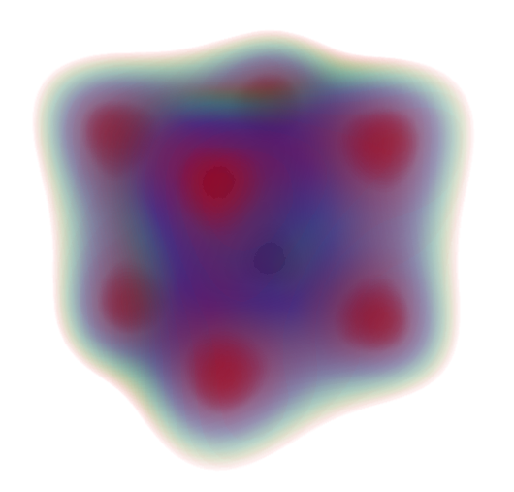
Direct Volume Rendering
http://www.sci.utah.edu/~cscheid/pubs/dvr.pdf

Slide 64
PART 5 IMMEDIATE PRACTICALITIES
Meta-Data Research Questions

Slide 65
Inclusiveness and Divergence
Probability that
result will
be useful
Maximum
Utility
Probability that
item will
be found
Increasing Value →
Cost of Service
Increasing Linkages→

Slide 66
Process Chaining and the Semantic Web
Levels of Certainty
Syntax or Assertion: Because I Say So (Appeal to Authority)
Schema: Because It Fits the Pattern (Appeal to Reason)
Value: Because It Is Fit for Purpose (Appeal to Fact)
Here lies the problem: how to determine if an item that fits the pattern is fit for purpose.
Value can only be determined through use.

Slide 67
Process of Standards Creation
From the General to the Specific
Build on Widely Adopted Precedents
Core →
Format →
Domain →
Specialty →
Organisation →
Two Models
Survival of the Fittest ✗
Selective Breeding ✓
Core
Format
Domain
Speciality
Organisation

Slide 68
META-DATA Precedence, Attribution, and Provenance
Aggregators can source meta-data from other aggregators, and clearinghouses could eventually store many redundant entries and harvest inefficiently.
All standards should support/ contain a provenance element
Useful for:
Proper attribution (A)
‘Shortest path’ analysis
(A → C → E)
Respect Relationships ?
(Disallow A →E)
Portal A
Portal B
Portal C
Portal D
Portal E
✗

Slide 69
HOW BIG IS THIS?
In excess of 4m meta-data nodes
Implies a space of 16 trillion network relationships
(interaction matrix)

Slide 70
EDSGER DIJKSTRA (1930-2002)
Basis of Network Analysis is the Shortest Path Analysis
Uses an edge weight – which can be any attribute of the relationship between two nodes.
Generic Derivations:
Composite Path Optimisations
Clustering and Dendogram-based Hierarchies
Proximity Analysis (Averaging and Integration-Style Analysis over a Network Impedance)
Gravity Models – used to assess competition between demand-satisfying supply centres
Catchment analysis – optimal assignment and allocation algorithms

Slide 71
“SCIENCEBOOK” OUR META-DATA RESEARCH IDEAS

Slide 72
“SCIENCEBOOK” OUR META-DATA RESEARCH IDEAS
Calculate a minimum spanning tree (optimal harvesting structure for all known meta-data records and sources).
Calculate a multidimensional tree of knowledge/ data
Calculate a network of minimum world data curation centres and repositiories
Calculate a scientist network with multiple, qualified relationships
Calculate an institutional network with multiple, qualified relationships
Calculate and document a knowledge base (processes and methodologies coupled to time, space, topic, and outcomes)

Slide 73
CHPC-SAEON-SAEOS COLLABORATION
Hosting Platform for SAEON, SAEOS, Risk Atlas, World Data Centre for BHH in Africa
Develop Earth and Environmental Sciences Test Case
Long-term, Managed Preservation of Environmental Data
Improved Indexing and Searching Capabilities
Improved Citizen Science Facilities
Client-side Map Image processing
Improved visualisation of large databases
Standards-based structured data aggregation
Networked Databases
Processing of physically distributed data.
Augmented reality and semantic interoperability

Slide 74
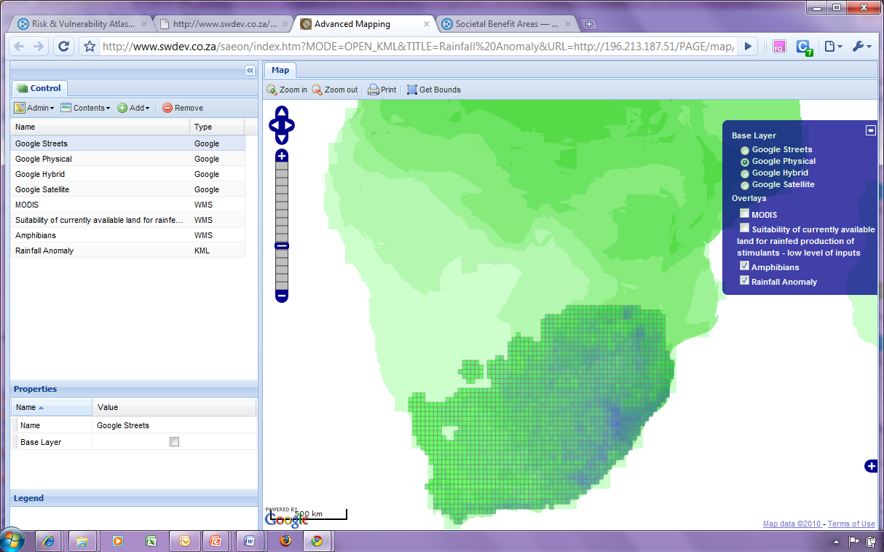
Example: Rainfall Anomaly and Amphibian Species Density

Slide 75
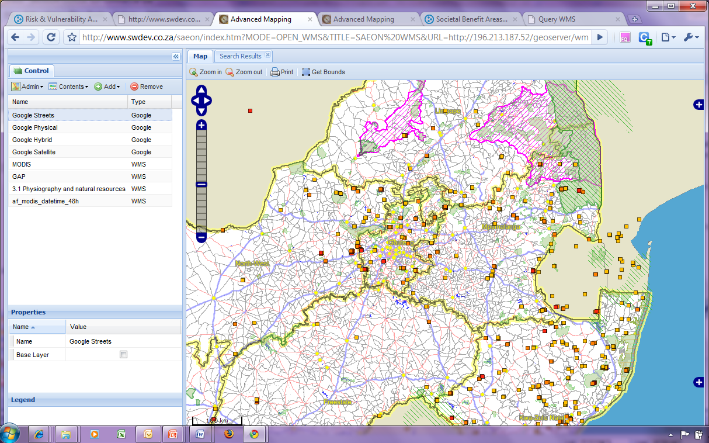
Example: Conservation, Active Fires, and Population

Slide 76
Next Steps
Workshop Feedback
Live Platform
Final Meta-Data Upload

