Slide 1
Basic Content Management in Plone
Wim Hugo

Slide 2
Morning Sessions
Session | Duration | Module
1 | 08h35 – 09h15 | Plone Functions and Capabilities
2 | 09h20 – 10h00 | Detailed Review of Content Types
3 | 10h00 – 10h20 | Tea Break
4 | 10h20 – 11h30 | Adding Detailed Content
5 | 11h35 – 12h30 | Case Studies and Examples
6 | 12h30 – 13h25 | Lunch
Afternoon: GeoPortals (optional)

Slide 3
Workshop Session 1
Screen Layout and Organisation
Content Management
Publication Life Cycles
Security and Permissions
Search Capabilities

Slide 4
Screen Layout and Organisation
Banner Area
Tabs
Portlets
Content Area

Slide 5
Screen Layout and Organisation
Quick Search
(LiveSearch)
Site Commands
Portlets

Slide 6
Content Management
Content is basically arranged as folders and files

Slide 7
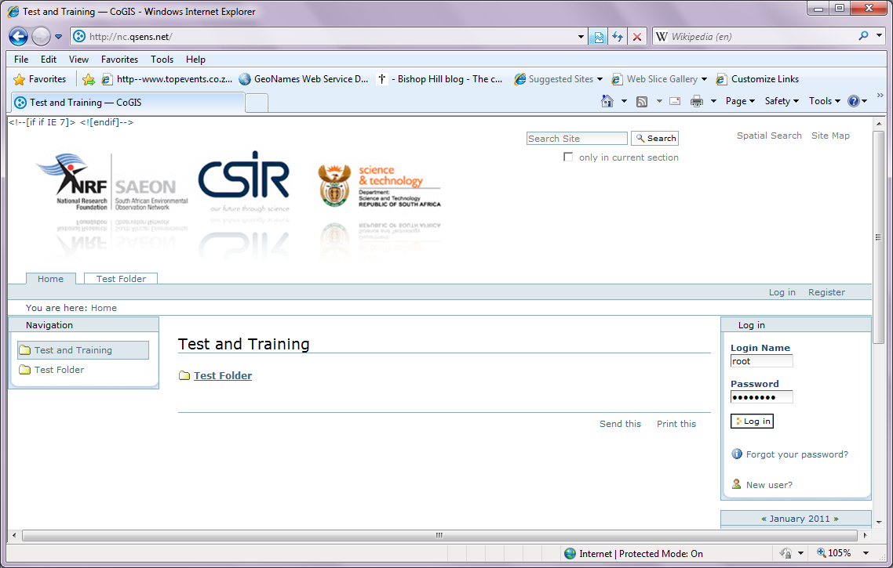
Logging In
Login Facility may be available as a portlet

Slide 8
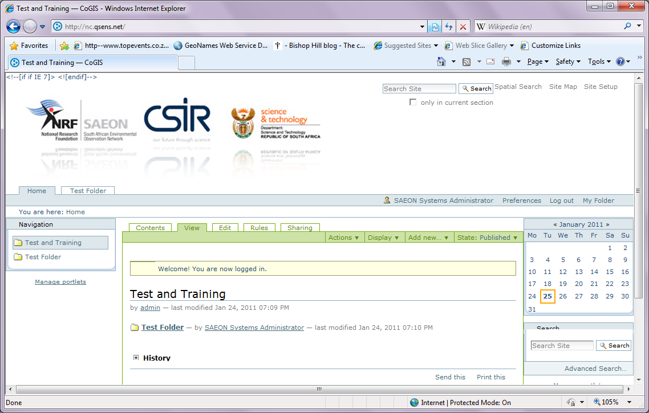
Screen Content – Logged In
Series of Additional Views
Series of Additional Commands

Slide 9
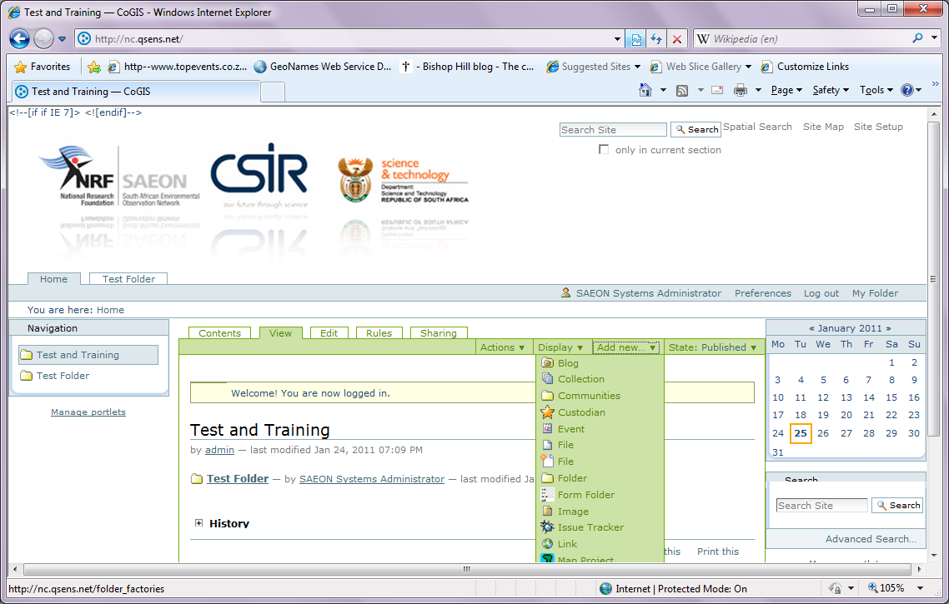
Content Types
Content Types – standard and ‘add-ins’.

Slide 10
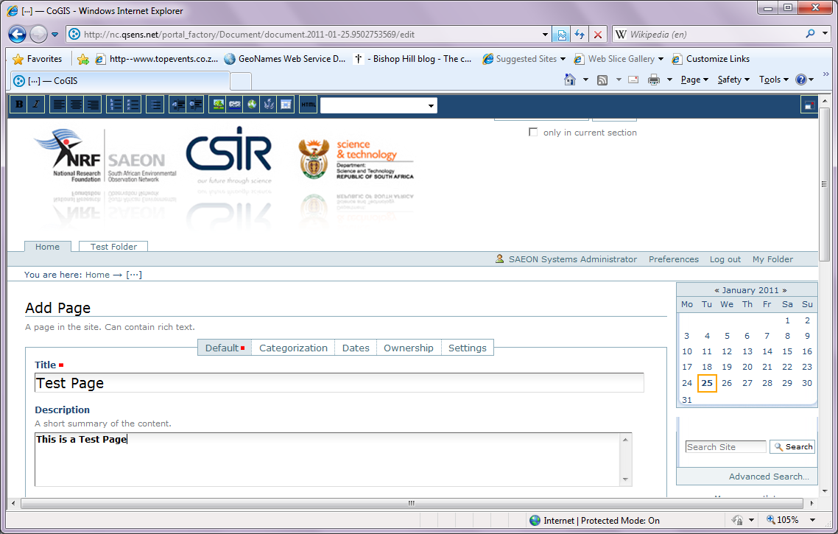
Adding Content Types - Page
Title and Description

Slide 11
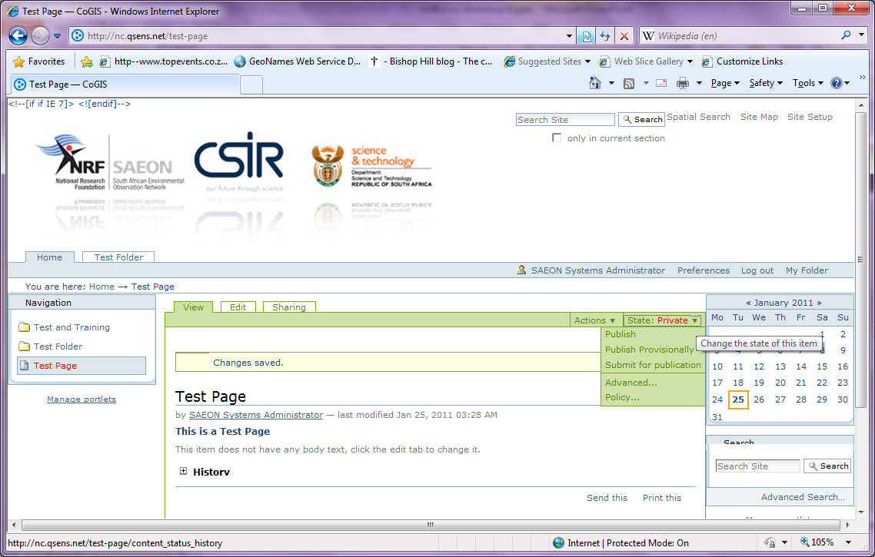
Saved Page – Publication State
Private by Default

Slide 12
Publication States and Actions
“Retract”
Published
Private
“Publish”
“Publish”
“Submit”
Pending Review
“Send Back”

Slide 13
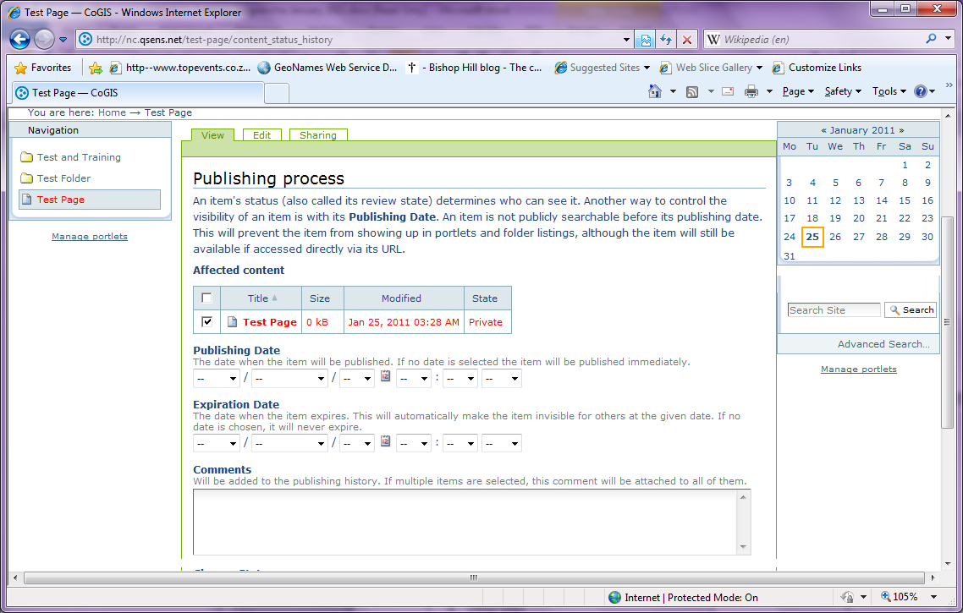
Advanced Publication Options
Control Publication and Expiry Dates

Slide 14
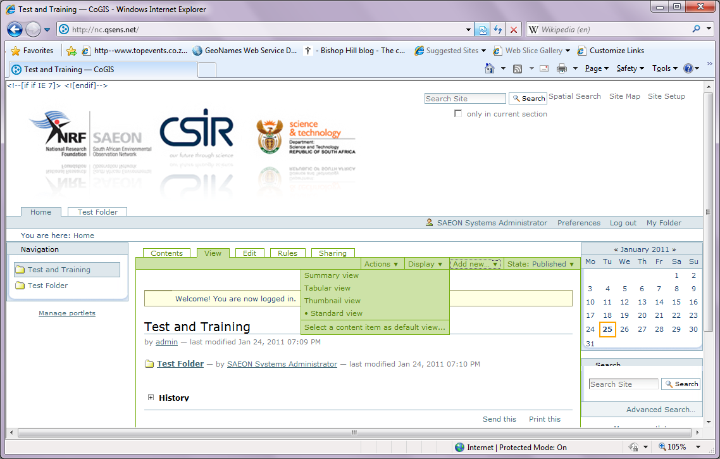
Display Options

Slide 15
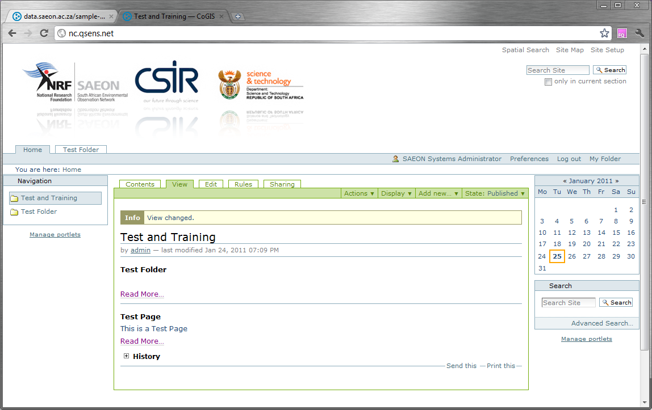
Summary View

Slide 16
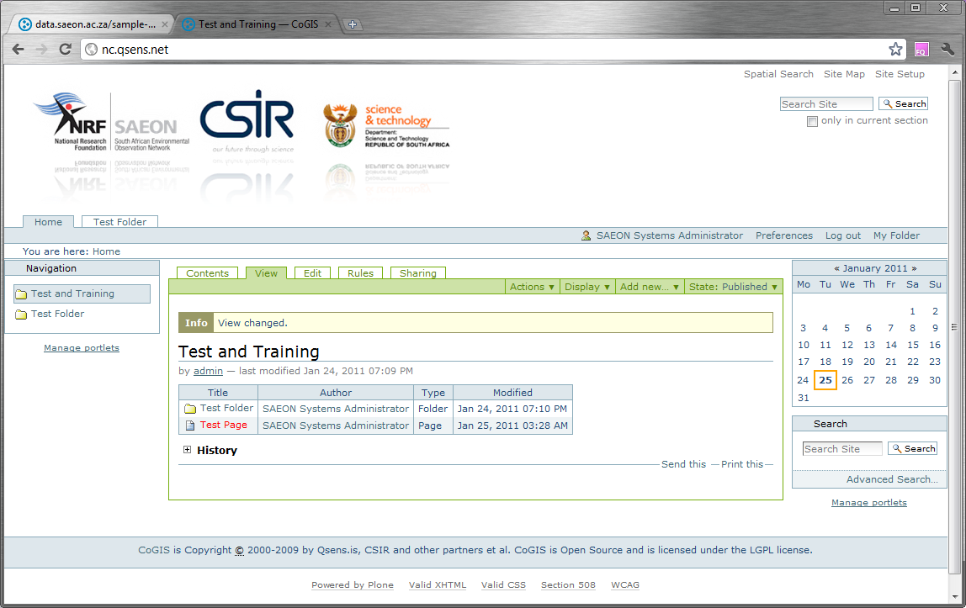
Tabular View

Slide 17
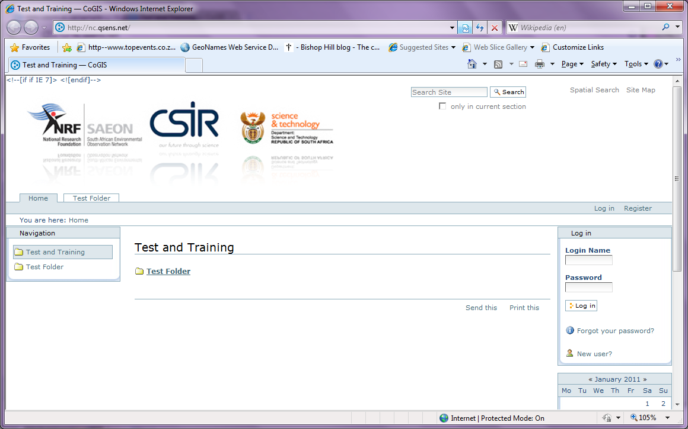
Register as a User
Plone allows registration as a new user by default

Slide 18
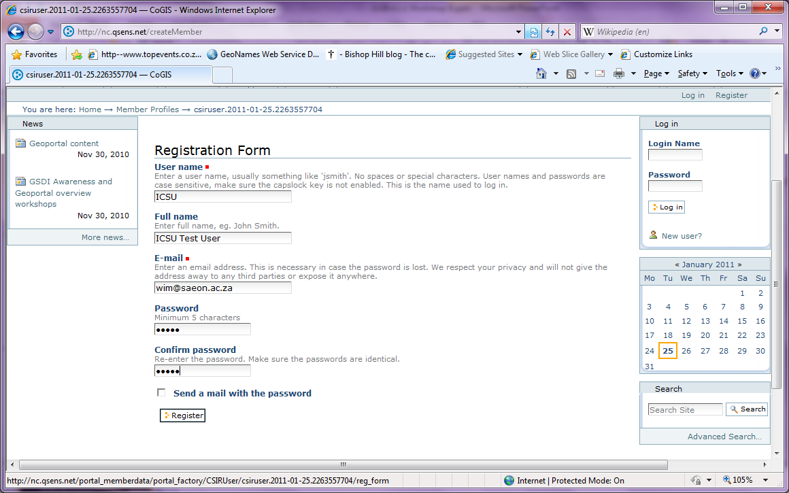
Fill in Details and Passwords
Click on ‘Register’ when done

Slide 19
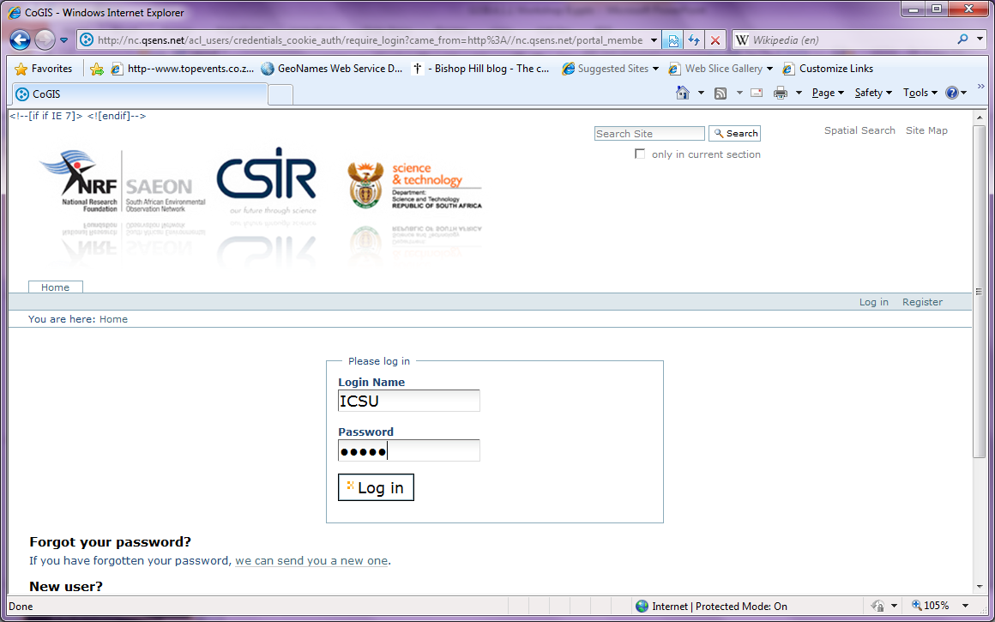
Log in with New Credentials

Slide 20
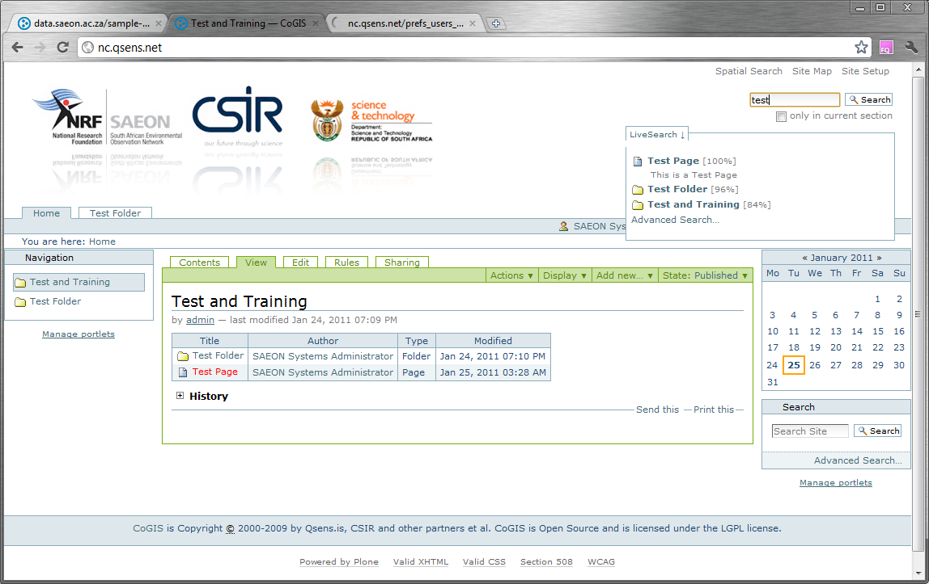
LiveSearch

Slide 21
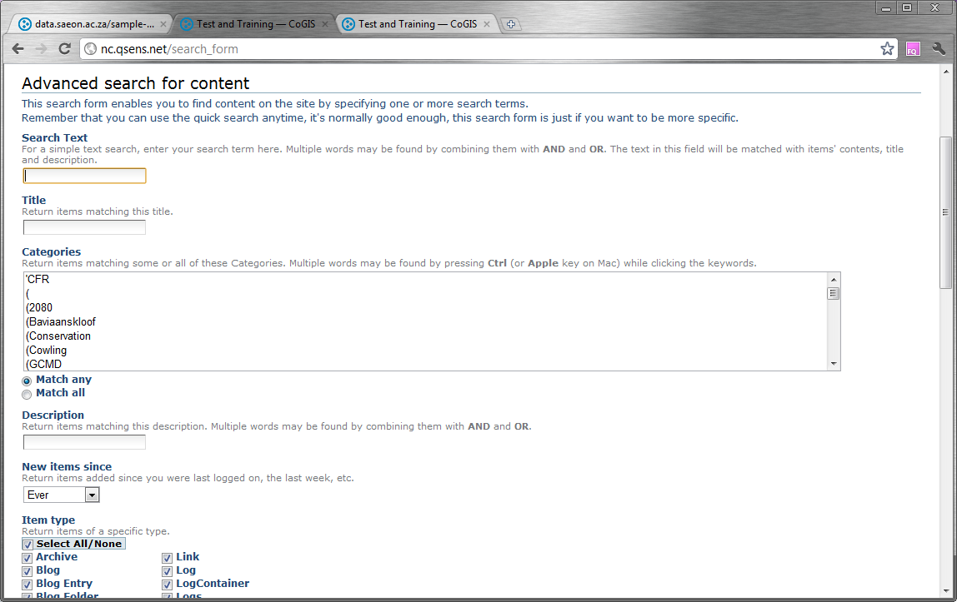
Advanced Search

Slide 22
Workshop Session 2
Folders
External Files
Pages
News Items
Links
Events
External Content

Slide 23
Prerequisites for uploading content
Registered user
Must be logged in
Must be a “contributor”
Confirm a work area
This will usually be a folder

Slide 24
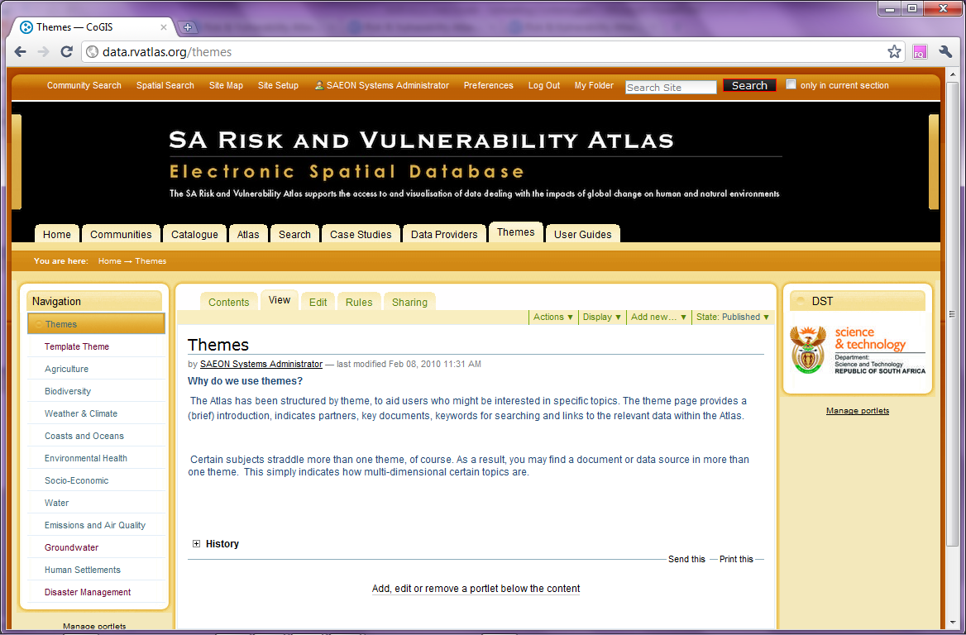
Logged in, Folder Work Area
User must be logged in
Content will usually be added under a Theme
Navigate to a Theme

Slide 25
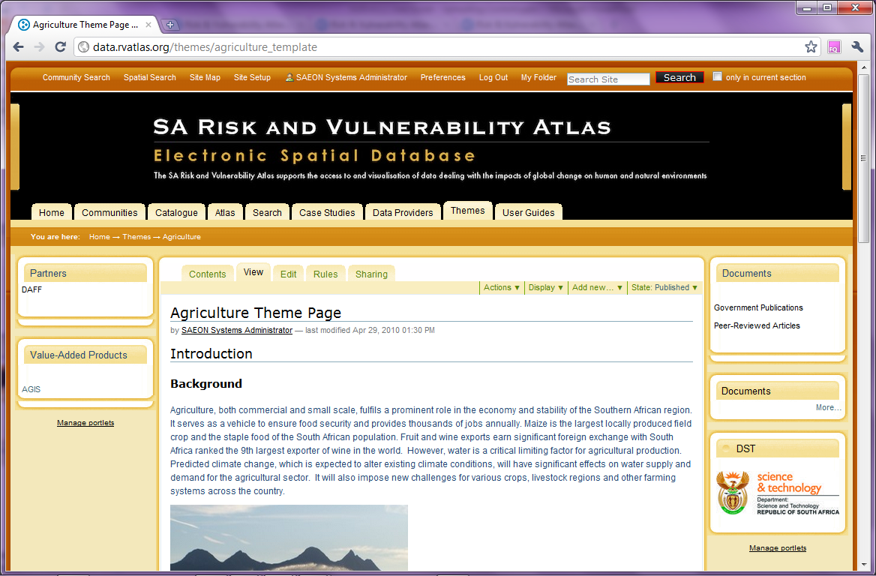
Work directly in the ‘Contents’ tab
Click on ‘Contents’

Slide 26
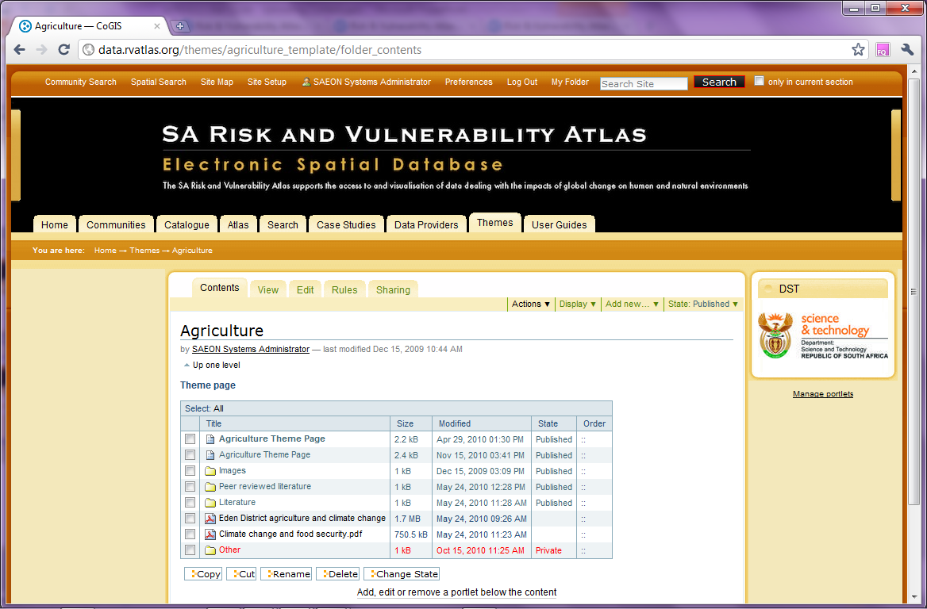
Note the Content Types and States …
Click on ‘Contents’
Folder contains sub-folders and any number of content types
Some items may not be published (yet).

Slide 27
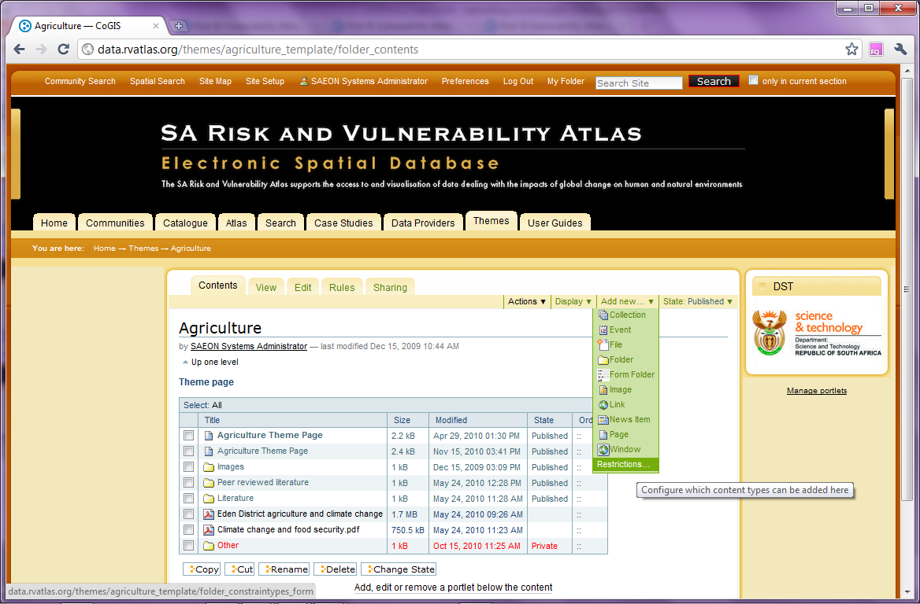
Click on ‘Add New’ …
Lists all content types available in the context.

Slide 28
Important Content Types
Folder
File
Image
Page
Window

Slide 29
Start by Adding a Folder
Click on ‘Folder’

Slide 30
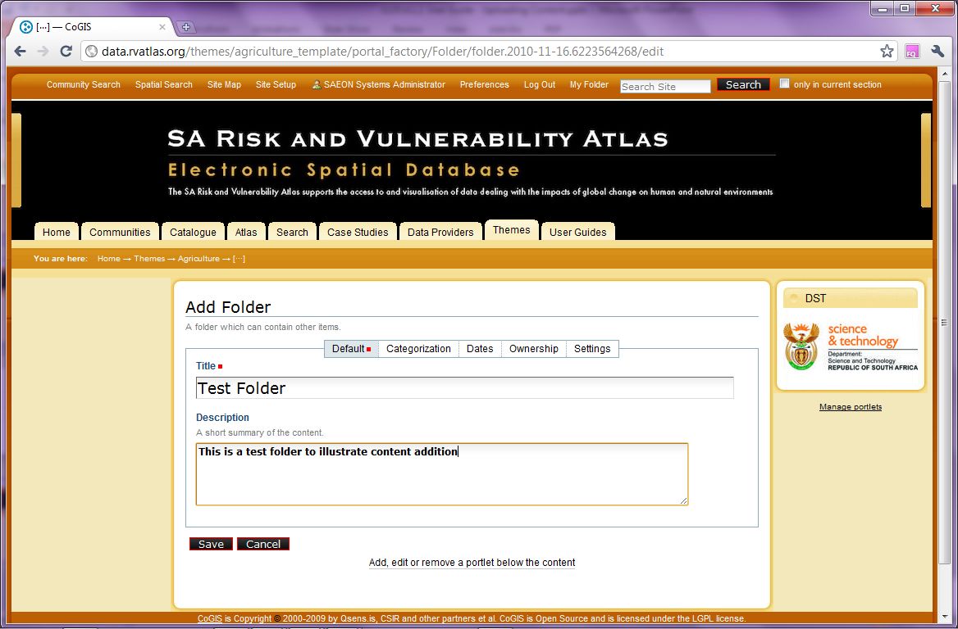
Name the Folder and Save
Provide a title and a description
Save the information

Slide 31
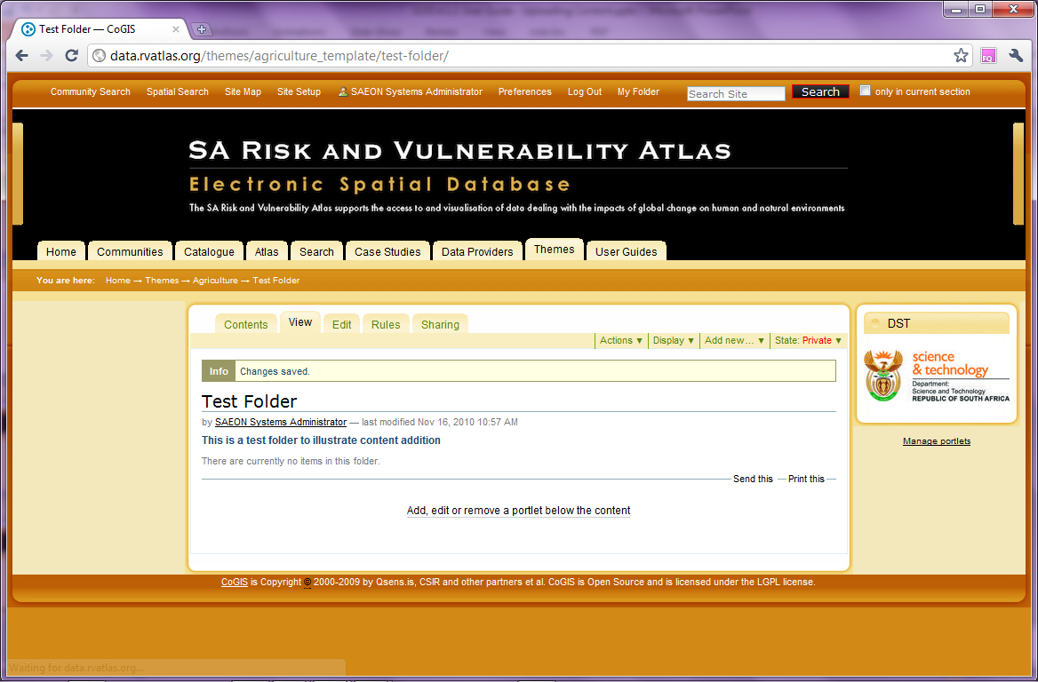
Note the Publication State …
Folder is private: not visible to anyone except the owner.

Slide 32
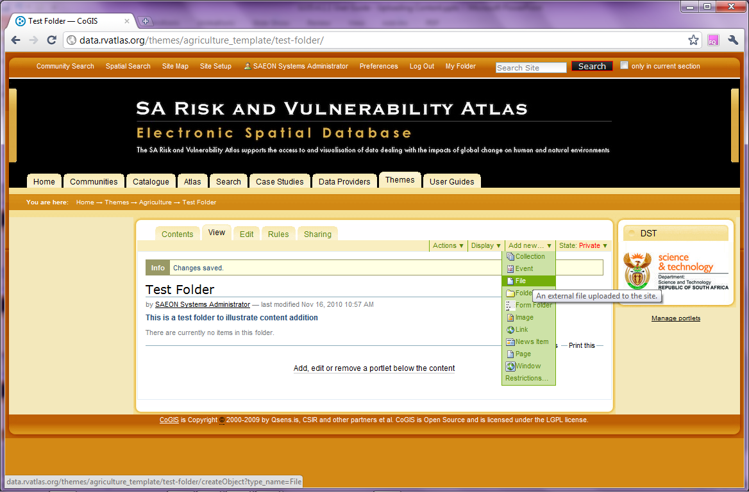
Add a File
Files can be uploaded to the portal from a local disk

Slide 33
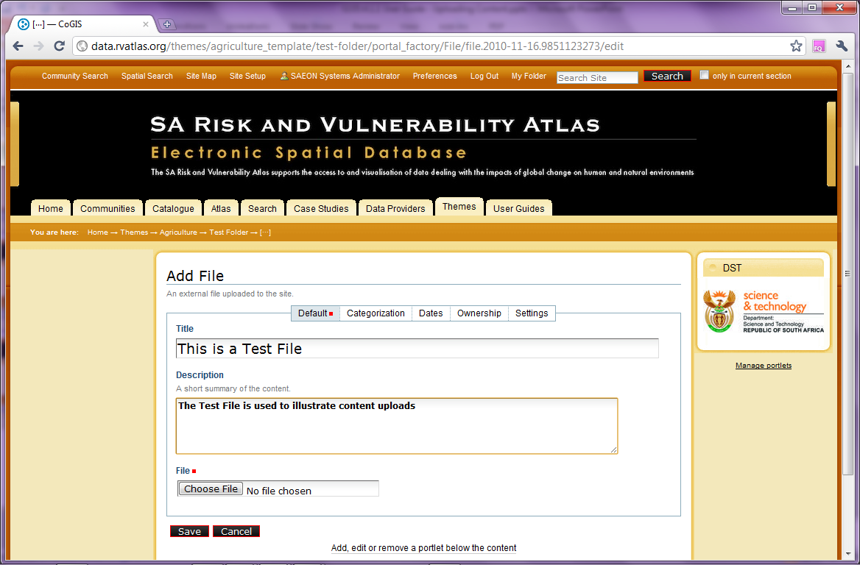
Provide File Details
Provide a name and a description for the file.
Select the file here

Slide 34
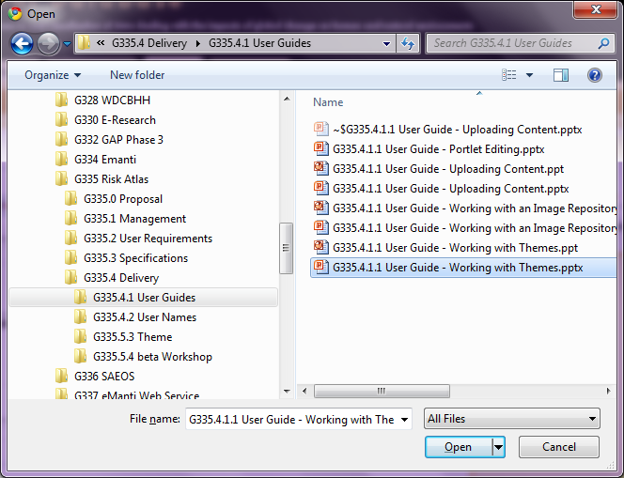
Provide File Details and Save
Select a file from a local disk location

Slide 35
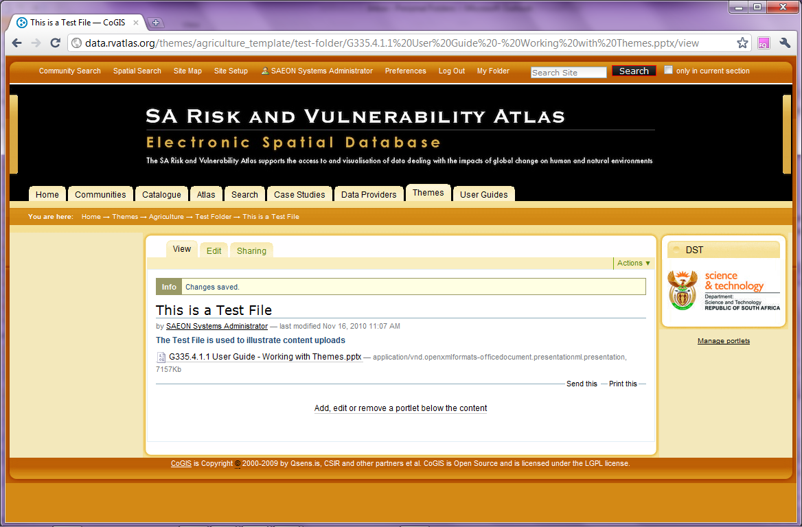
File is Uploaded through FTP
The file is visible, and if clicked and the portal is capable of displaying it, it will do so. If not, the portal will download it

Slide 36
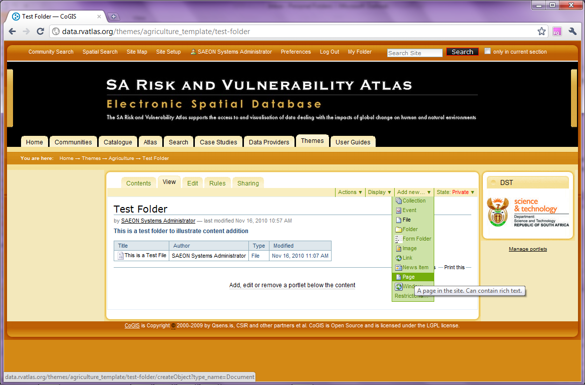
Create a Simple Page …
Creating a page requires some composition skills and practice 0 bit is not difficult

Slide 37
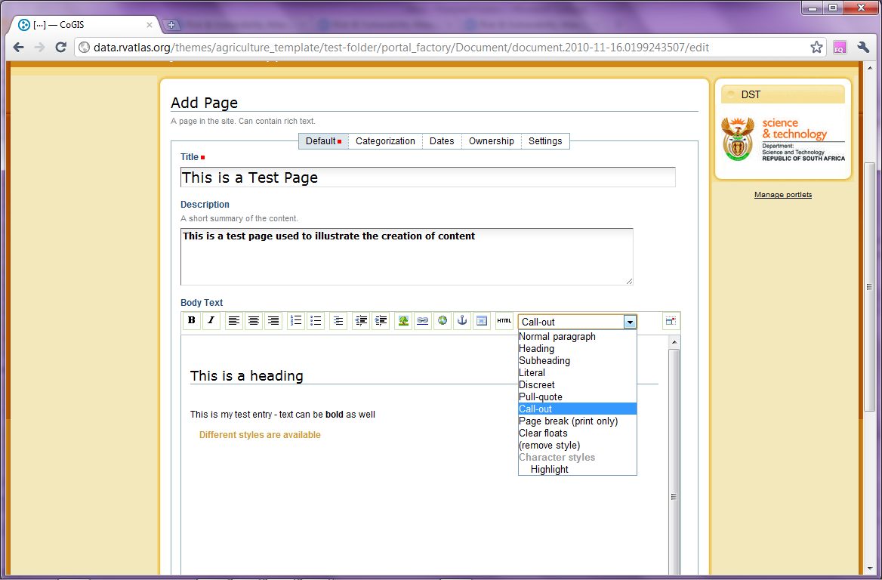
Pages can be created in a WYSIWYG HTML Editor
Provide a title and a description for the page.
The toolbar can be used to add different types of web page content.
Predefined styles can be applied to the page

Slide 38
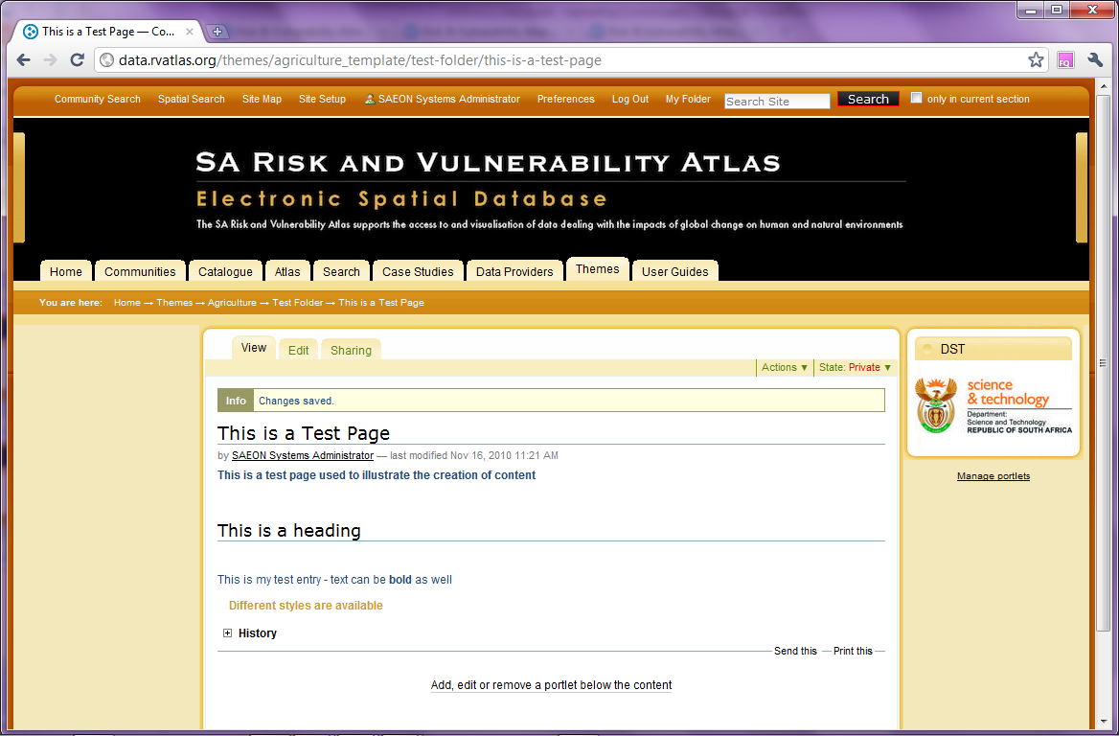
After Saving, the Page is Available
The finished page is displayed

Slide 39
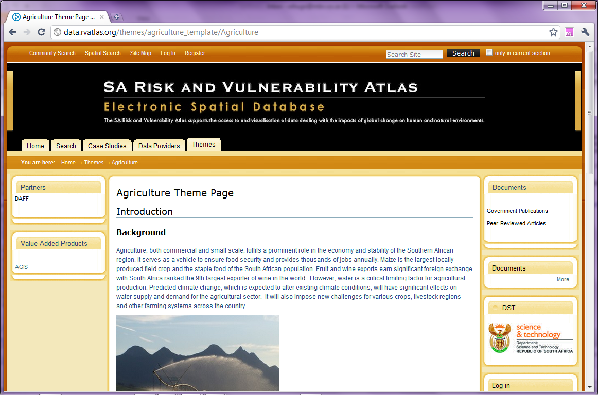
Pages can be elaborate …
This is a page containing images as well.

Slide 40
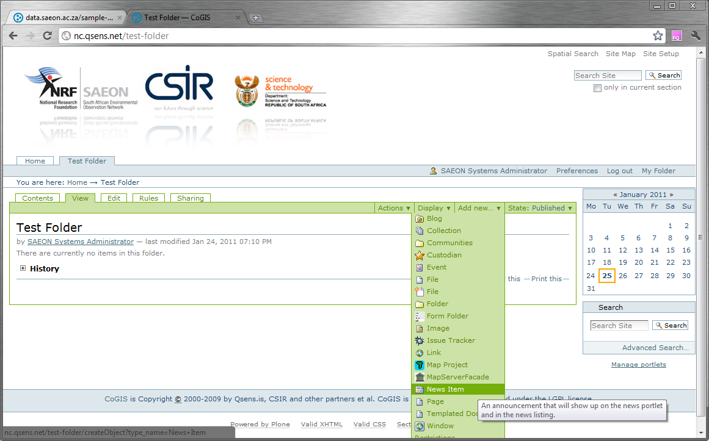
Add a News Item
Select ‘News Item’ from the list of available content types

Slide 41
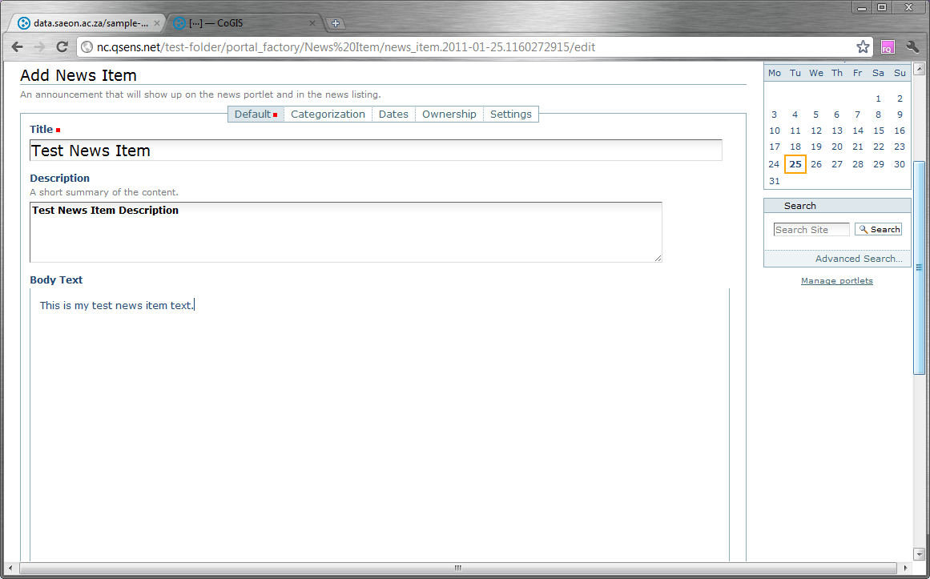
Fill in the News Item Content
Title and ‘Abstract’, with news item body

Slide 42
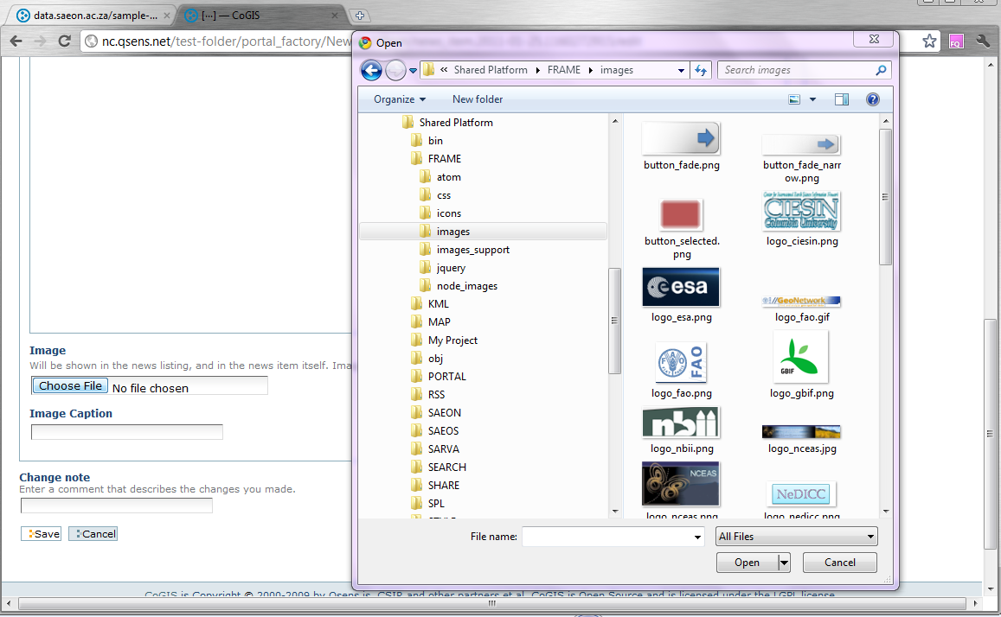
News can have an Image
Select an Image to Upload. Remember the caption.
Title and ‘Abstract’, with news item body

Slide 43
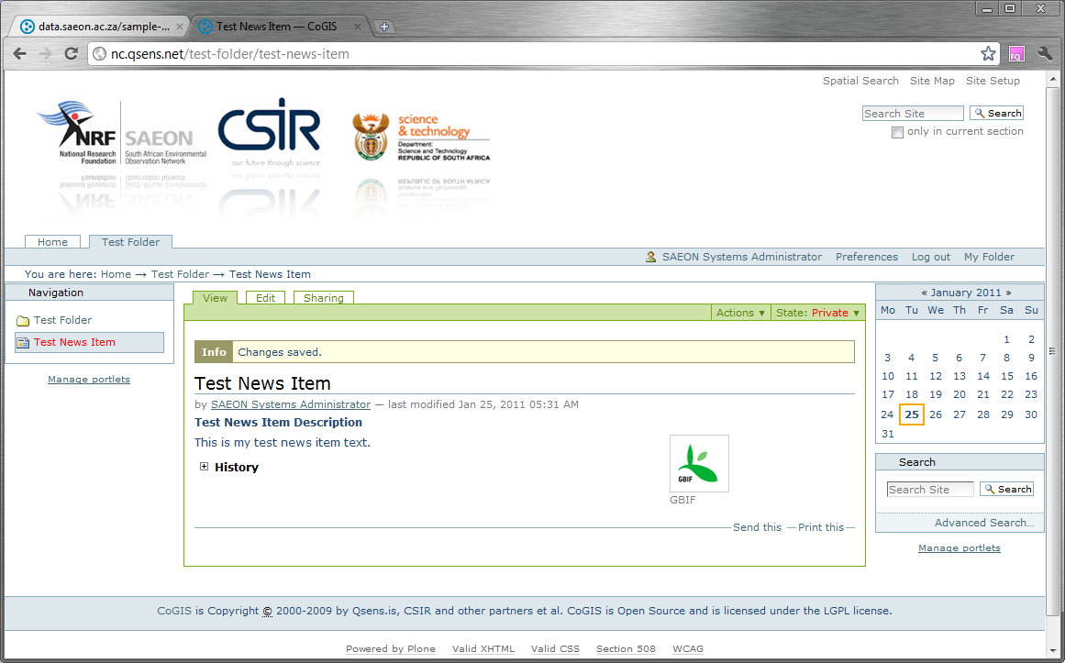
Finished Item
Remember to publish …

Slide 44
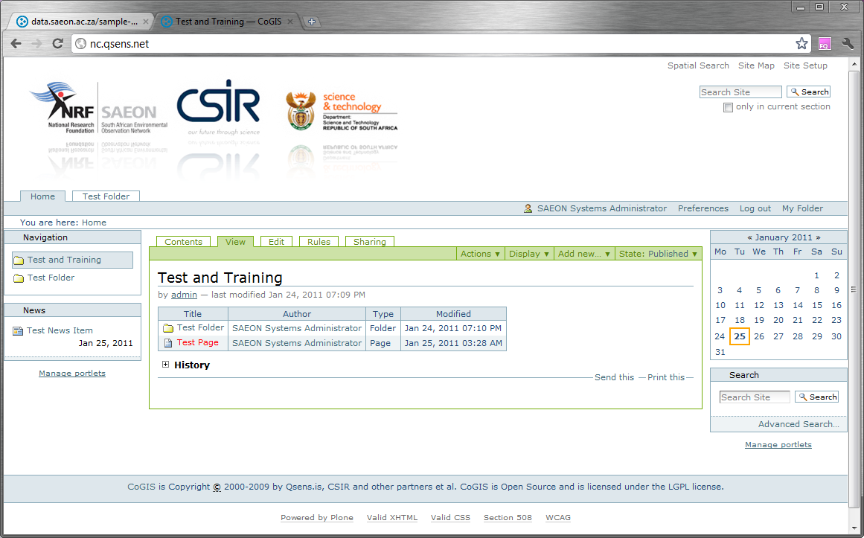
News Porlet
Published Items show in News Portlet

Slide 45
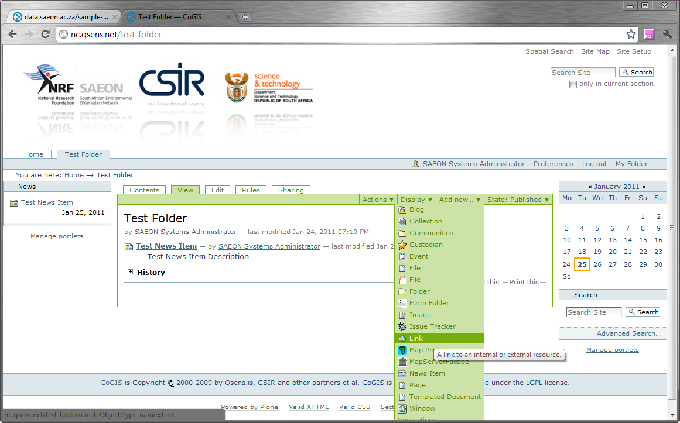
Adding a Link
Select ‘Link’ from the list of available content types

Slide 46
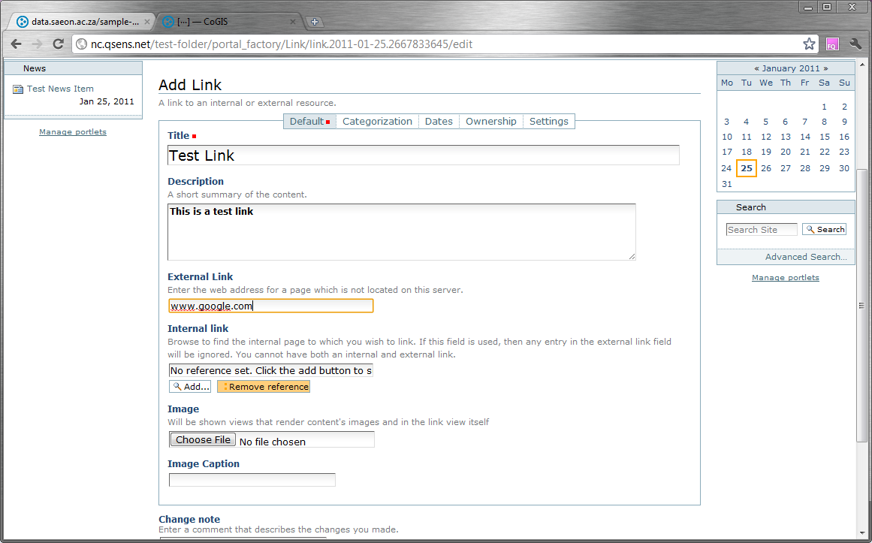
Fill in Required Fields

Slide 47
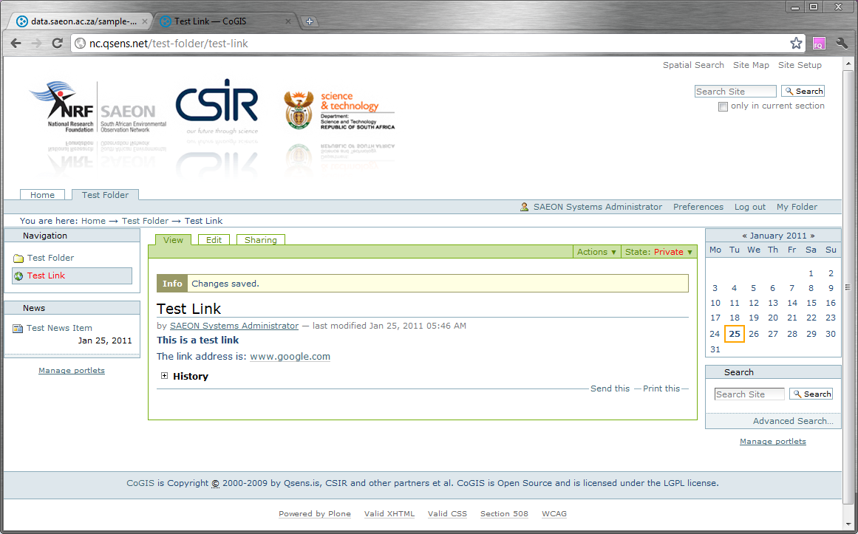
Saved Link

Slide 48
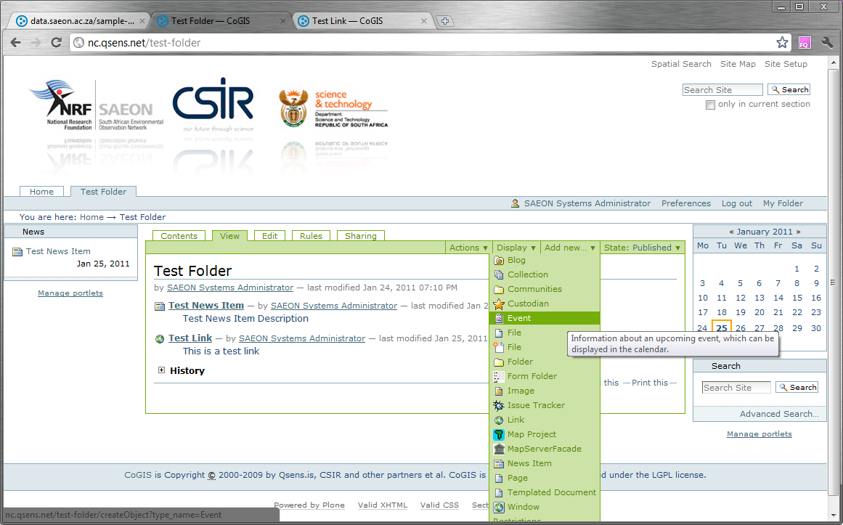
Adding an Event
Select ‘Event’ from the list of available content types

Slide 49
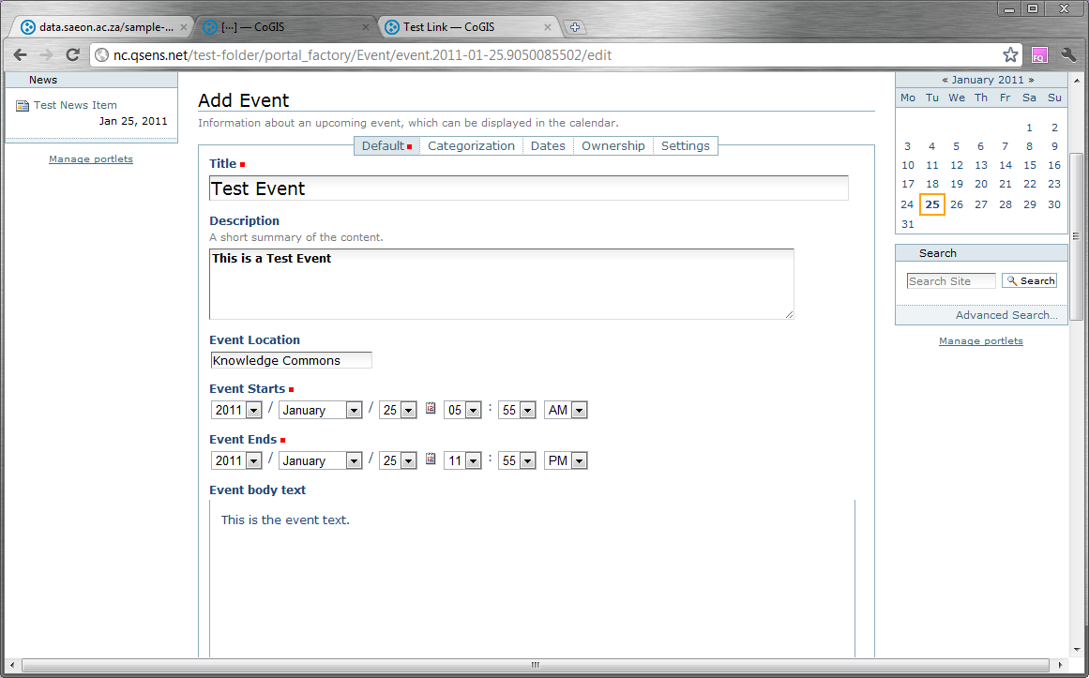
Populate Event Data

Slide 50
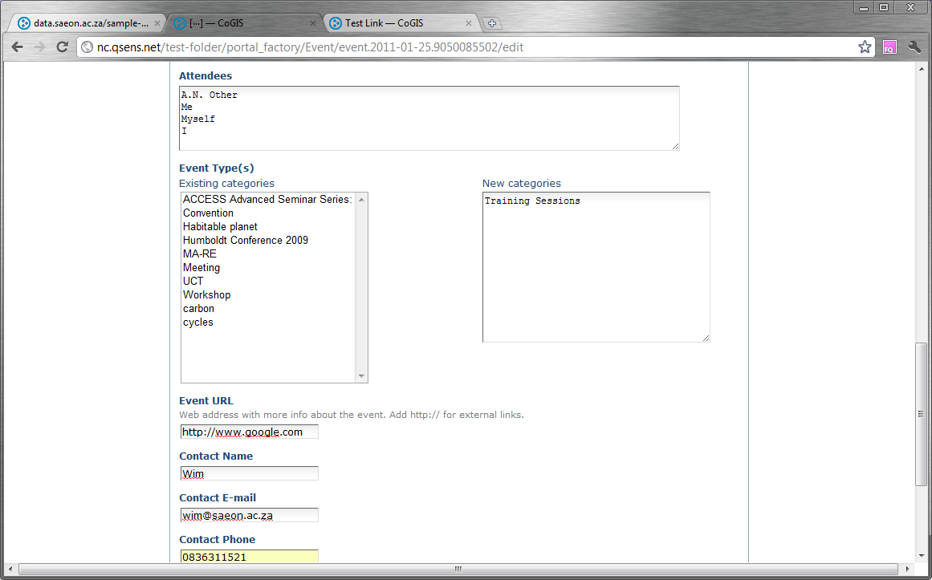
Event Data (Continued)

Slide 51
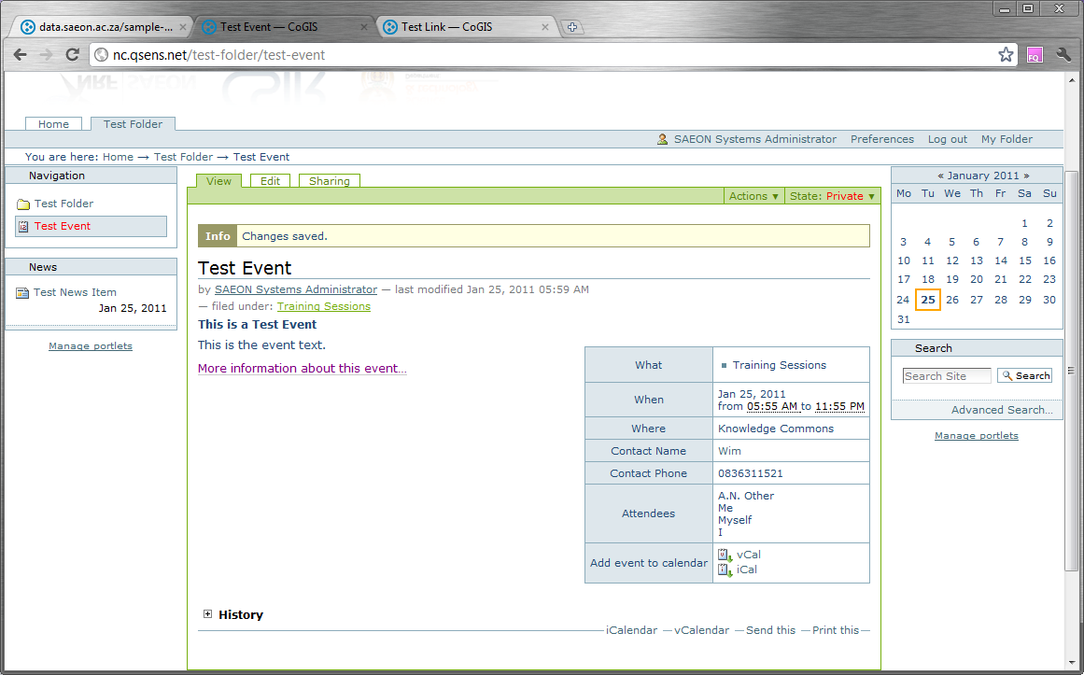
Saved Event

Slide 52
Workshop Session 3
Default Views
Custom Pages
Styling and Page Organisation
Images and Hyperlinks
Portlets

Slide 53
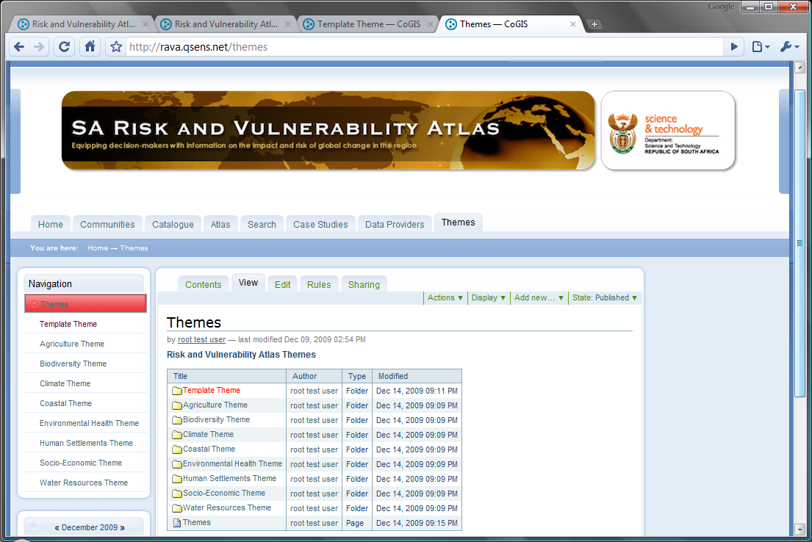
Look at an Established Example
The ‘Themes’ topic opens a set of theme folders
The Template Theme can be used for new themes
The Template Theme is not published and is only visible to some users
A pro-forma Theme has been created for each theme area by copying the template
A Theme page has also been created as an introduction. Click to view and edit.

Slide 54
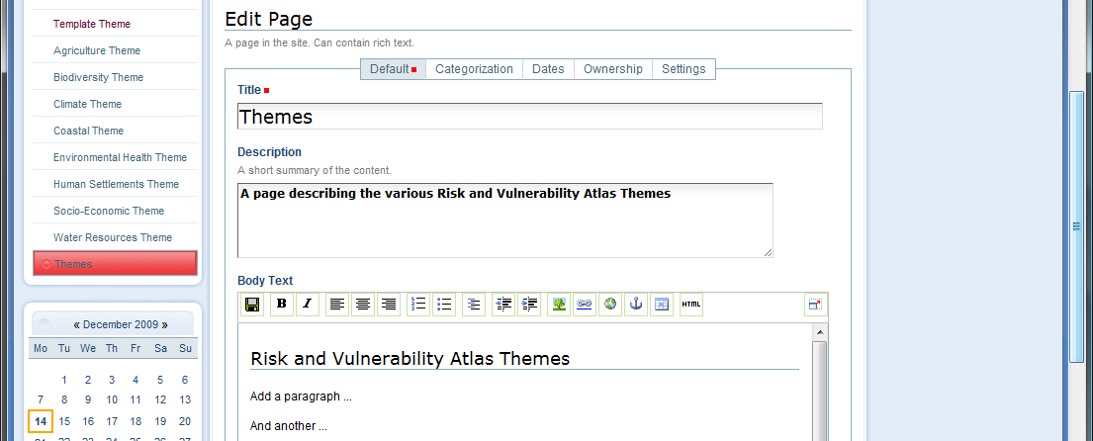
Editing the Landing Page
The page opens in ‘View’ mode. Click ‘Edit’.
The title and description can be edited.
A simple wysiwyg editor is available - but can also be switched to HTML view
Other types of pages can also be used – this example is the simplest option.

Slide 55
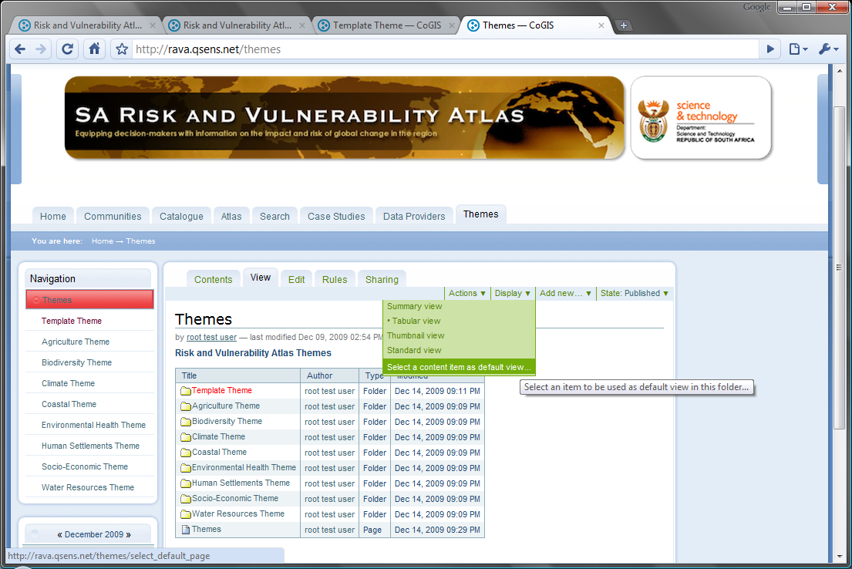
Make the Landing Page the default view
Return to the
‘Themes’ topic.
Click on ‘Display’ and on ‘Select content item as default view’.

Slide 56
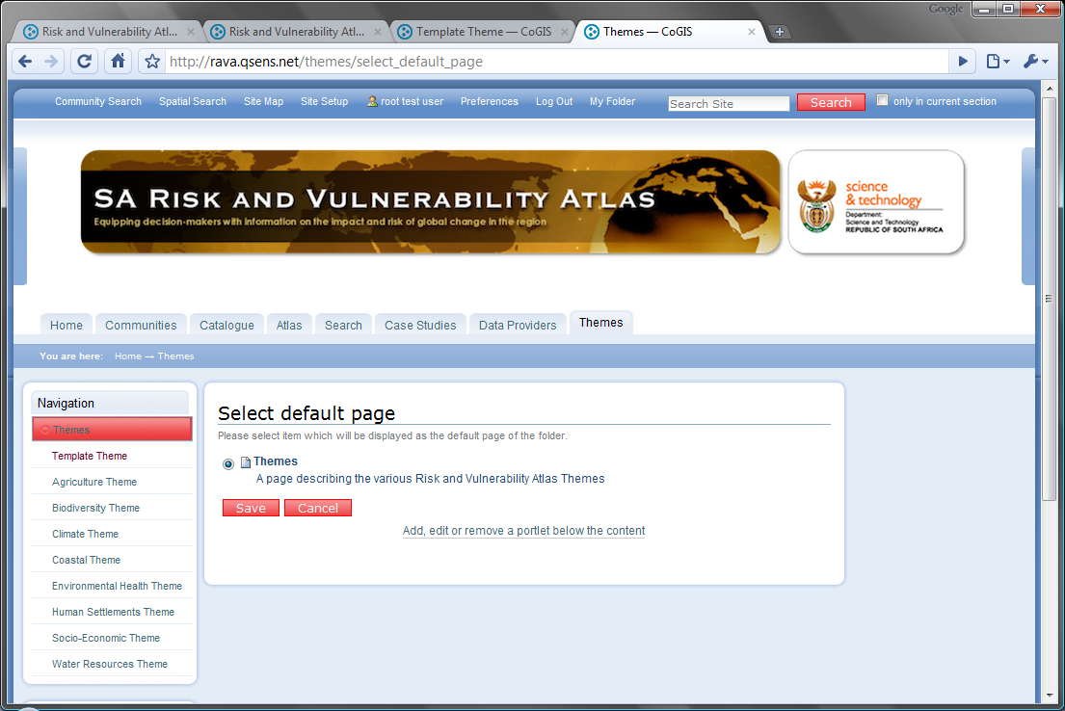
Select the default view …
Only one content item is available as an alternative default view – the page we have just edited.
Select it and click ‘Save’

Slide 57
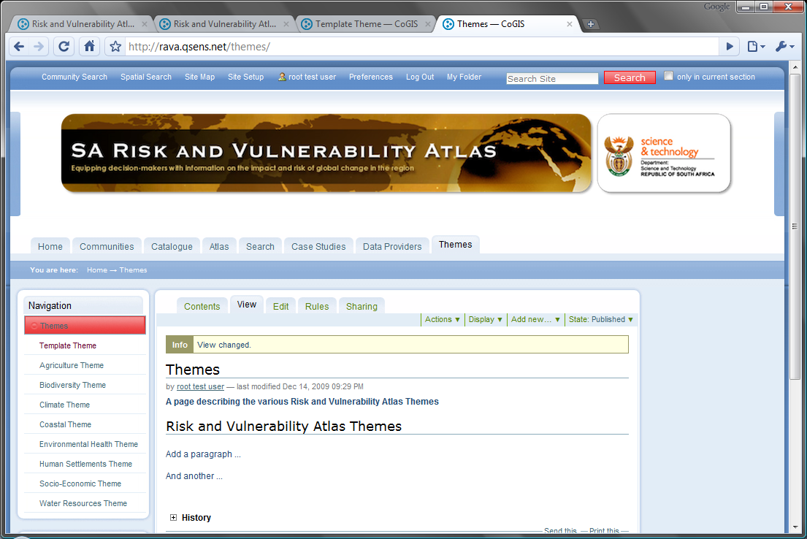
New default view
Clicking on ‘Themes’ now displays the page as a default instead of the normal list of content items.
The content items are still visible in the Navigation pane.

Slide 58
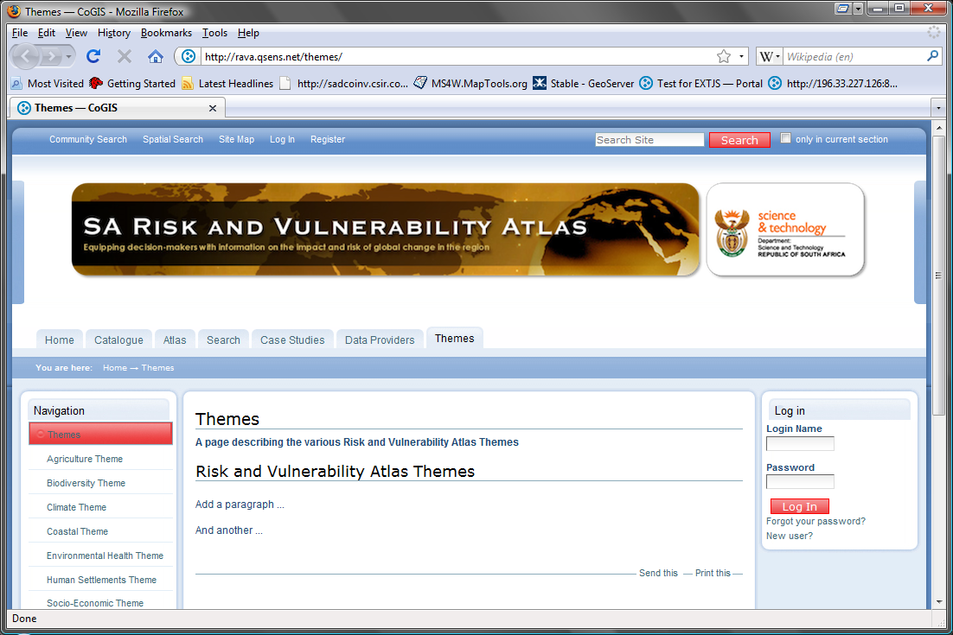
What ordinary users see
Users that are not logged in do not see the template theme – it isn’t published
They also do not see menu items and editing facilities.

Slide 59
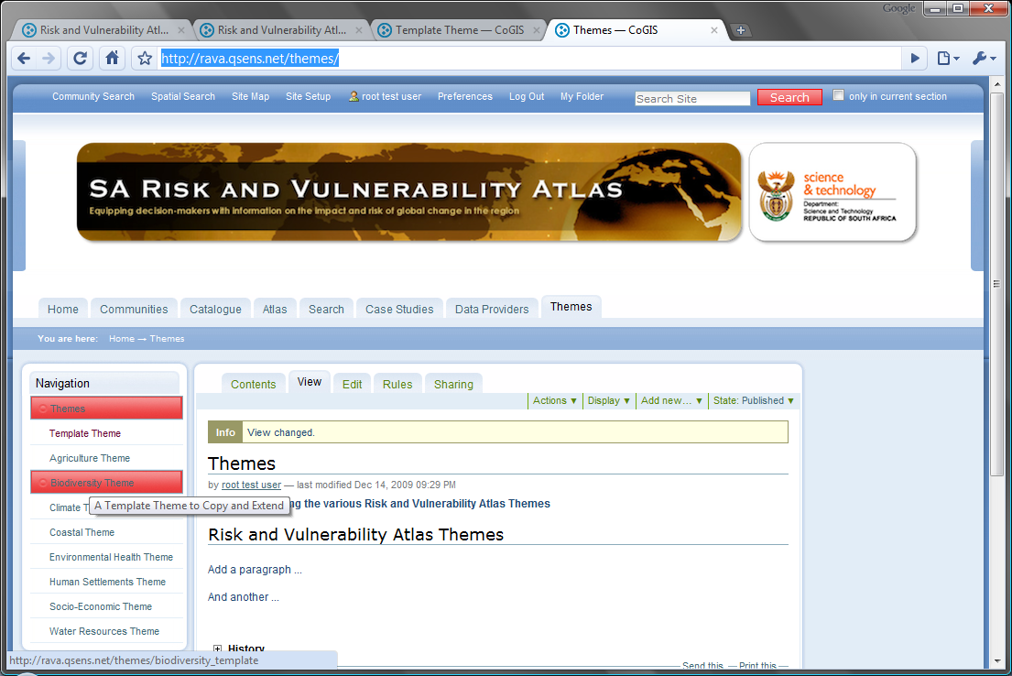
Editing and Customising a Folder
Click on the folderto be edited and customised

Slide 60
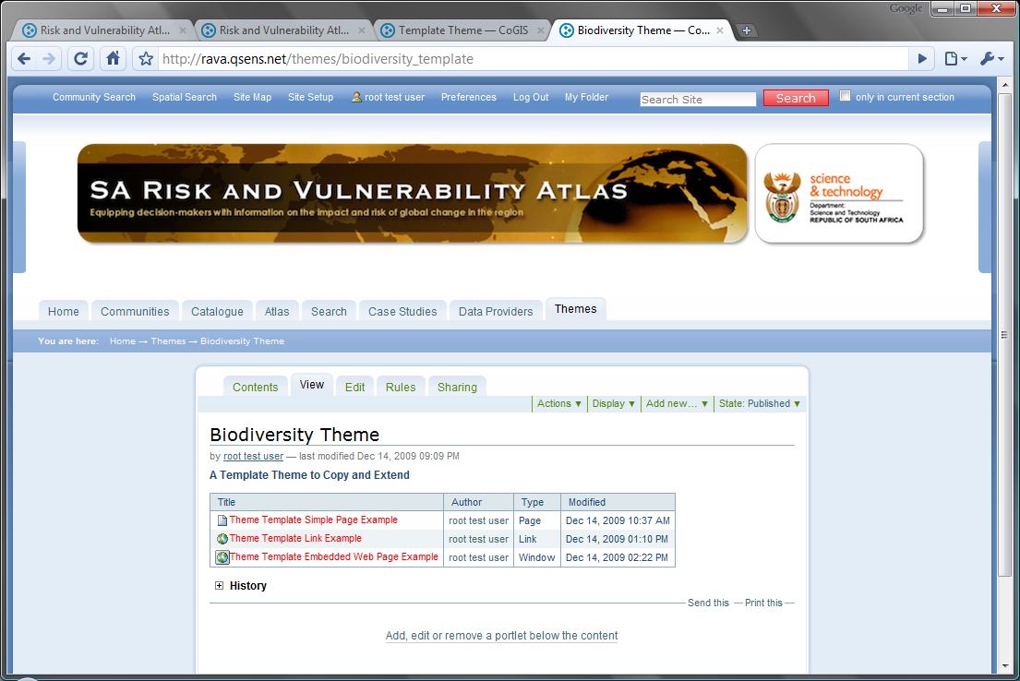
Controlling Structure
Each theme template contains three example content items:
A Simple Page
A Link
An Embedded Page
Note that they are not published (displayed in red)

Slide 61
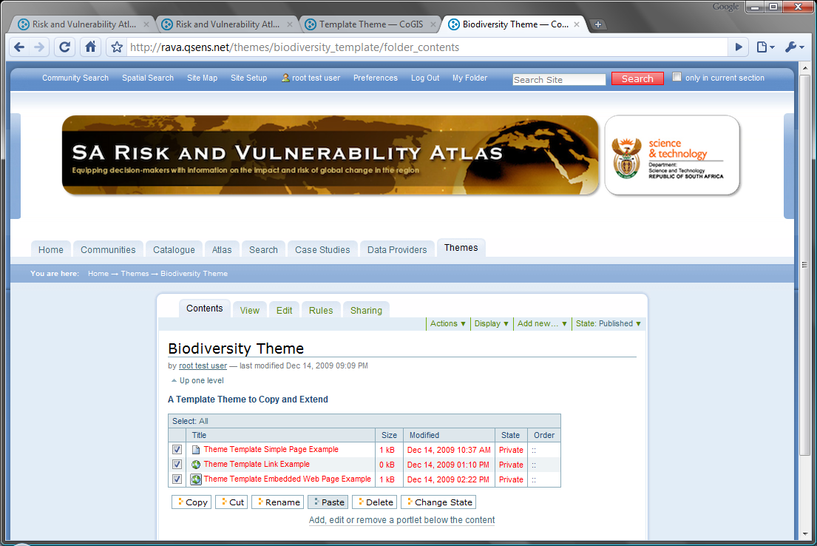
Switching to Content View
Its easier to work in ‘Contents’ view when modifying content.
Several commands are available to assist and the tick boxes allow multiple selections.
Step 1 is to verify the names and descriptions of items. Select all three items and click ‘Rename’.

Slide 62
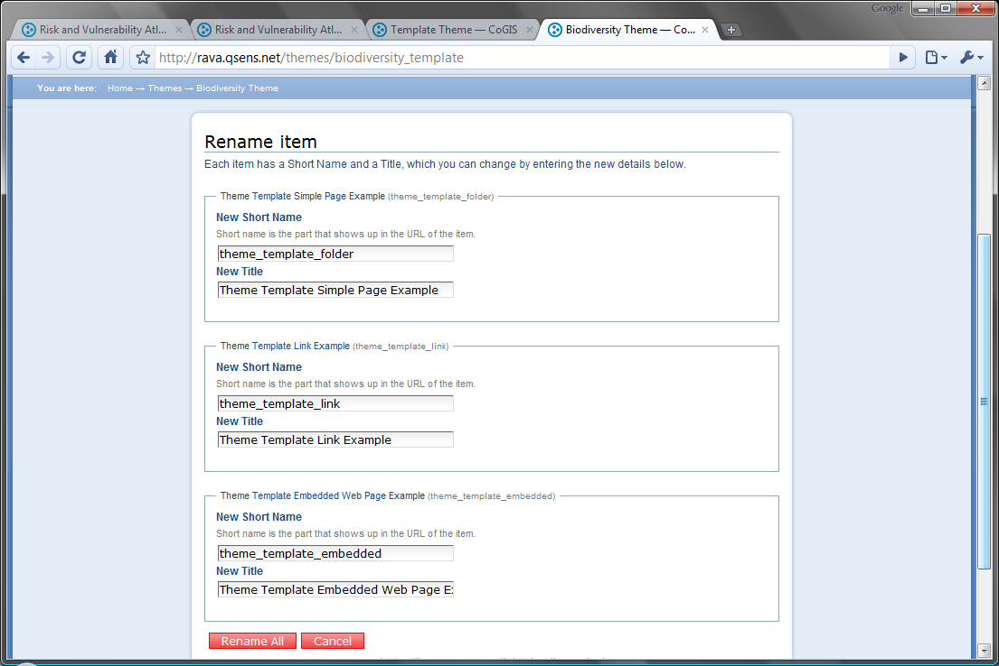
Rename items …
The items can be given any convenient name. Remember that the short name is used by the system, and is of better use if it is unique, awhile the title is used in the user interface to display items.

Slide 63
Rename items …
Click ‘Rename All’
Items have new titles.

Slide 64
Editing a Simple Page
Click on the ‘Simple Page’ to edit..

Slide 65
Editing a Simple Page
Click on “Edit”

Slide 66
Creation/ Editing of a Simple Page
Title: Item will be listed and displayed with this title
Description: will show up as tooltips.
Body: editor is ‘what you see is what you get’ or HTML.

Slide 67
Example: Adding an Image to a Page
Several tools are available to assist with editing, including one for insertion of images
The images must already be in the portal.
The images can be uploaded from disk, but this is not recommended – images should be described using meta-data.

Slide 68
Example: Searching for an Image
One can search for an image …

Slide 69
Recently used images
Or find it in the portal structure, including lists of recently accessed material
Set image properties for display and positioning

Slide 70
Save the page
Add narratives and additional content …
Save the page.

Slide 71
Managing and Editing Portlets
Portlets are displayed in the right and left panels. Some simple portlets are very useful.
Click on ‘Manage Portlets’ to proceed.

Slide 72
Adding a ‘Static Text’ portlet
Select ‘Static Text Portlet’ from the list.

Slide 73
Editing a Portlet
The Static Text Portlet is also a simple HTML page. Provide a title for the portlet.
Add entries for links first as simple paragraphs.

Slide 74
External Links
Highlight the paragraph (text) to be hyperlinked and click on the ‘External Link’ button.
Highlight the paragraph (text) to be hyperlinked and click on the ‘External Link’ button.
Type the URL for the link. The link can also be previewed.
Type the URL for the link. The link can also be previewed.

Slide 75
Opening a link in a new window
Switch to HTML view
Normally, the link will open in the same browser window as the portal. To force it into a new window or new tab, add the highlighted text to each link
Text to add:
<a class = “external-link” href = “http:// …..”
target = “_blank” >
Click on ‘Save’ when done.

Slide 76
Portlet Settings
The new portlet is now visible in the list
Set this to ‘Block’ to eliminate parent portlets – these are shown by default.
Save portlet settings

Slide 77
Viewing a New/ Modified Portlet
New portlet is displayed

Slide 78
Adding more portlets
Many portlets can be added.

Slide 79
Linking Additional Portlets
In this instance, we are creating a link to BGIS

Slide 80
Additional Resources
Plone Home Site
www.plone.org
Comprehensive Documentation

