Slide 1
Working with Images, Meta-Data, and Communities
Risk and Vulnerability Atlas
User Guides
G335.4.1.1

Slide 2
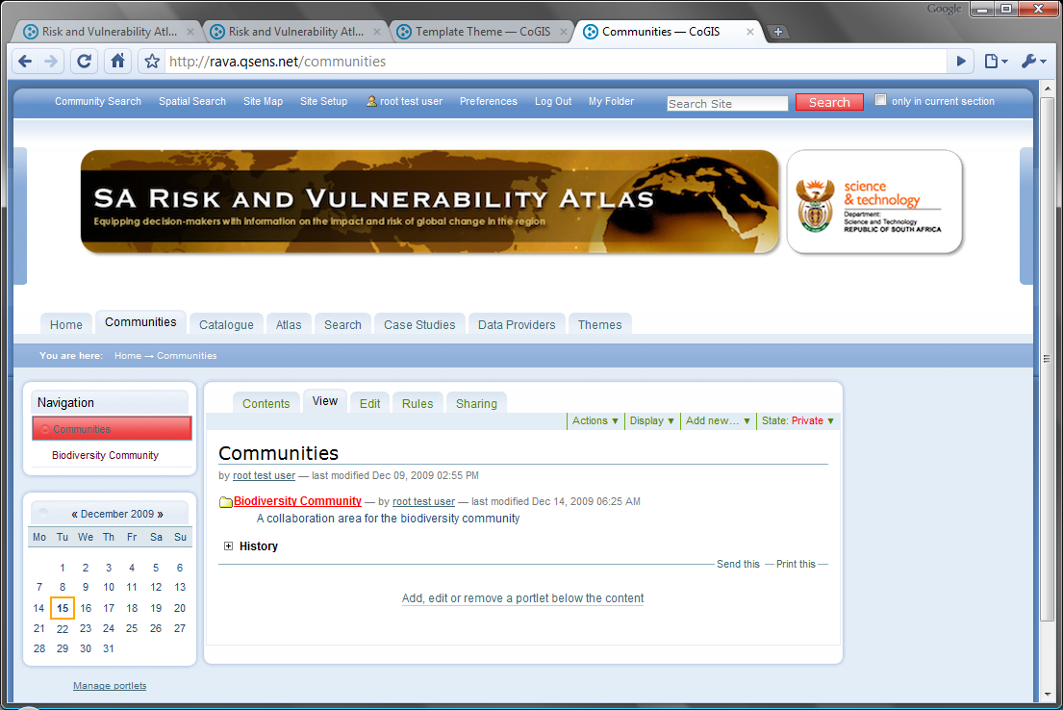
Communities
We think it’s best to create re-usable content, such as images and references, in the content area of a community
One community has already been created. There will probably be a community for each theme area.

Slide 3
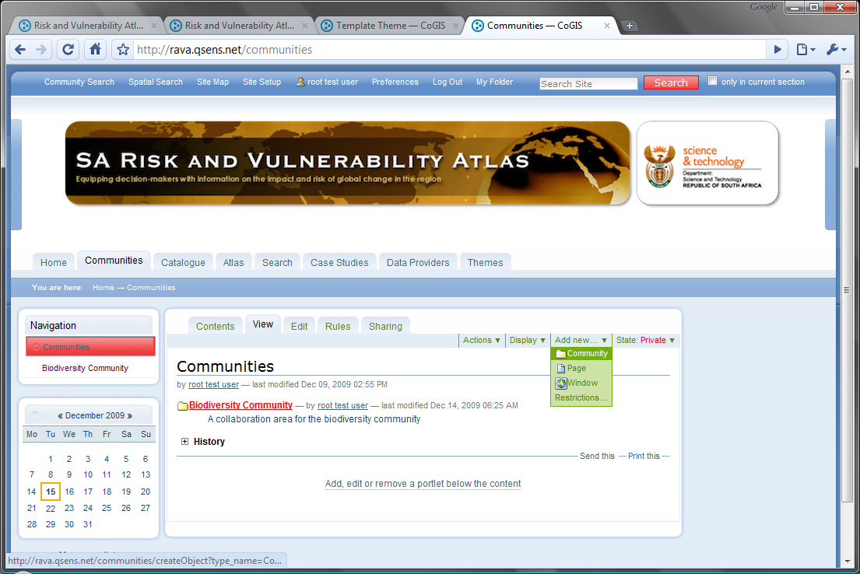
Add a New Community
To add a community, click on ‘Add New’ and ‘Community’

Slide 4
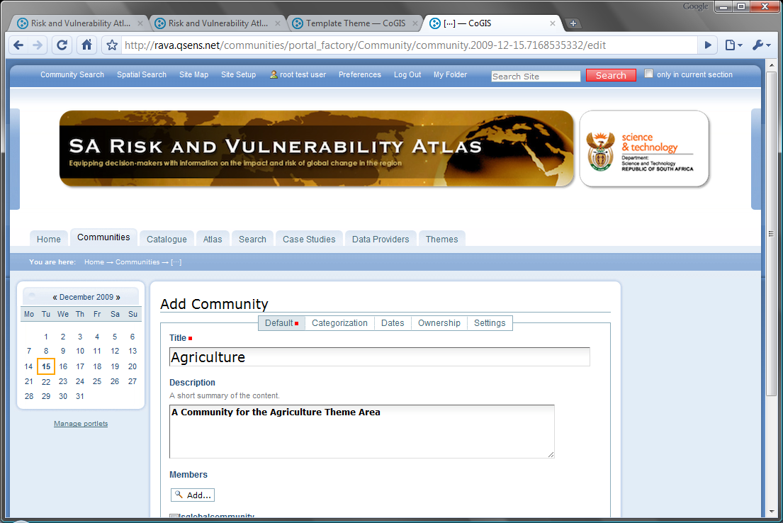
Community Properties
We are creating a community for Agriculture
The description shows up as a tooltip and in search results.
Leave the other settings for now and click ‘Save’.

Slide 5
Default Community Structure
Each community contains three default items on creation
A community can maintain one or more controlled vocabularies.
Each community can create a customised search facility.
Each community can create folders and sub-folders of content. This is where we will create an image repository. Click on ‘Content’ to proceed.

Slide 6
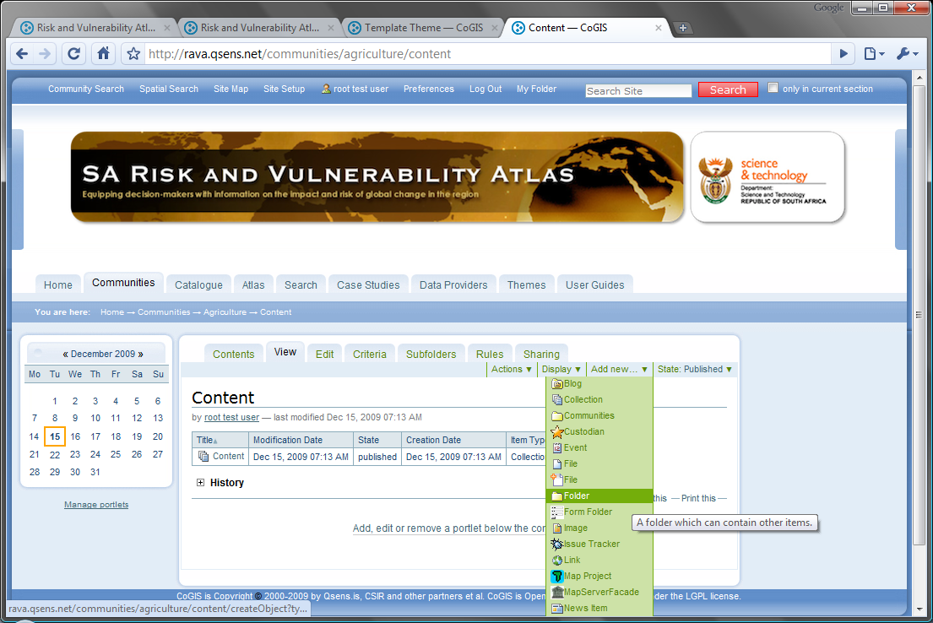
Adding an Image Repository
The best container for an image repository will be a folder. Click ‘Add New’ and ‘Folder’ to create one..

Slide 7
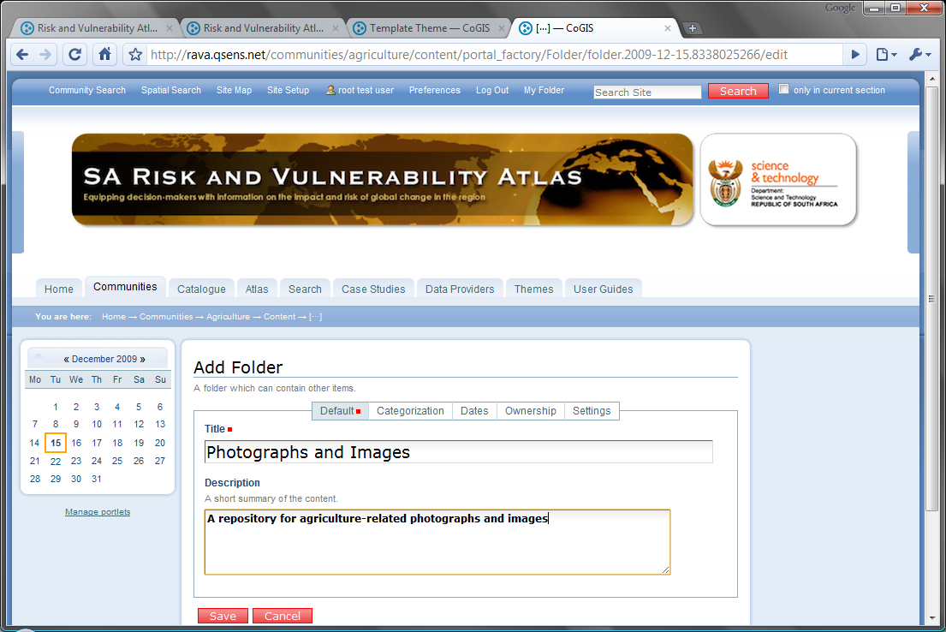
Image Repository Folder
Provide a title and a description, and click ‘Save’.

Slide 8
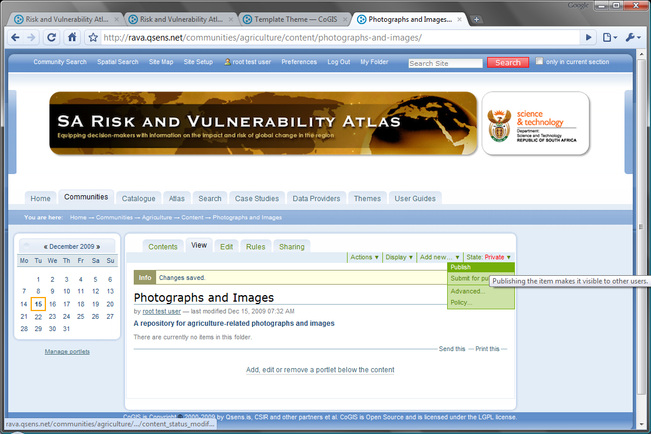
Publishing the Folder
Remember to publish the folder so that others can see it.

Slide 9
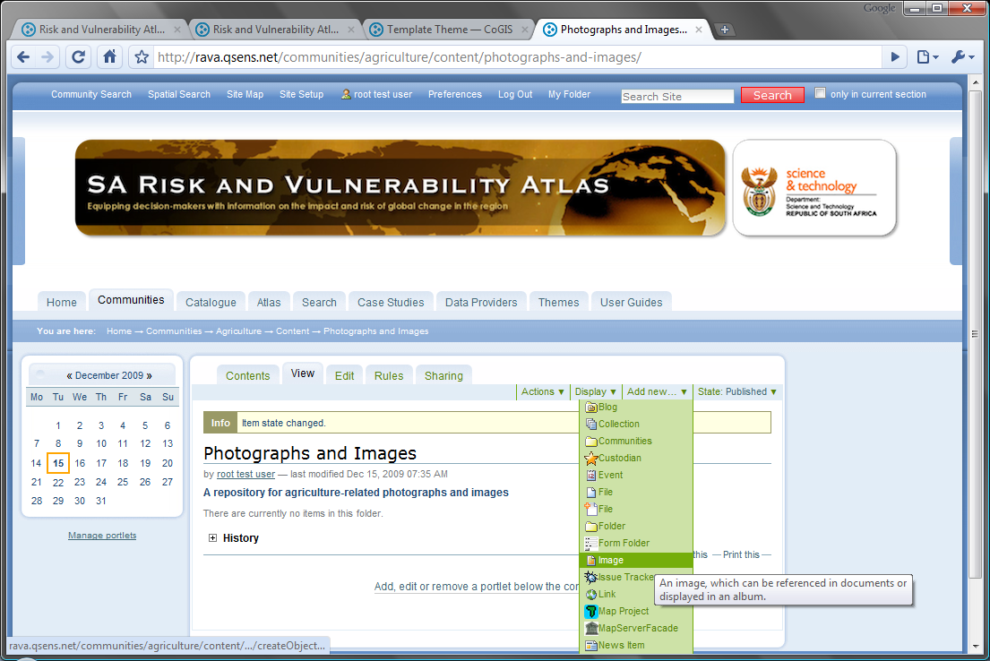
Adding Images
We can now immediately add an image. Click ‘Add New’ and ‘Image’.

Slide 10
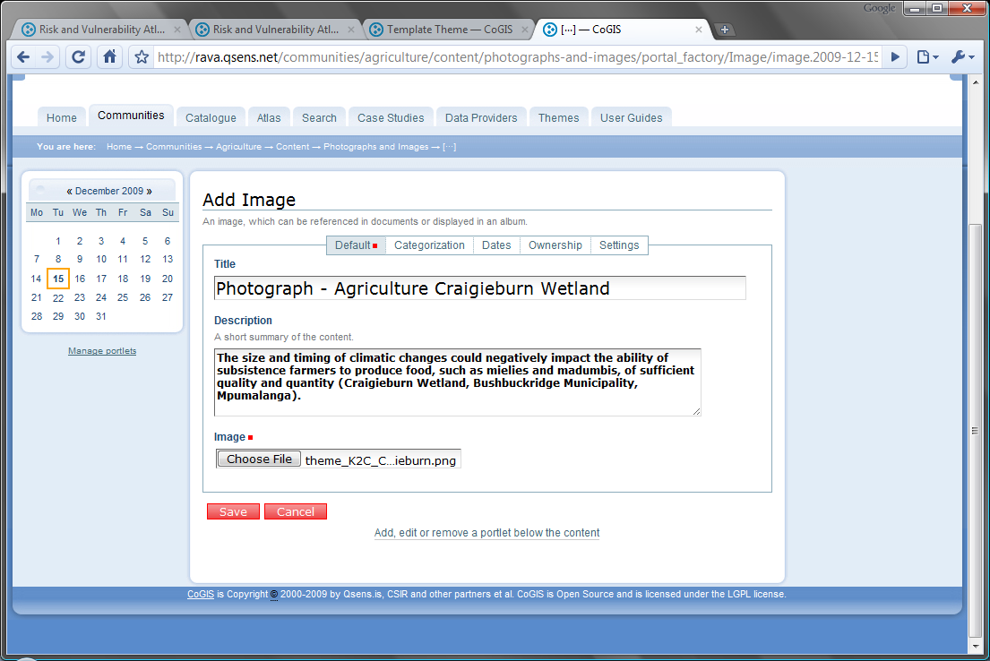
Describe the Image and Load from Disk
Provide a title and a description. Then click on ‘Choose File’ to upload from disk.
Click on ‘Save’ when the image has finished uploading. This could take some time, depending on the size of the image.

Slide 11
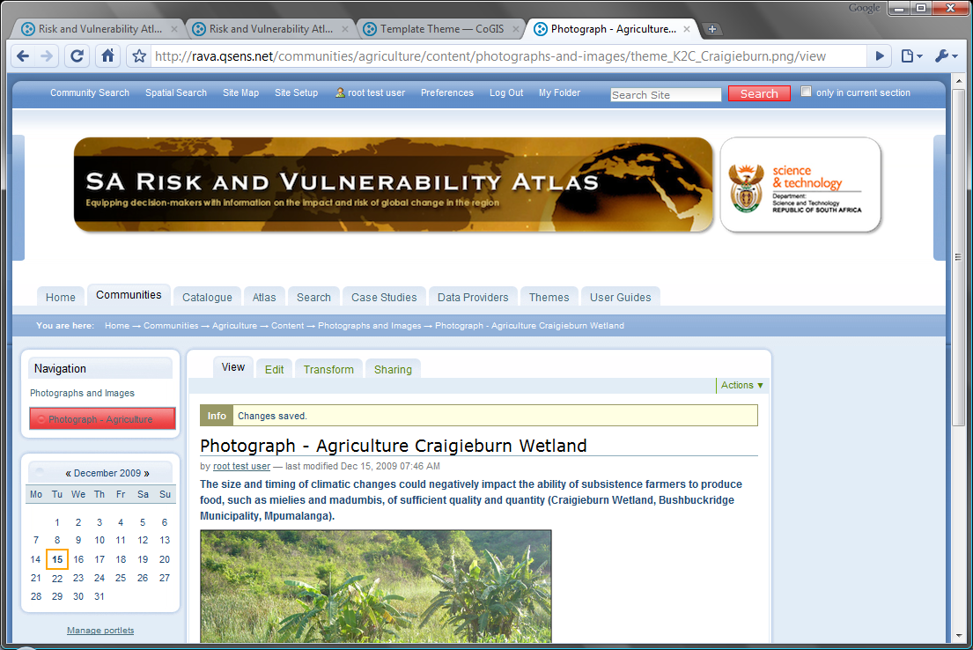
Uploaded Photograph

Slide 12
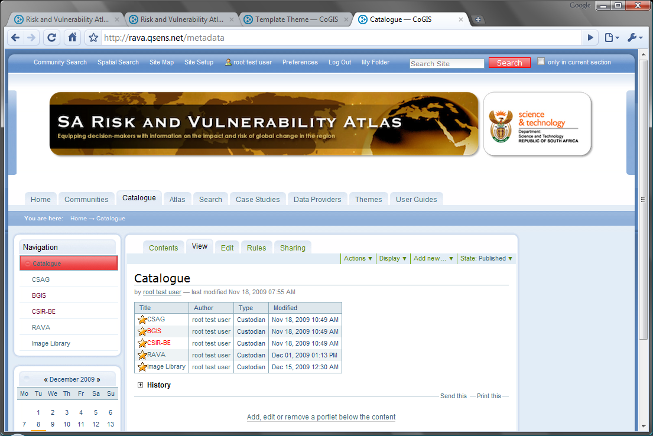
Providing Metadata
It is quite important to provide a meta-data record for each image. This is not so difficult to do. Click on ‘Catalogue’.
An Image Library ’catalogue already exists. Click to add meta-data.

Slide 13
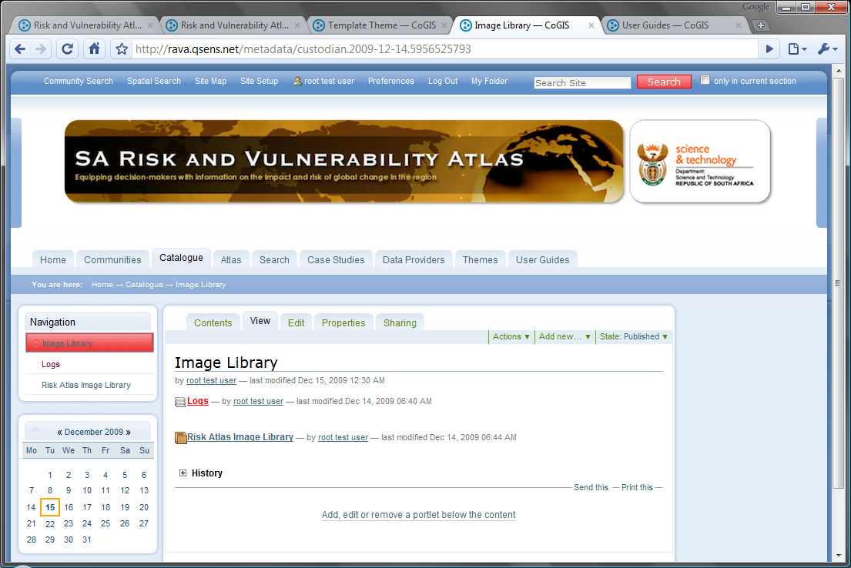
The Risk Atlas Image Library
The catalogue contains a log and a Meta-data Collection. Click to continue

Slide 14
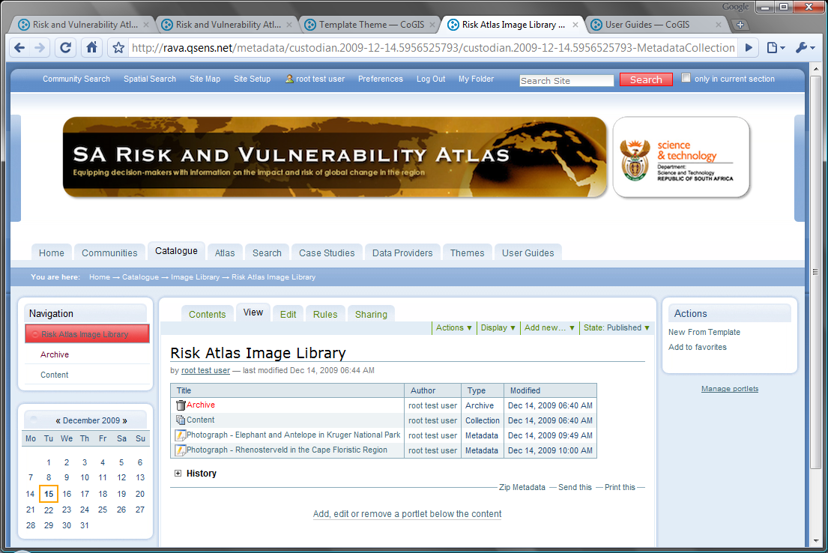
Adding a New Meta-Data Record
The collection already contains several entries.
Click on ‘New from Template’ to add a record.

Slide 15
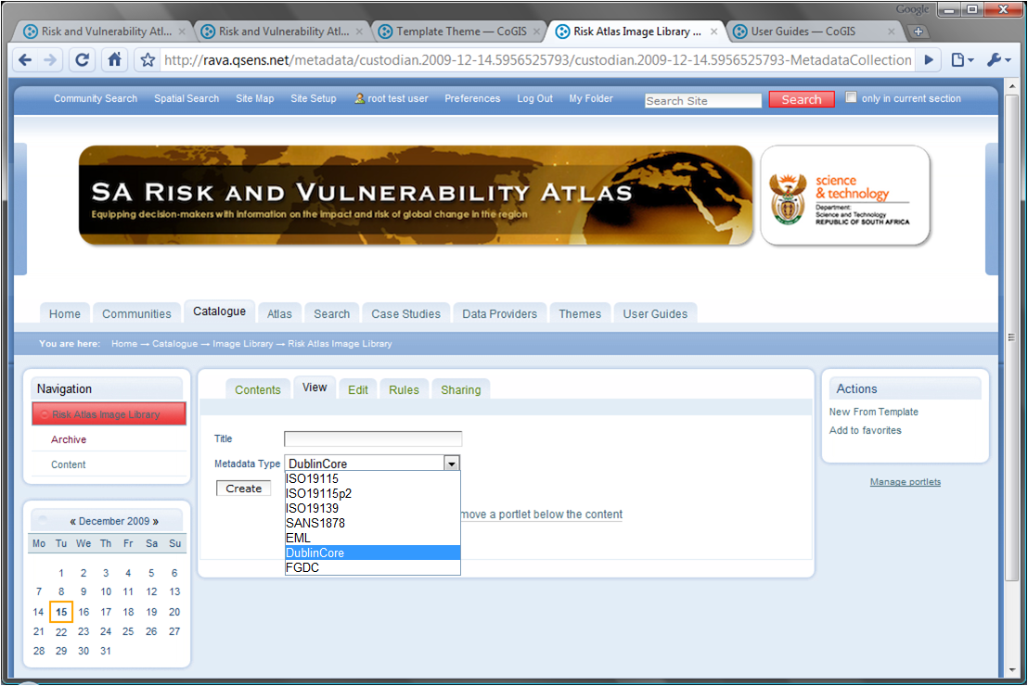
Select ‘Dublin Core’
Provide a suitable title and select ‘Dublin Core’ as a basis for the record.
Click on ‘Create’.
A dialog box will indicate that the document has been created.
Click ‘Back’ or ‘Image Library’ to return to the catalogue entries.

Slide 16
Template creates as document
The template creates a new document with a provisional internal name.
Click to access.

Slide 17
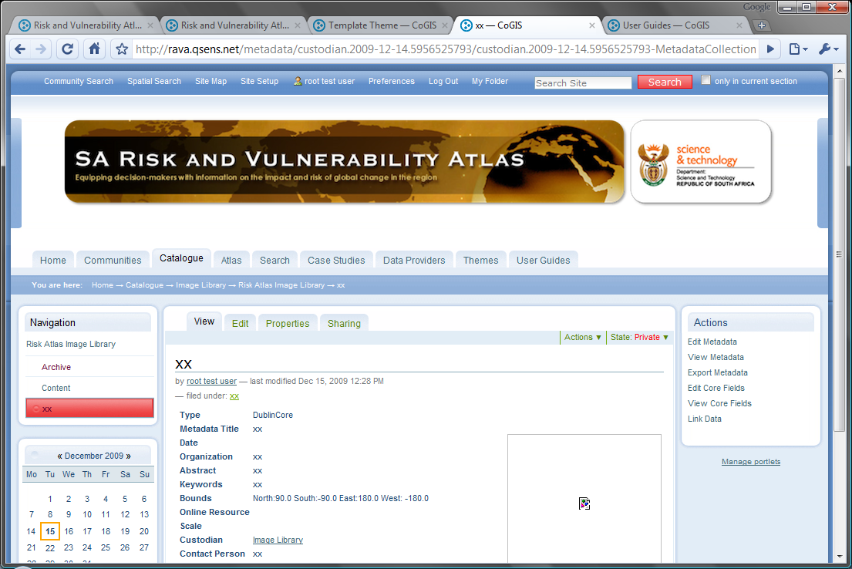
The template needs to be edited
The template needs to be edited – click on ‘Edit Core Fields’.

Slide 18
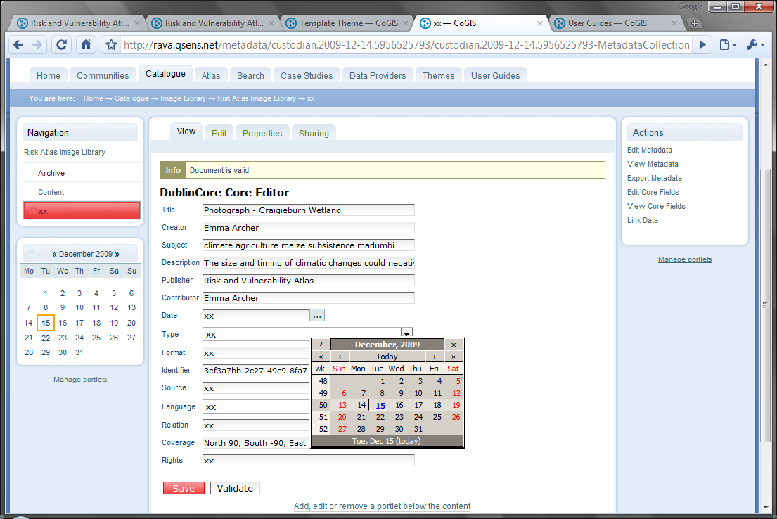
Fill in the Dublin Core fields
Fill in all the required fields
Some fields provide assistance

Slide 19
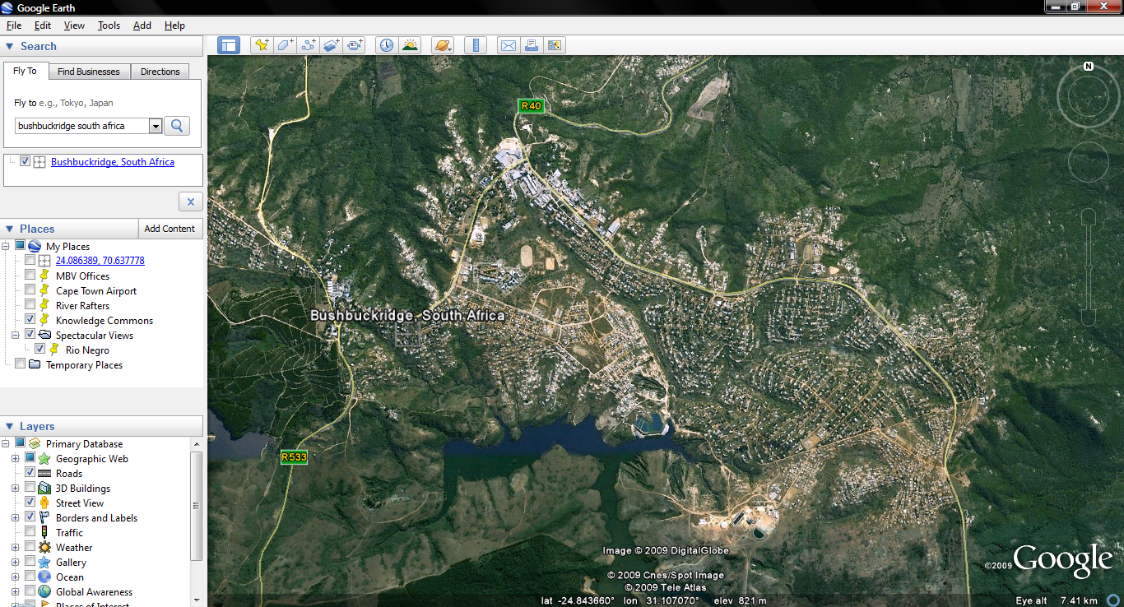
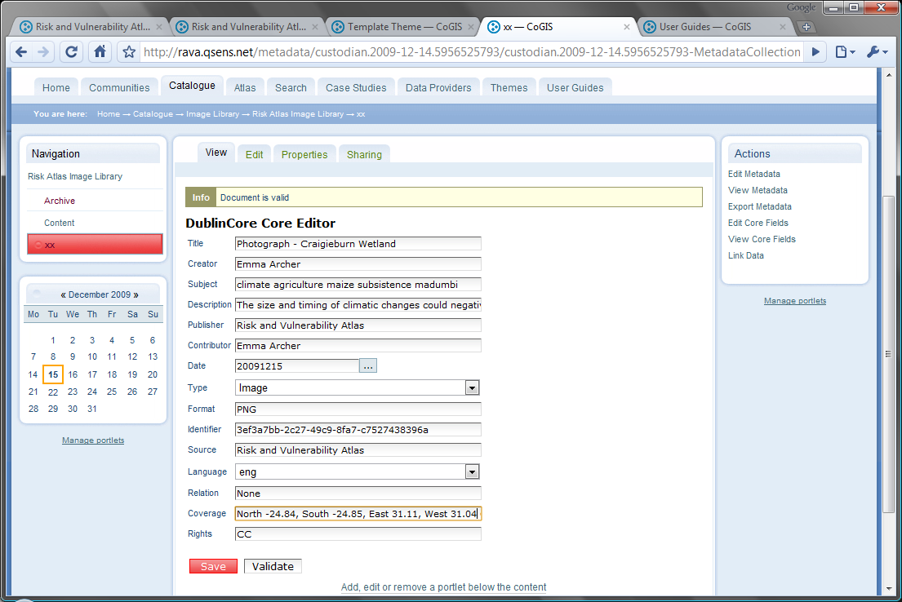
Use Google Earth to find an approximate location
Click ‘Save’ when done.

Slide 20
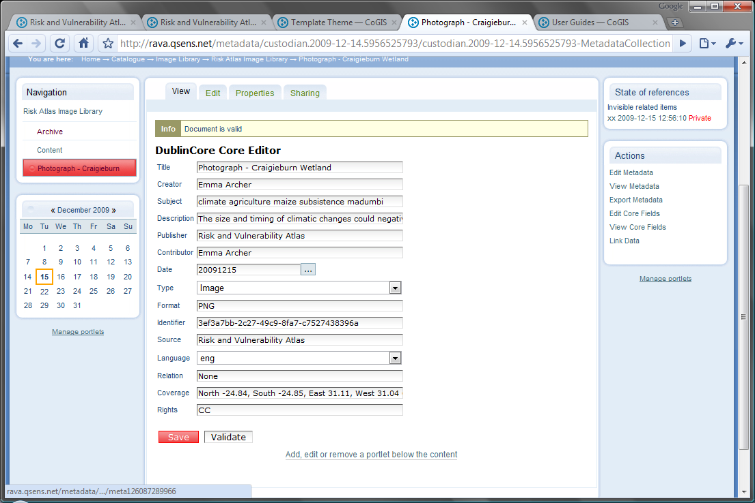
Document is Validated Again
Each time the document is saved, it is validated against the schema for Dublin Core
Click on ‘View’ to return to the meta-data document.

Slide 21
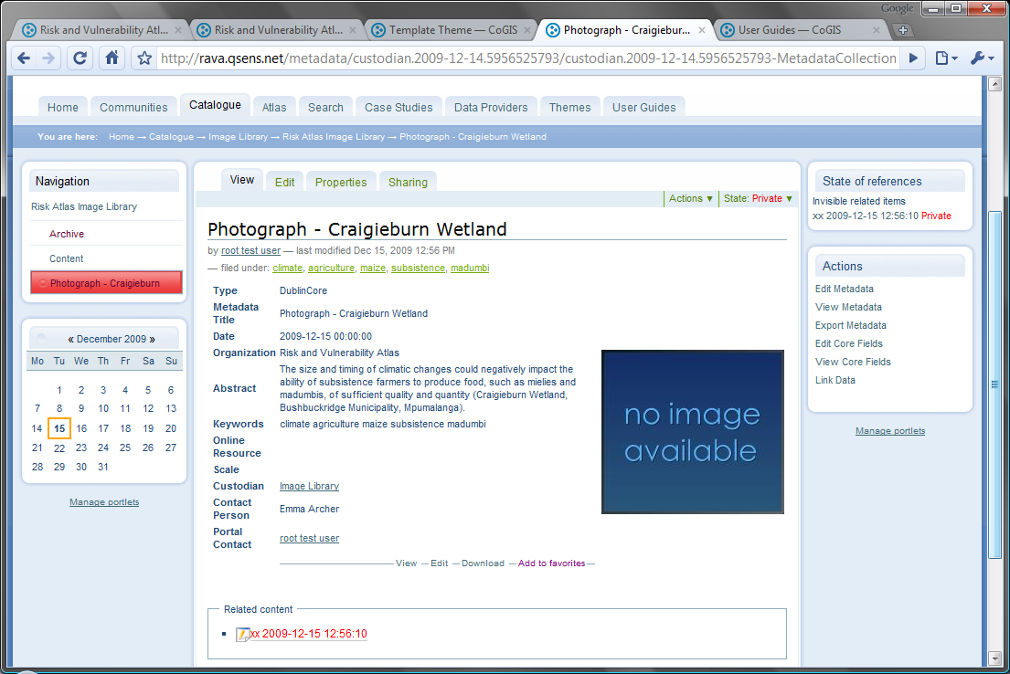
Linking to Data
Document is still private
Dublin Core documents need not be geo-referenced, hence no thumbnail map is produced
A link is maintained to the original (template)
Click here to link the meta-data record to the image

Slide 22
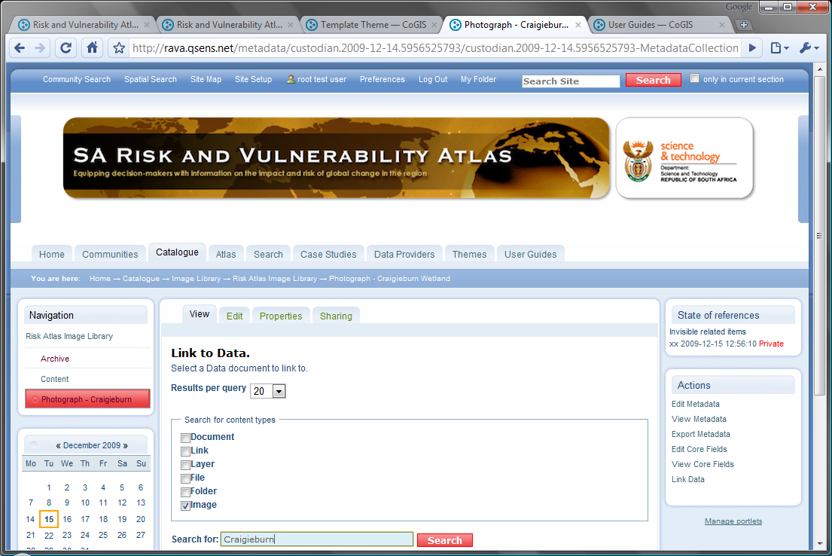
Search for Content Items to link to
We want to link to an image uploaded earlier
‘Craigieburn’ was in the title of the image as well.
Click ‘Search’.

Slide 23
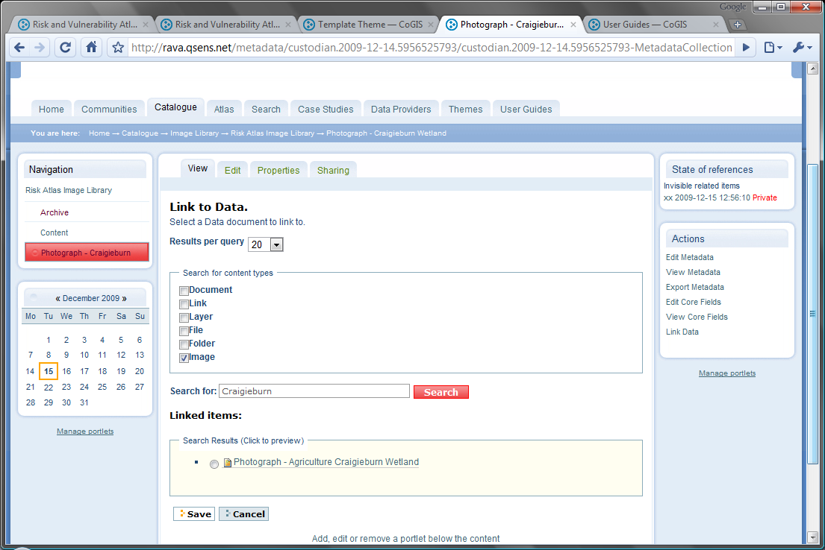
Search Result
The image uploaded earlier is found. Click the photograph radio button and click ‘Save’
The image uploaded earlier is found. Click the photograph radio button and click ‘Save’

Slide 24
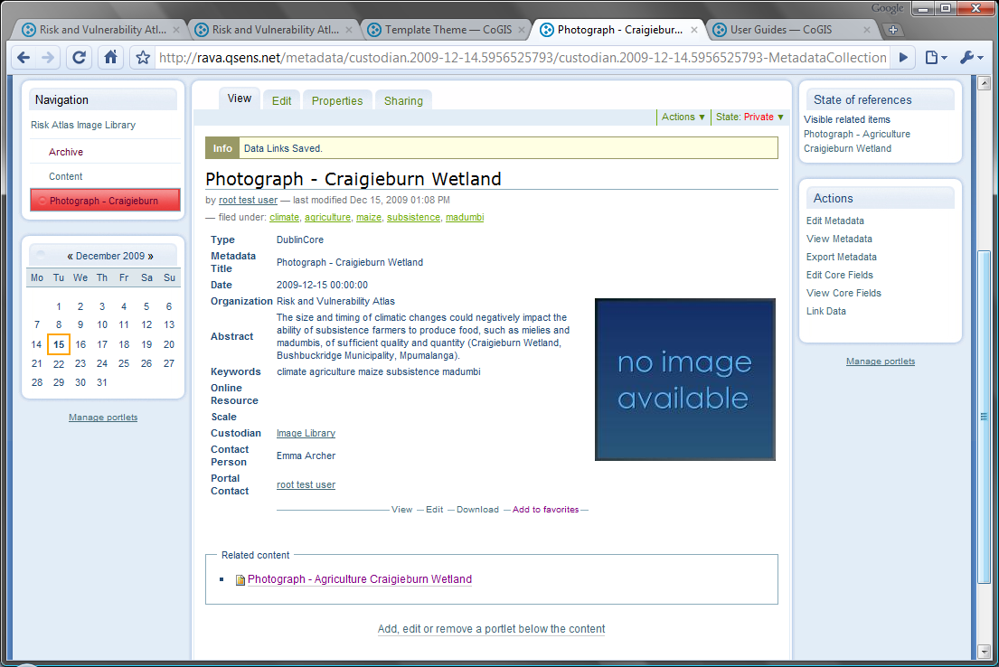
Link is now in place
The image and the meta-data record are now linked. Clicking on either goes to the photograph.
The image uploaded earlier is found. Click the photograph radio button and click ‘Save’

Slide 25
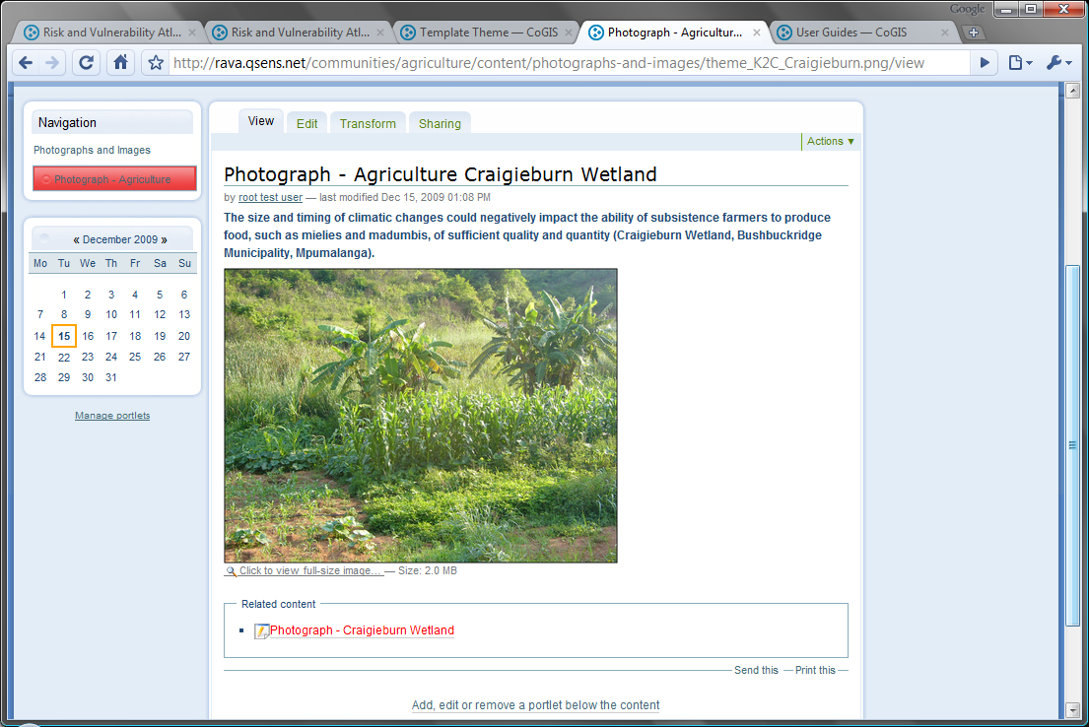
The Image is also linked to its meta-data
The image and the meta-data record are now linked. Clicking on this link goes to the meta-data record.

Slide 26
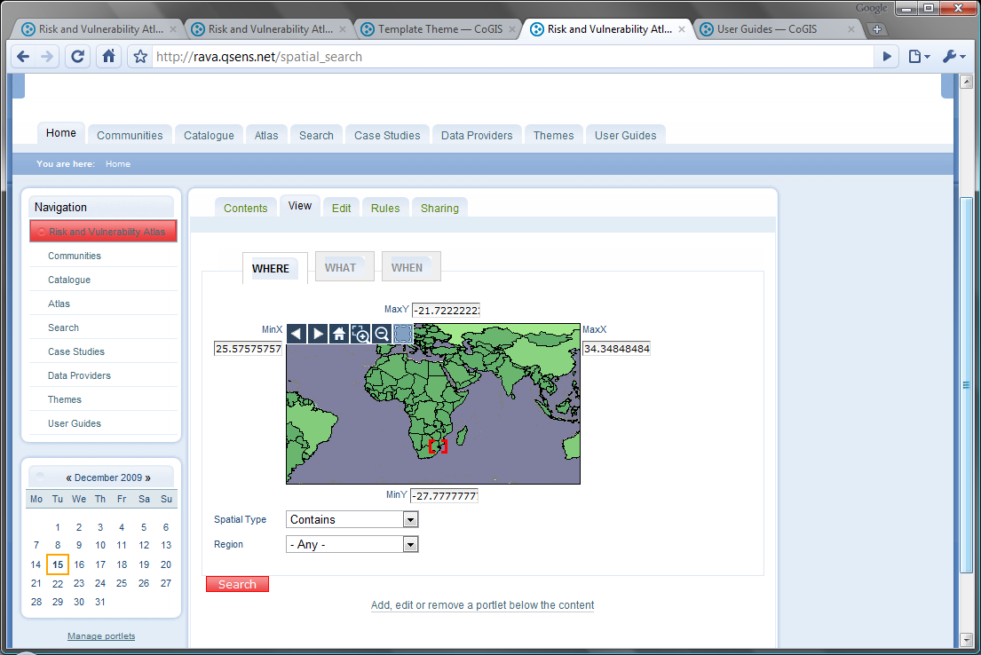
We can now search for the meta-data …
If we search in the eastern part of SA for items containing ‘subsistence’ as a keyword, we must find our meta-data record.
The image and the meta-data record are now linked. Clicking on this link goes to the meta-data record.

Slide 27
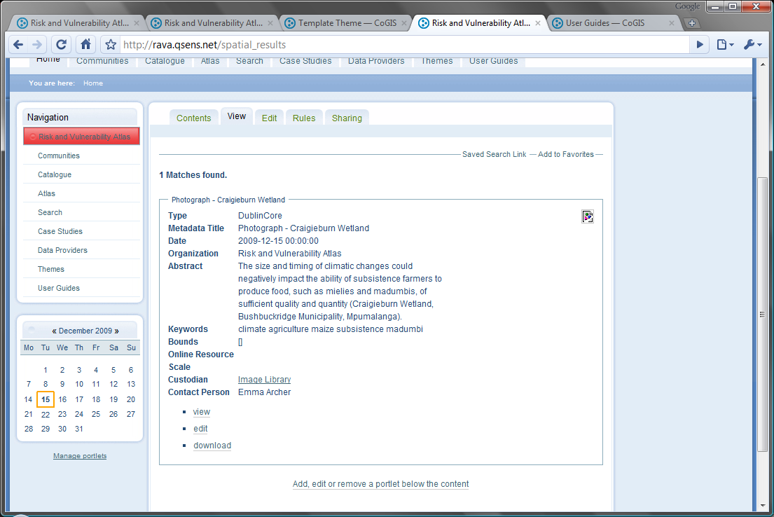
… and find it again.
Click on ‘View’ to see the full meta-data record and to navigate to the photograph.

