Slide 1
Adding Meta-Data Manually
Example: SAEON Documents Meta-Data Repository
Updated: 14 Nov 2011

Slide 2
This example assumes that a document related to the meta-data record has already been uploaded to the portal.
The example uses the SAEON documents meta-data repository at
http://data.saeon.ac.za/metadata/custodian.2011-08-30.1317146822/custodian.2011-08-30.1317146822-MetadataCollection

Slide 3
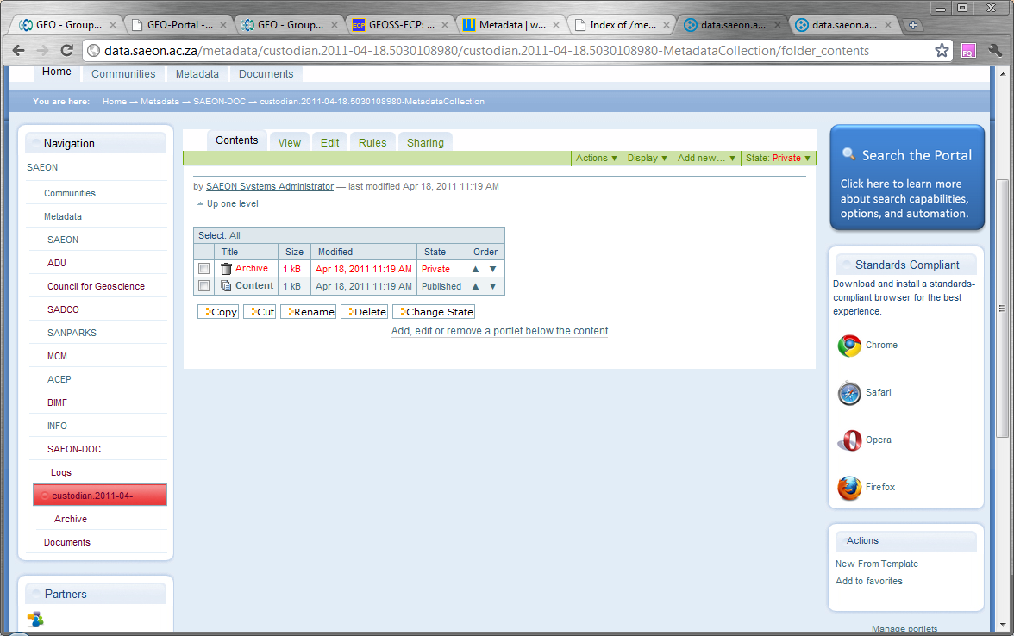
Add Meta-Data Manually
Click on ‘New from Template’ to add meta-data manually.

Slide 4
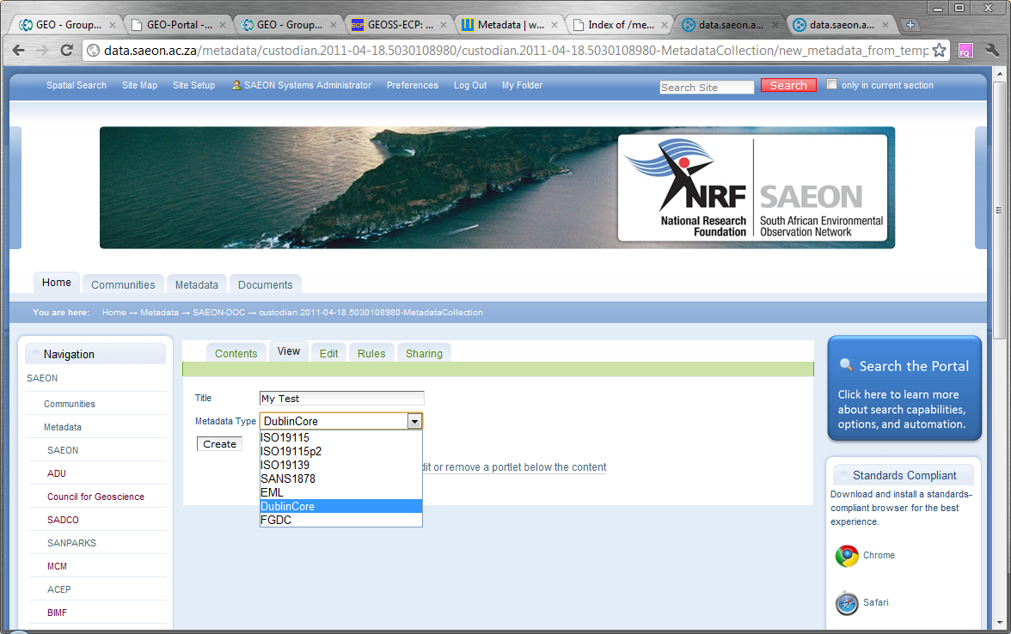
Select a Meta-Data Standard
This in an internal title – not so important. Select an appropriate standard (Dublin Core in this example) and click ‘Create’

Slide 5
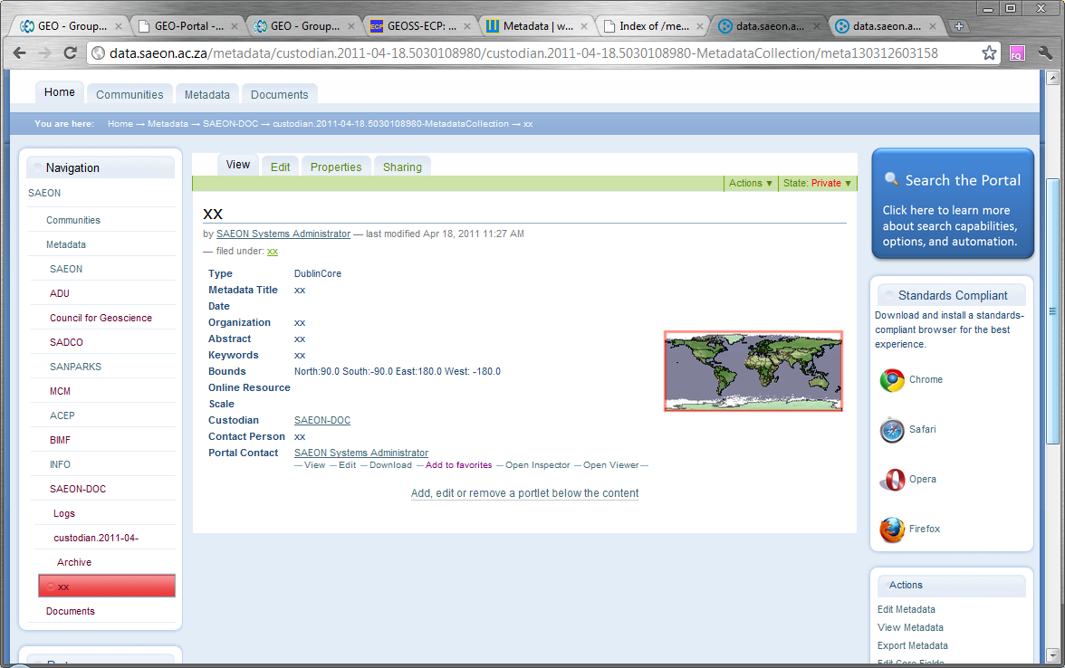
Template Record is Created
A blank record is provided. To edit it, click on ‘Edit Core Fields’.
A blank record is provided. To edit it, click on ‘Edit Core Fields’.

Slide 6
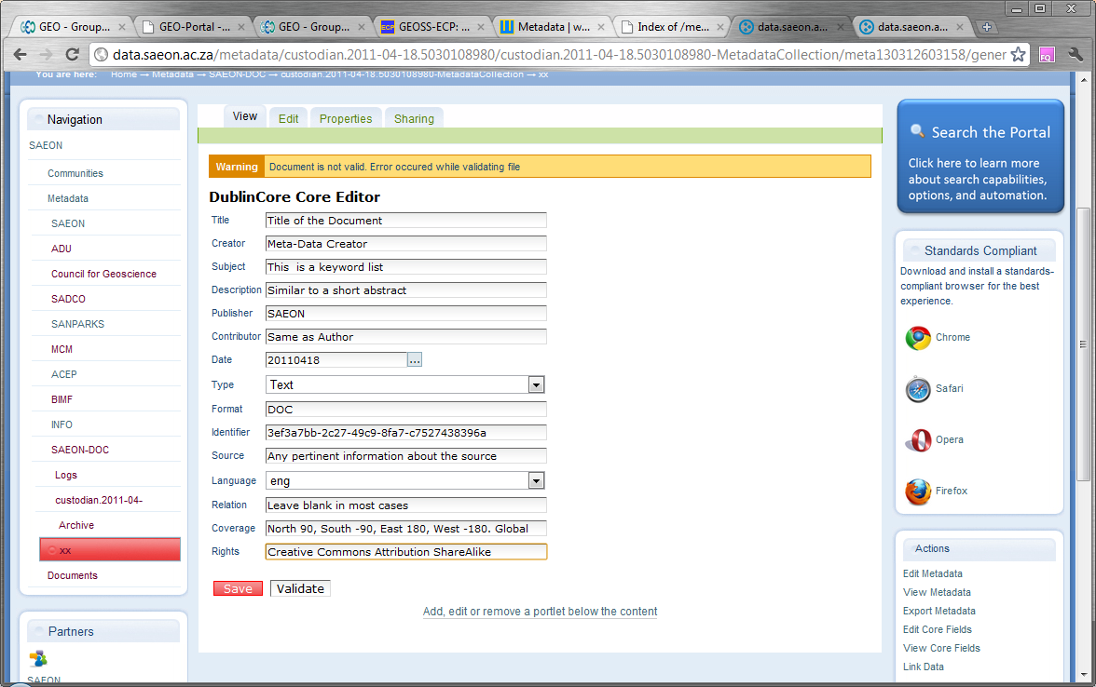
Fill in the Meta-Data Record
Fill in all available fields, and click ‘Save’.

Slide 7
Validation
The schema is very strict, so the document may not validate.
This is not a major problem: after saving the document, navigate to the document entry – see overleaf.

Slide 8
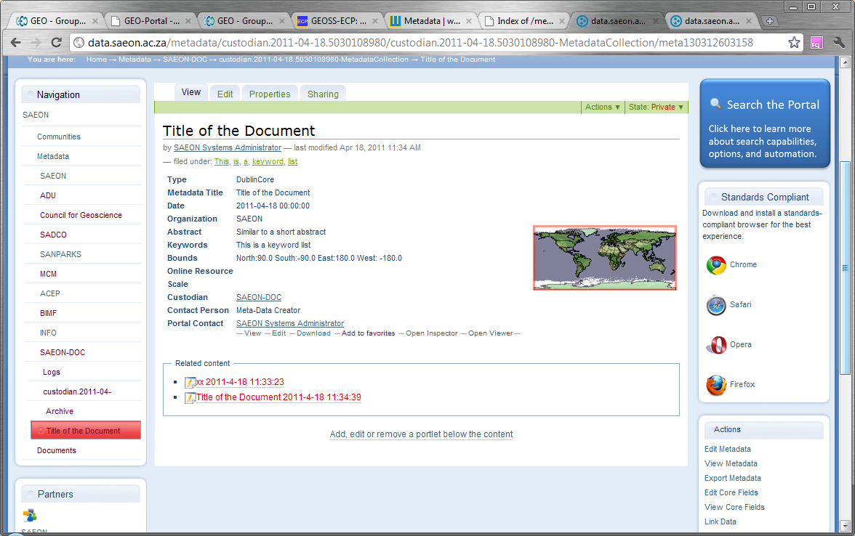
Viewing Meta-Data and Linking Content
The meta-data record, even though not valid, will be listed in the navigation. Click to view if you get lost.
Click on ‘Link Data’ to link to a data item or document in the portal.

Slide 9
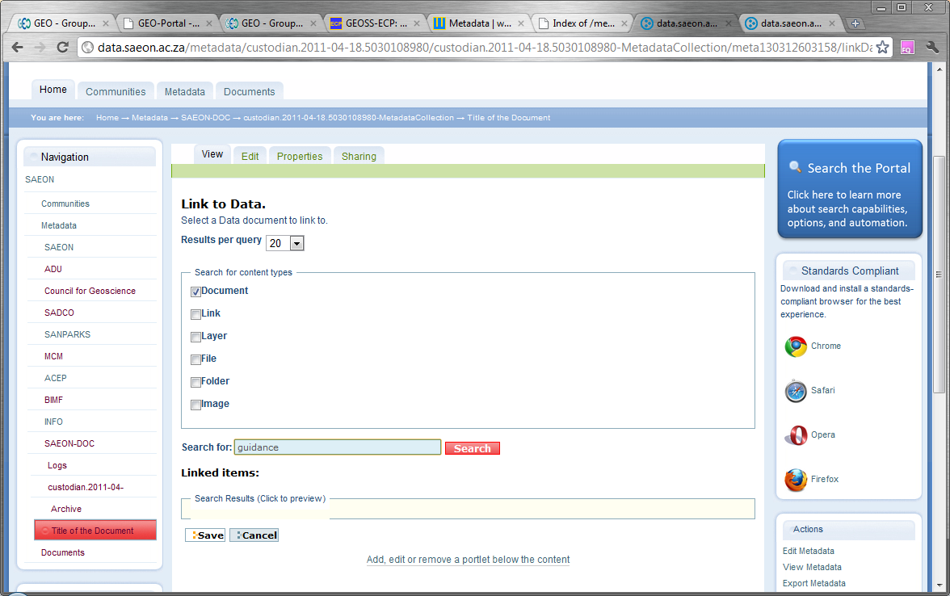
Search for Content
Select a type of content to limit search results, and an optional keyword. Click ‘Search’.
Select a type of content to limit search results, and an optional keyword

Slide 10
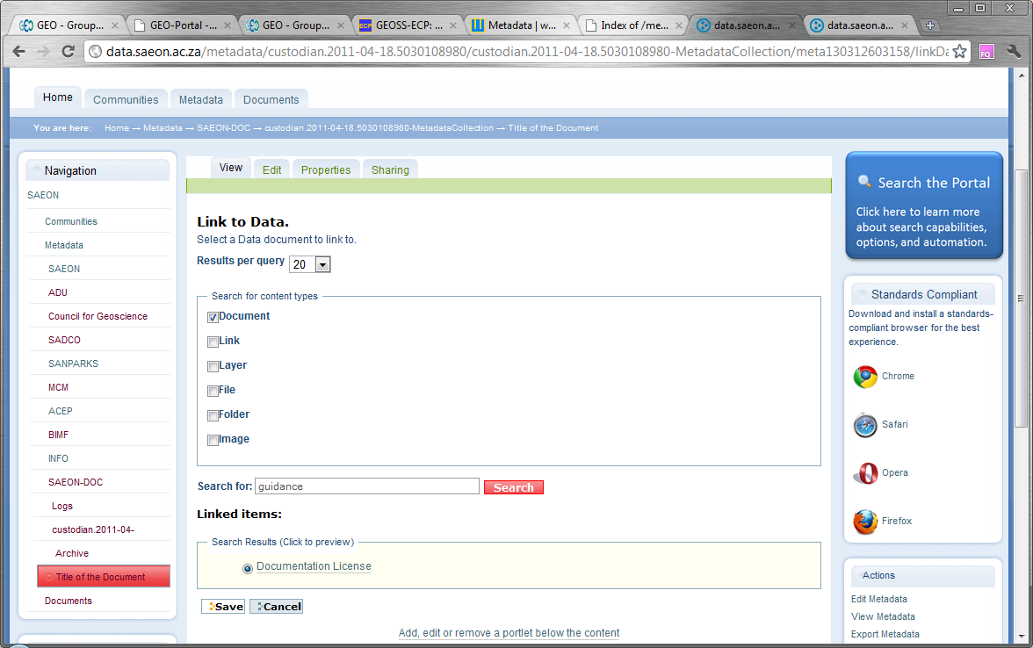
Save the link
Select a search result to link to the meta-data. Click ‘Save’.

Slide 11
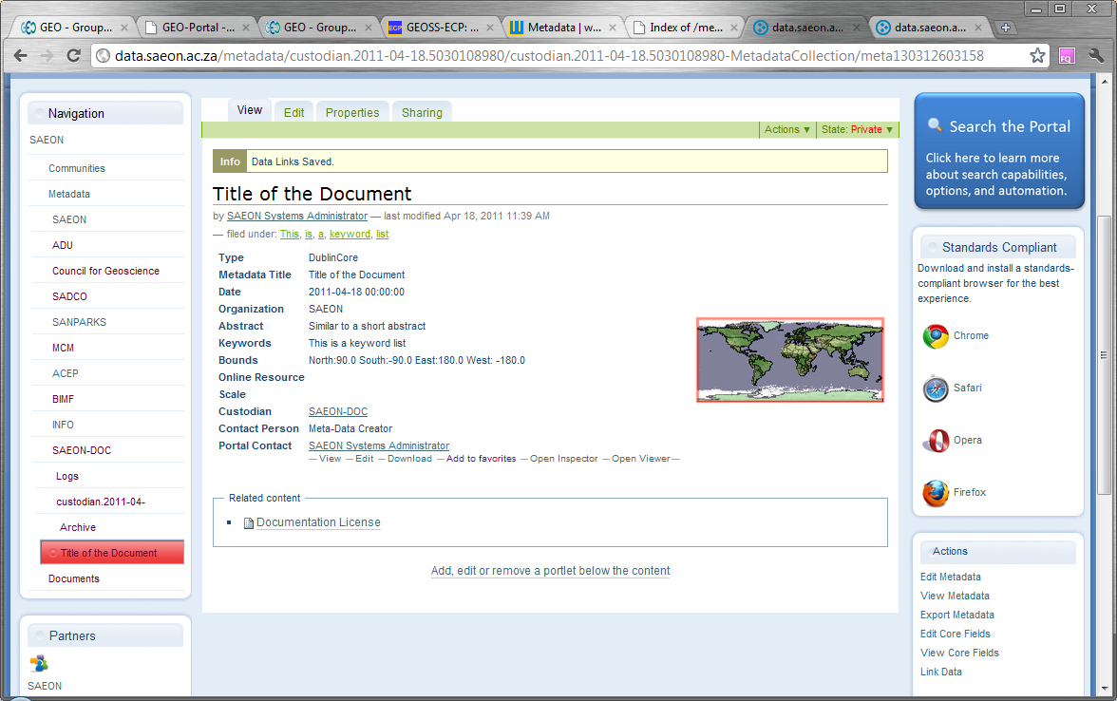
Link is Visible …
The content item is now linked to the meta-data.

Slide 12
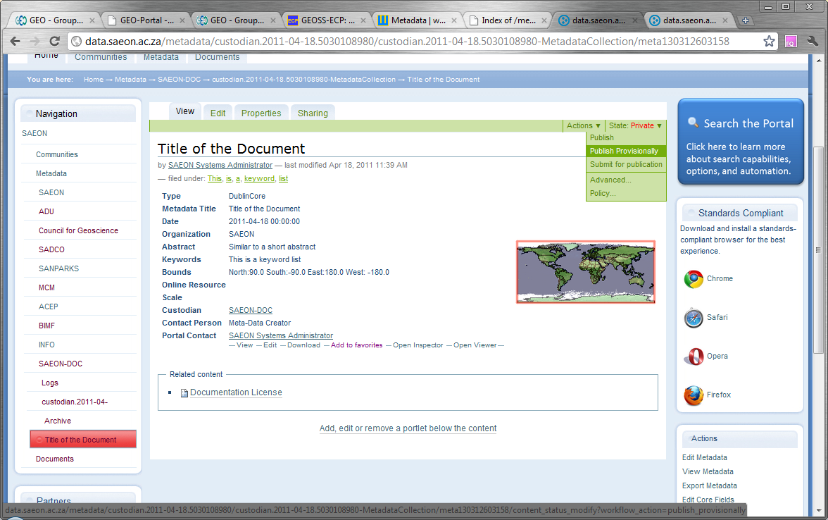
Publish or Publish Provisionally …
Publish the Meta-Data

Slide 13
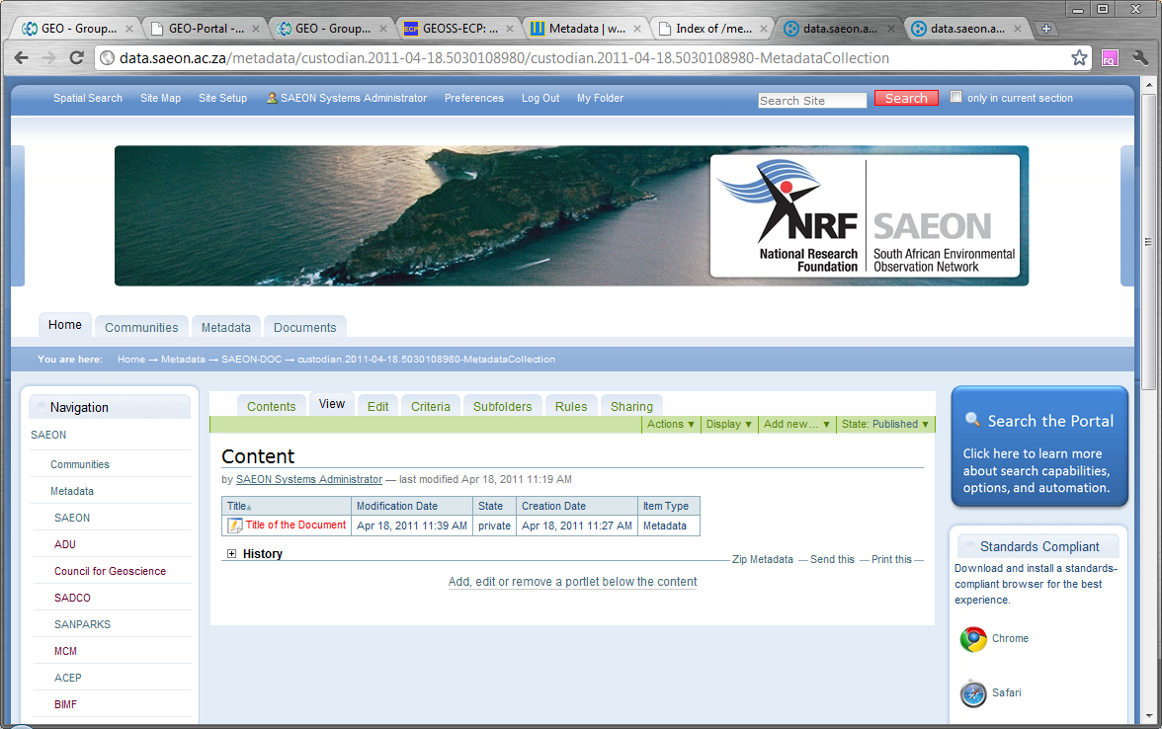
Meta-Data Entry is in the Meta-Data Collection

