Slide 1
GeoBON Workgroup 8 Towards Interoperable Infrastructure for GEO BON by 2015
EU BON Initial Informatics Workshop
Trondheim, Norway, 29-31 May 2013
Wim Hugo, SAEON

Slide 2
Why GEO BON?
New technologies are dramatically improving the collection and analysis of biodiversity information. These monitoring systems, which consist of satellite, air, land and ocean-based instruments, are being interlinked through the Group on Earth Observations (GEO) to form a Global Earth Observation System of Systems (GEOSS).
The biodiversity arm of this expanding “system of systems”, called the Biodiversity Observation Network, or GEO BON, will represent the first step towards achieving a more complete understanding of the status and trends in the world’s living resources. It was launched in February 2008.

Slide 3
http://www.earthobservations.org/geobon_a.shtml

Slide 4
Brief History
Date | Meeting | Outcome
2006 | User Needs workshop, Geneva | General concept for GEO BON
2008 | Meeting of GEO BON stakeholders, Potsdam | GEO BON concept document
2010 | 1st GEO BON All Hands Meeting, Asilomar | GEO BON implementation plan
2012 | 2nd GEO BON All Hands Meeting, Asilomar | EBVs, 2015 deliverables

Slide 5
2015 Deliverable
“Functional Infrastructure by 2015”

Slide 6
Functional Infrastructure implies –
data flow from observations through various aggregation and processing/ modelling services, supporting evaluation of EBV’s and derived indicators;
automated and streamlined, as appropriate;
using a plug-and-play (service-oriented) approach;
coordinated through a GEO BON registry system and linked to the GEOSS Common Infrastructure;
transparent to users through multiple channels, portals and applications.
Notes:
THIS IS THE SYSTEM IDEAL

Slide 7
Framework
Ideal
Reality
Generic Use Cases
Essential Biodiversity Variables
All Interoperability Implications
Deliver: Products
Services, Data, Best Practice, Standards, …
Specific, Achievable Use Case
“Winning” EBVs
Required services only
Some manual work
Limited to Contributing Organisations, Projects, and Initiatives

Slide 8
Use Case Perspectives

Slide 9
Manifesto
GEO BON data and services are described properly, preserved properly, and discoverable;
Once discovered, its utility, quality, and scope can be understood, even if the data sets are huge;
Once understood; it can be accessed freely and openly;
Once accessed, it can be included into distributed processes, and collated - preferably automatically, and on large scales;
Once processed, the knowledge gathered can be re-used.
All against a backdrop of a move to extend formal meta-data with emerging semantic web technology, increased focus on cross-domain interoperability, and the construction of knowledge networks.

Slide 10
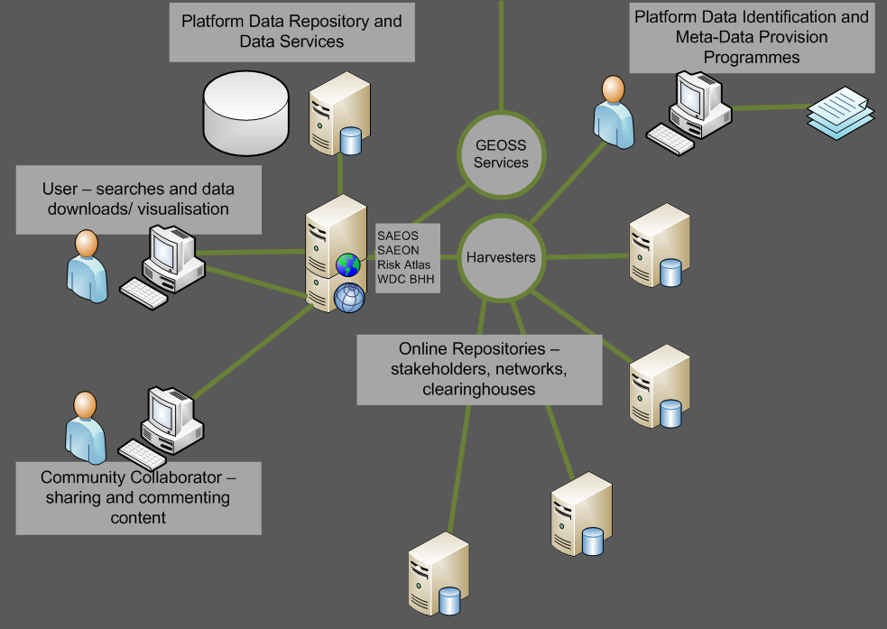
Generic Use Cases DISCOVERY AND VISUALISATION
The platform is based on a shared and aggregated meta-data repository, and the meta-data repository is capable of accepting and working with a range of well-established meta-data standards.
These include Dublin Core, Darwin Core, the ISO 19115 family, EML, and FGDC. The list is likely to be extended from time to time to accommodate other standards in widespread use by a user community or new provider.
Harvesters can be used to automate meta-data acquisition from standardised providers.

Slide 11
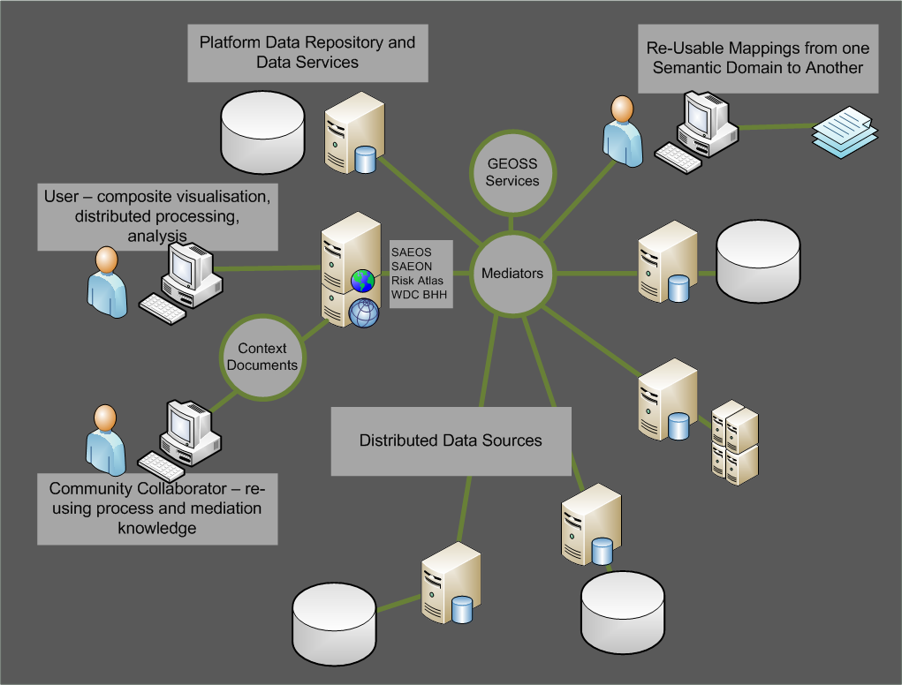
Generic Use Cases MEDIATION AND COLLATION
Mediators are required to map a data source or sources to a process or service.
The service can be as simple as a mapping service, and the mediation as rudimentary as renaming the layers to match the context of a map.
More advanced mediations define the linkages between distributed data sets, how data should be aggregated for aggregation, analysis or display purposes.
Mediations are stored in ‘Web Context Documents’, but advanced ones probably using RDF.

Slide 12
Generic Use Cases AUTOMATED PROCESS CHAINING
Distributed data sources and processes can also be chained together: in such cases, one needs to describe the process in a standardised way for future re-use.
This happens already in e-commerce systems, and scientific workflows also have sveral contenders for the process of automation – but the jury is still out on this.
Automation and mediation rely greatly on semantics for their efficient functioning. These could be as simple as agreed dictionaries of terms, and can automate some of the mediation.
?

Slide 13
Streamlined data flow, end-to-end
GEOSS &
GEO BON
Registries
Specimen
Obser-
vation
Occurrence
Analysable dataset
Processing service-1
Taxonomy
Individual
Plot/ Site
Eco-logical
Analysable dataset
Processing service-2
EBV-1
Measure-ment
Indicator-1
EBV-2
Remote sensing
Indicator-2
EBV-x
Scenarios
Geo-spatial
Analysable dataset
In Situ
Processing service-3
Spatial data
Surveys
Eco-system Services
Analysable dataset
Other inputs
National
Statistics
Notes:
EX SITU AND IN SITU

Slide 14
Streamlined data flow, end-to-end
GEOSS &
GEO BON
Registries
Specimen
Obser-
vation
Occurrence
Analysable dataset
Processing service-1
Taxonomy
Individual
Plot
Eco-logical
Analysable dataset
Processing service-2
EBV-1
Measurement
Indicator-1
EBV-2
Remote sensing
Indicator-2
EBV-x
Scenarios
Geo-spatial
Analysable dataset
In Situ
Processing service-3
Spatial data
Surveys
Eco-System Services
Analysable dataset
Other inputs
National
Statistics

Slide 15
Essential Biodiversity Variables

Slide 16
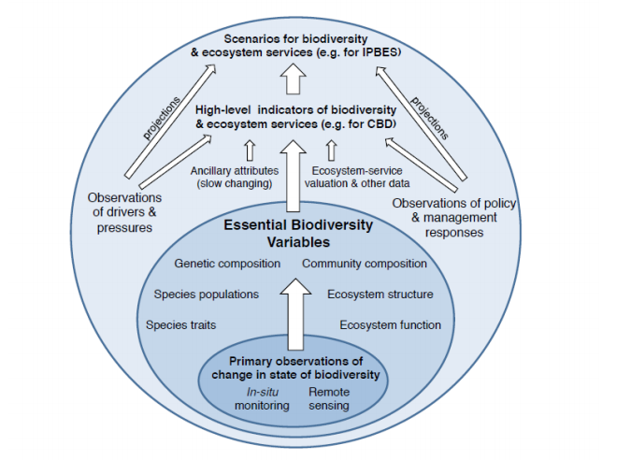
Summary

Slide 17
Interoperability Implications

Slide 18
Interoperability
Aspect | Standards Status | Deficiencies/ Tasks
Syntactic | Emphatically Yes | Penetration/ Implementations
Schematic | Yes | Penetration/ Translations Content Standards
Semantic | Partly Existing | Patchy/ Major Work to be Done Conceptual Models

Slide 19
Streamlined data flow, end-to-end
GEOSS &
GEO BON
Registries
Specimen
Obser-
vation
Occurrence
Analysable dataset
Processing service-1
Taxonomy
Individual
Plot
Eco-logiical
Analysable dataset
Processing service-2
EBV-1
Measurement
Indicator-1
EBV-2
Remote sensing
Indicator-2
EBV-x
Scenarios
Geo-spatial
Analysable dataset
In Situ
Processing service-3
Spatial data
Surveys
Eco-System Services
Analysable dataset
Other inputs
National
Statistics
Notes:
INTEROPERABILITY NEED

Slide 20
Typical EBV Details
EBV Class | EBV
Genetic Composition | Allelic Diversity for Selected Species
 | Breed and Variety Diversity
Species Populations and Ranges | Abundances for a selected set of species
 | Distributions for a representative set of species
Species traits | Phenology of selected functional groups
 | Body Mass for Selected Species
Community Composition and Interaction | Overall taxonomic diversity for selected locations
 | Species interactions
Ecosystem Extent and Structure | Ecosystem extent and fragmentation for a range of ecosystems
 | Ecosystem structure
Ecosystem function and processes | Net primary productivity
 | Nutrient retention
Notes:
Presumably the narrative for this slide would be something like “Initially, groups should focus their Use Case efforts on identifying those observations, data-sources, and models that can yield insights into the EBV’s such as these…”
WE HAVE TO REVERSE ENGINEER THESE

Slide 21
Generic Data Families
Spatial Coverage
XYZ
Temporal Coverage
Semantic/ Ontological Coverage
P: Phenomenon
mostly physical or aggregate biological
Tx: Species (with some extensions)
Al: Allele/ Genome/ Phylogenetic
Each unique combination of these, supported by a vocabulary/ ontology is a generic data family

Slide 22
Some Generic Data Standards and Interoperability Requirements
XYZ, t, P
NetCDF
NetCDF
Multi-dimensional
Traditional Spatial
XY, t, P
S-DB
WxS
Signals
XYZ, t, P/ B
O&M
SOS
Ecosystem
XYZ, t, P/ B
MetaCat
CSV
XYZ, T, Tx
GBIF Index
DwC
Occurrence
XYZ, T, Al
GenBank
FTP/ ASN.1
Genome

Slide 23
Some Generic Data Standards and Interoperability Requirements
XYZ, t, P
NetCDF
NetCDF
Multi-dimensional
Traditional Spatial
XY, t, P
S-DB
WxS
Signals
XYZ, t, P/ B
O&M
SOS
Ecosystem
XYZ, t, P/ B
MetaCat
CSV
XYZ, T, Tx
GBIF Index
DwC
Occurrence
XYZ, T, Al
GenBank
FTP/ ASN.1
Genome

Slide 24
Meta-Data Landscape
ISO 19115/p2
EML
FGDC
OPeNDAP/
NetCDF/ HDF-5
Dublin Core
DwC

Slide 25
Main Components
Data
“Bind”
Visualise
Data
Analysis
Mediator
“Publish”
www
www
Process
Meta-Data
Discovery
Assess
Meta-Data
“Find”

Slide 26
2015

Slide 27
Populating a Framework
Essential Biodiversity Variables, Data Families,…
Organisations, Initiatives, Projects, …
Community Standards, Practices, Ontologies …

Slide 28
Framework Example
EBV Class | EBV | Data Family | Typical Source | Meta-Data | Data Services
Genetic Composition | Allelic Diversity for Selected Species
 | Breed and Variety Diversity
Species Populations and Ranges | Abundances for a selected set of species | XYZ, t, Tx, P | GBIF, … | DwC | DwC+
 | Distributions for a representative set of species |  |  | DwC | DwC/ ABCD
Species traits | Phenology of selected functional groups |  |  |  | DwC+
 | Body Mass for Selected Species
Community Composition and Interaction | Overall taxonomic diversity for selected locations
 | Species interactions
Ecosystem Extent and Structure | Ecosystem extent and fragmentation for a range of ecosystems
 | Ecosystem structure
Ecosystem function and processes | Net primary productivity
 | Nutrient retention
Across all WGs
Comprehensive review of gaps and overlaps

Slide 29
Prioritised, consolidated deliverables
Registry interoperability:
GBIF Registry,
EU BON /GEOSS registry/ broker,
BioVeL Biodiversity (Services) Catalogue,
DataONE/KNB/LTER
Data index and data services:
GBIF
TDWG Extensions
Data provider tools:
GBIF, EU BON, DataONE
GEO SBA Sources
Modelling web services:
WG7 Test Case
BioVeL Services Catalogue
AIP-6 to test the end-to-end use case
SAEON/ SAEOSS Shared Platform
Helpdesk and tech support:
EU BON,
GBIF capacity building
Best practice
Recommendations on use of standards
Handbook Chapter
Notes:
PILOT PROJECTS

Slide 30
Additional Ideas
WG 7 collaboration
Joint engagement with other WGs
Engagement with TDWG:
DwC Extensions for abundance
Unique identifiers for sampling
Repository of human-readable protocols with DOI
Rank order abundance
Protocol for Citizen Science and Crowdsourcing: each WG?
Indicator Definition Standard
Interoperable services
DwC and DwC+: Separation of ‘Manifest’ and ‘Payload’ ?

Slide 31
Challenges and Issues
Integration with GCI and GEOSS Registry/ Broker
Each generic family of data requires a controlled vocabulary/ ontology
Funding and champions for missing components after 2015

Slide 32
Communications to make this happen
We need to have a technical liaison on each WG.
Vice versa, WG8 will assign a contact person for each WG.
Every WG needs to maintain a document describing their inputs, standards used, system components, and service interfaces.
Intelligence of collaborations between cyberinfrastructure projects
Best practice recommendations to all WGs

Slide 33
Thanks!

Slide 34
Notes

Slide 35
WG 8 Questions
Publish a cycle
and an initial ‘standards’ guidance.

Slide 36
WG7
Now 3 deliverables
Specific Use Case based on on of these?
Funding prospectus – 5-6 pages

Slide 37
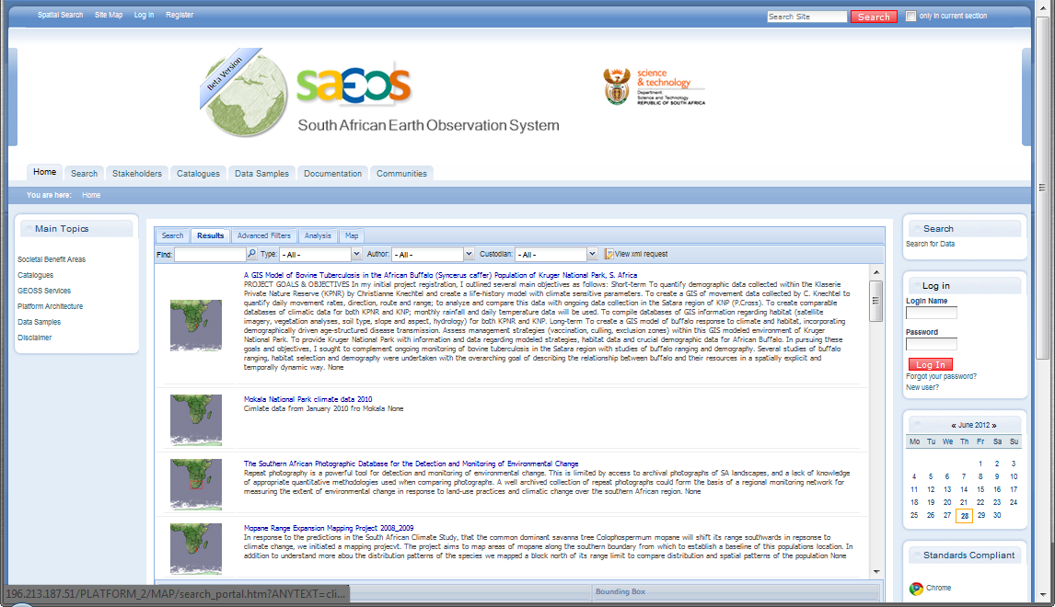
Typical Search Result (CLIMATE)
Summary Meta-Data

Slide 38
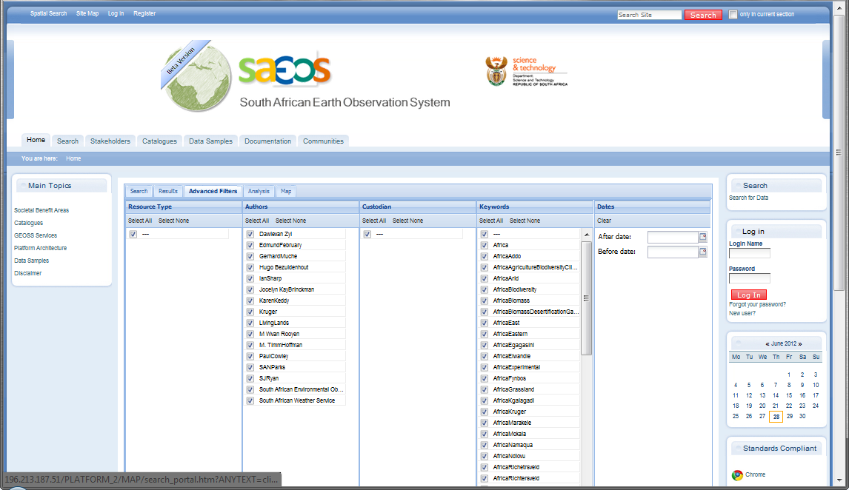
FILTERING SEARCH RESULTS
Filter by Author, Custodian, Date, etc.

Slide 39
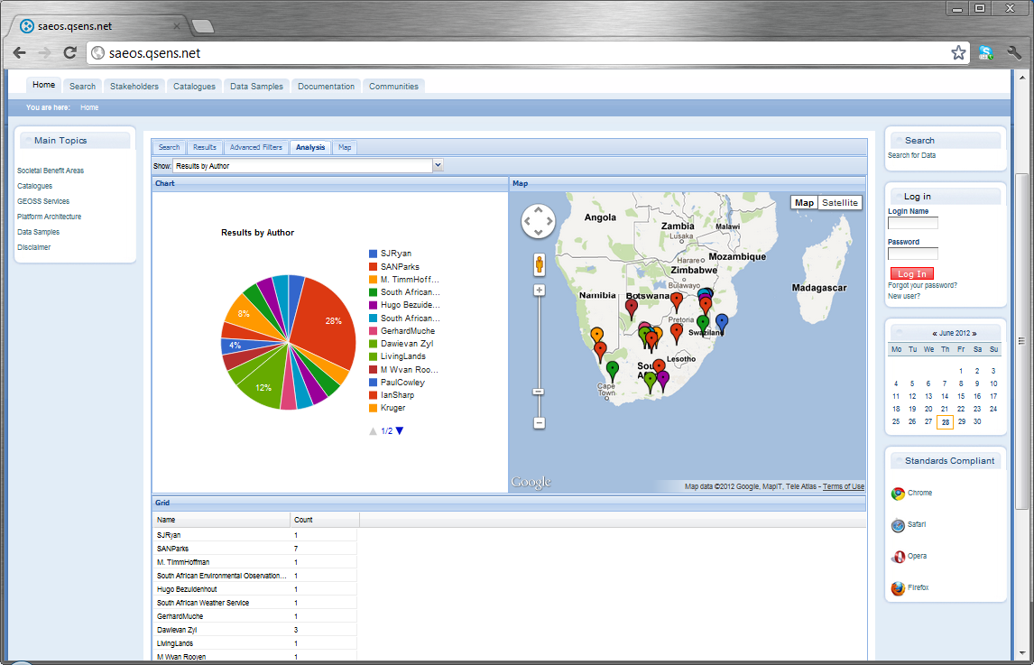
Search Result Analysis
Analysing Search Results

Slide 40
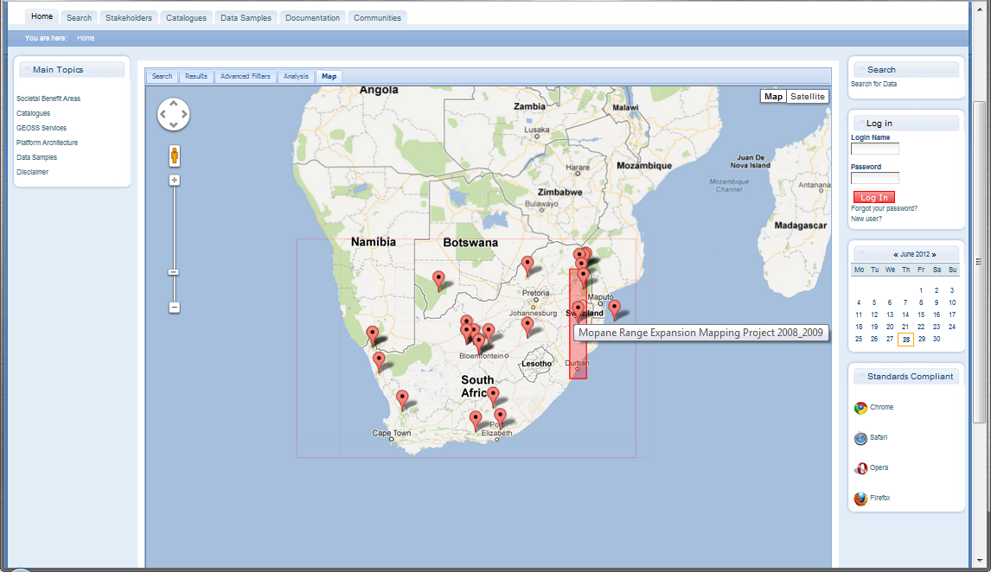
Spatial Coverage of Search Results
Analysing Search Results
Click to see detail

Slide 41
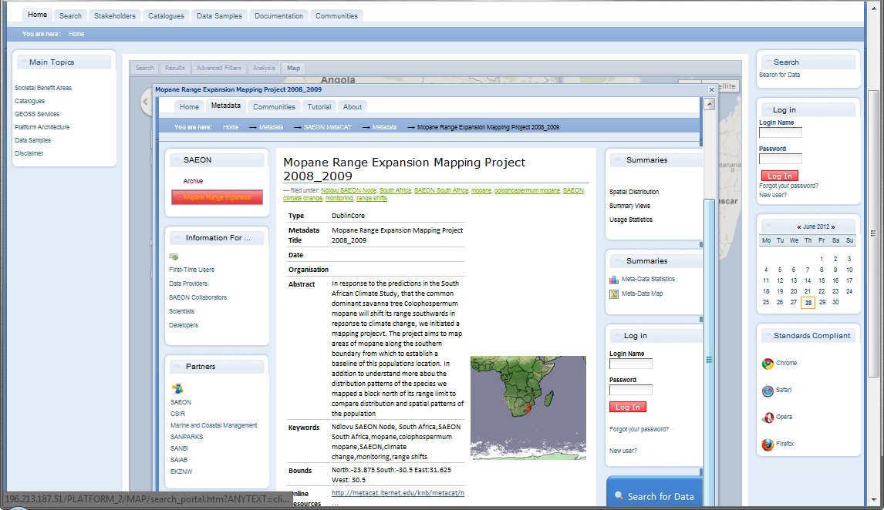
DetAILED META-DATA

Slide 42
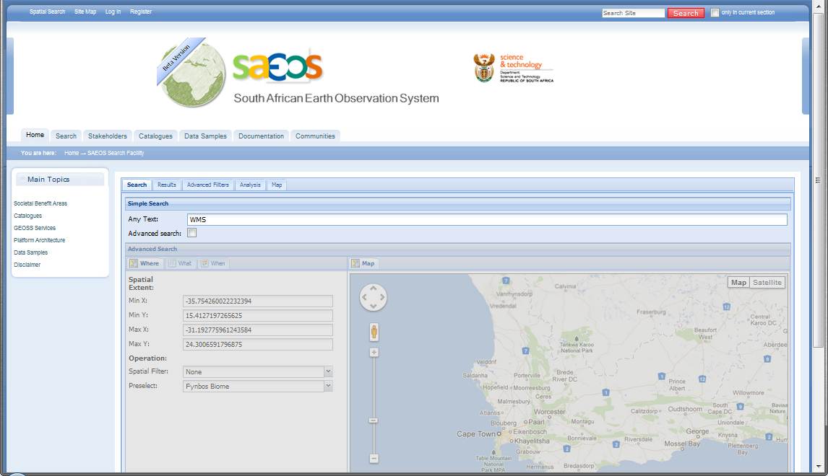
SEARCH FOR WEB MAP SERVICES
WMS

Slide 43
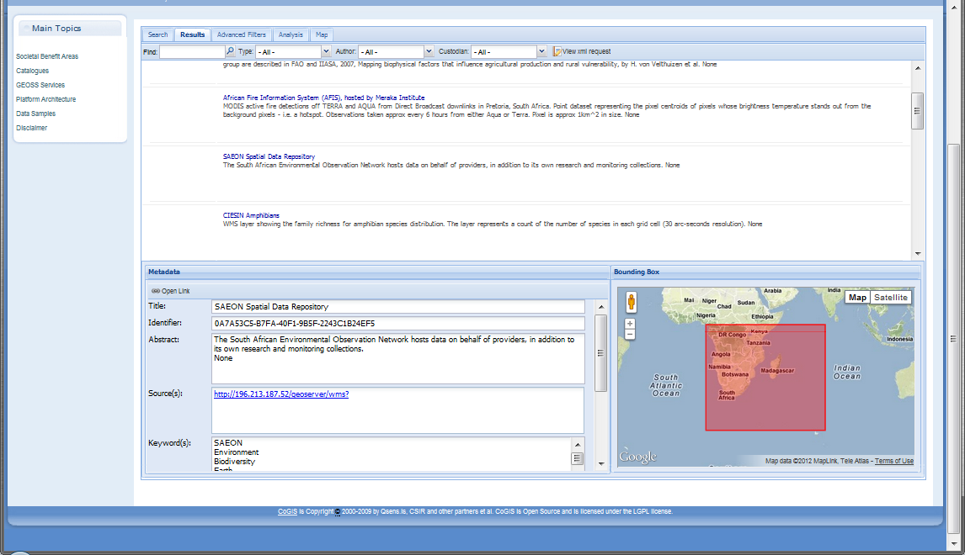
SPATIAL DATA SERVICES
Click to see detail
Click to see detail

Slide 44
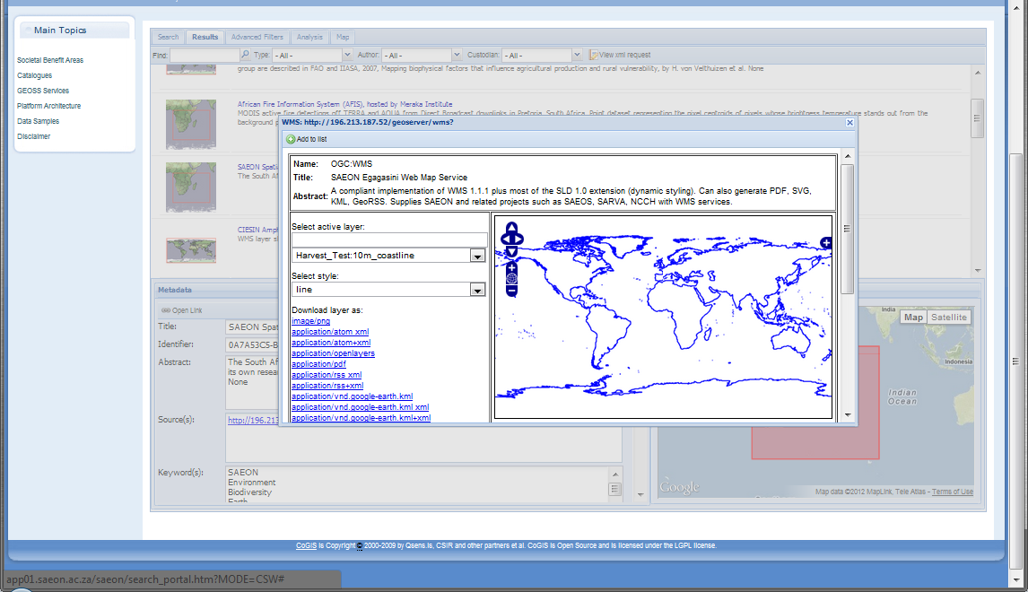
PREVIEW OR DOWNLOAD
Layers available from service
Download formats and options

Slide 45
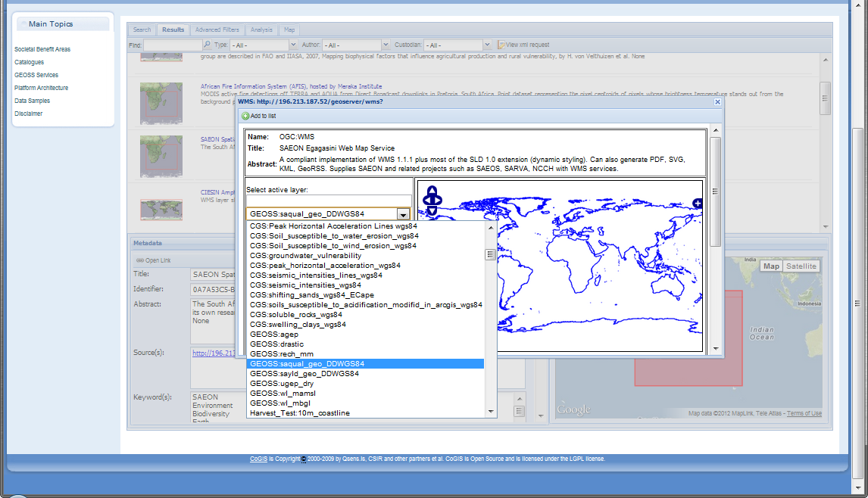
Select appropriate layer

Slide 46
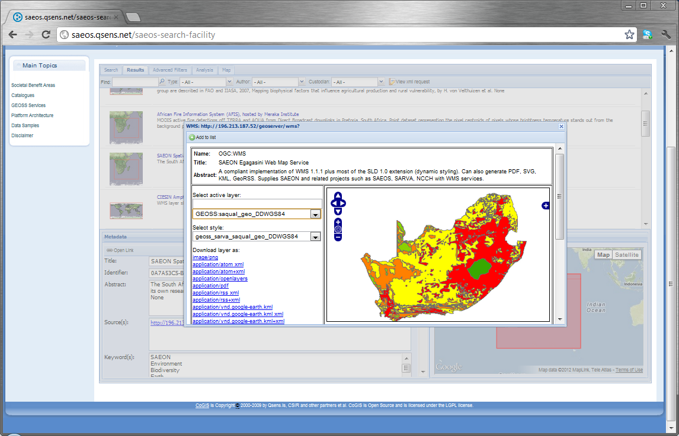
Multiple layers/ RASTERS in same service
Note alternative styles

Slide 47
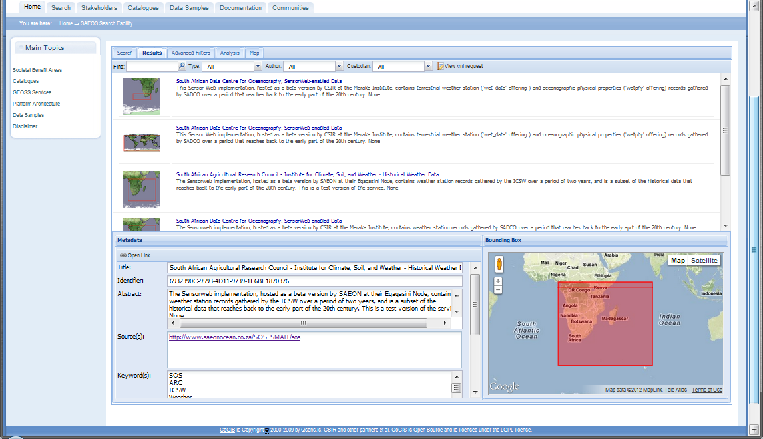
Sensor OBSERVATION SERVICES
Click to see detail
Click to see detail

Slide 48
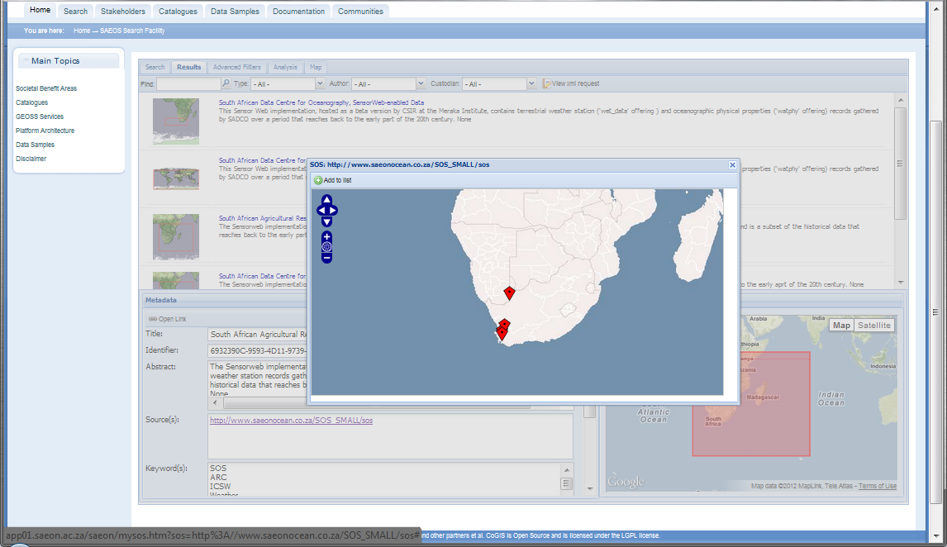
OBSERVED FEATURES ARE SHOWN
Location of sensors

Slide 49
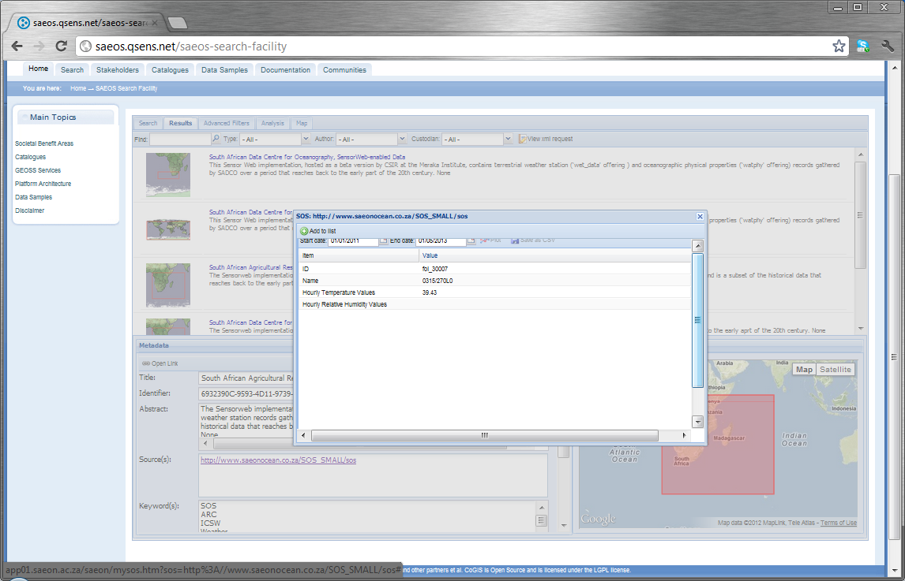
CLICK A FEATURE …
Latest values for observed phenomena

Slide 50
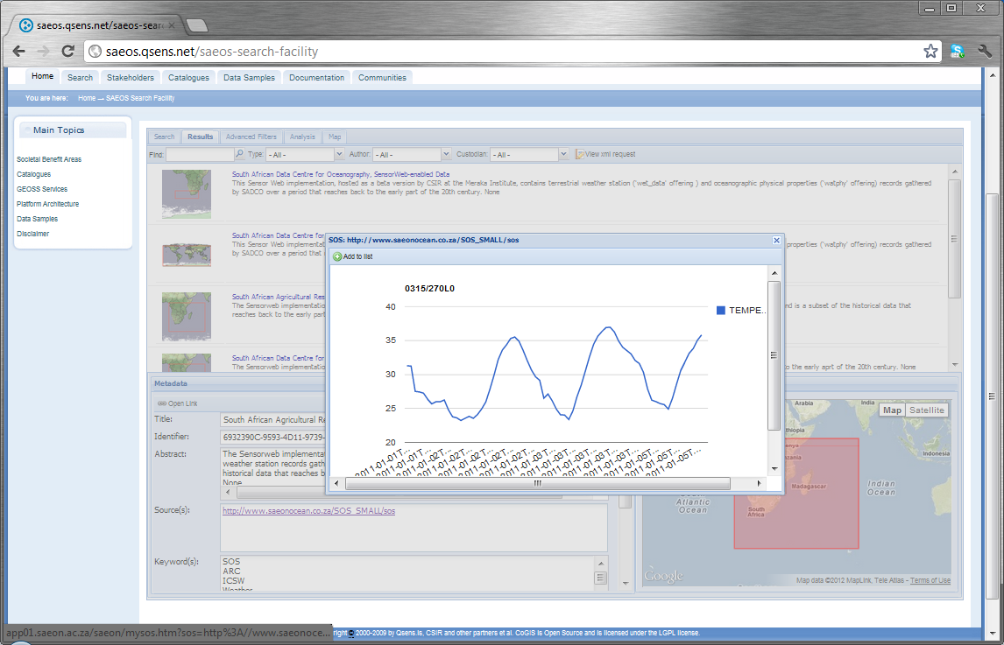
TIME SERIES DATA
Select start and end dates

Slide 51
Examples: Interoperability
Distributed WxS in OpenLayers Client
Distributed WxS, KML, and GeoRSS in OpenLayers Client
Persist distributed WxS plus others as WCD
SHP/ Raster to SQL/ WxS/ SLD
CS/W Request as Dublin Core
CS/W Request as JSON/Atom to Search Result Presentation
CS/W Request as GeoRSS to OpenLayers Client
CS/W Request integrated with OpenLayers Client
CS/W Request integrated with Desktop Client
Search GUI to any CS/W endpoint
Search GUI to OAI-PMH endpoint
EuroGEOSS Broker Return to Search Presentation
CS/W Request to EuroGEOSS Broker
SOS in Extended OpenLayers Client
NetCDF in Extended OpenLayers Client
HDF-4 in Extended OpenLayers Client
Distributed WFS, NetCDF, and SOS to Charting Services (Google Charts)+ mediation
Citizen Science Module to WFS
Citizen Science to EML and ISO 19115
WPS in Scientific Workflow + mediation

Slide 52
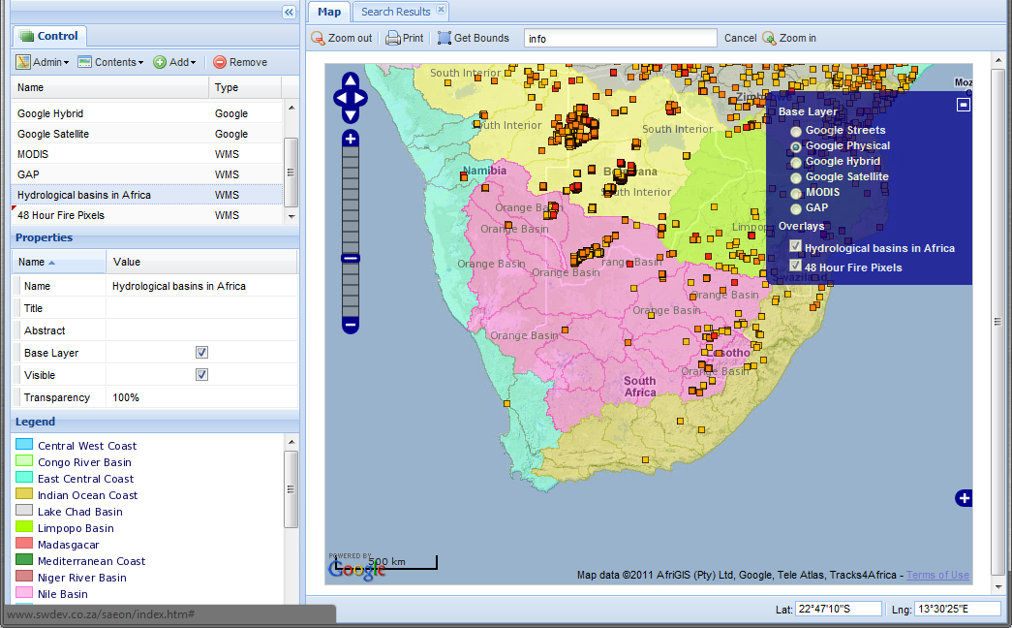
Multiple WxS Sources
FAO,
Rome, WMS
Meraka Institute, Pretoria, SA, WMS

Slide 53
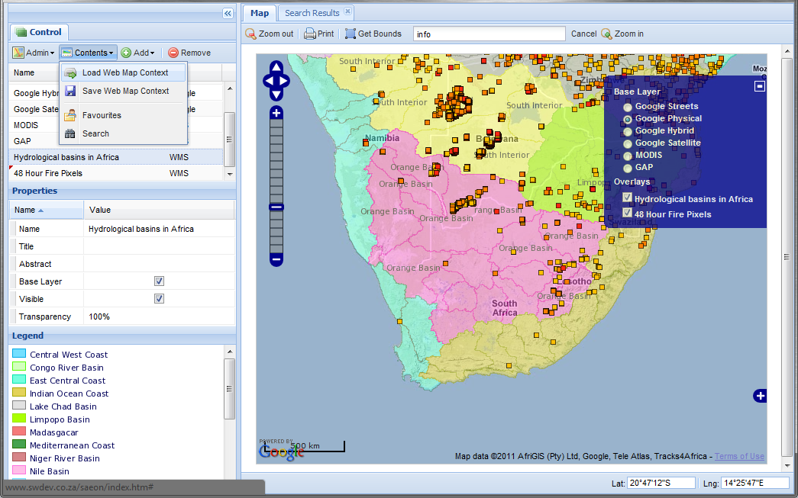
Persist Web Context Documents
Load from server storage
List of WCDs

Slide 54
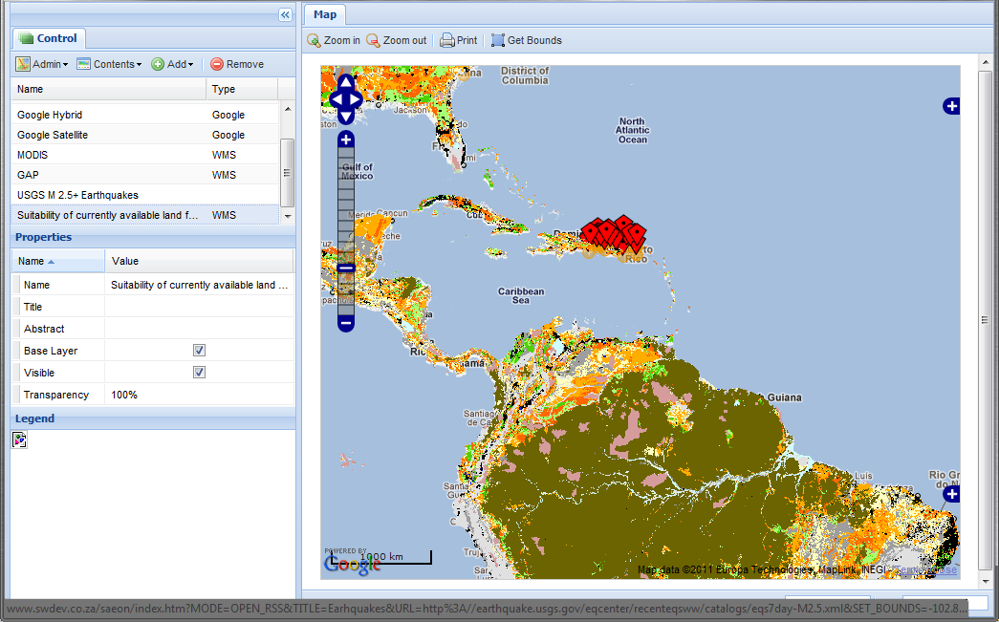
Support Multiple Data Standards
GeoRSS
WxS
Also: KML, NetCDF, HDF-4, SOS

Slide 55
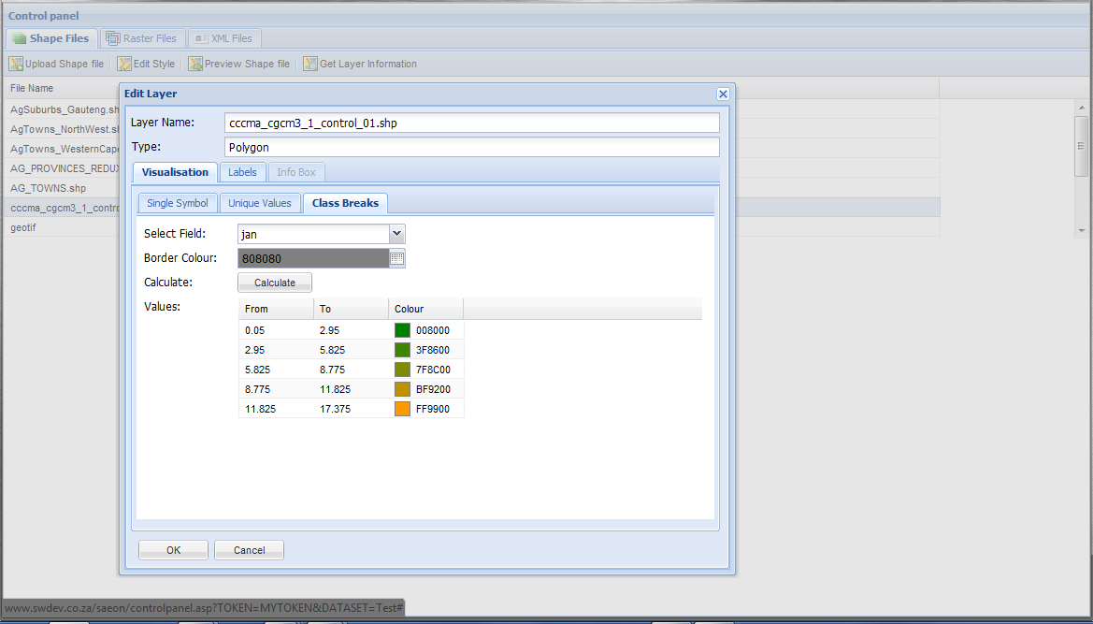
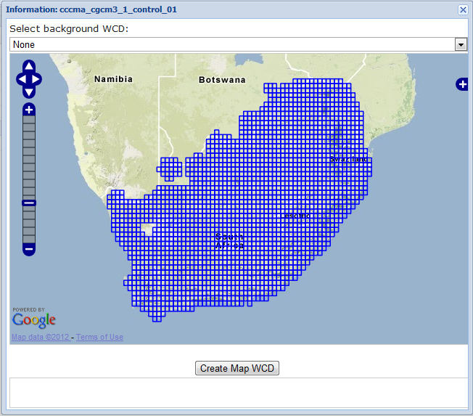
Data Upload, Styling, and Publication

Slide 56
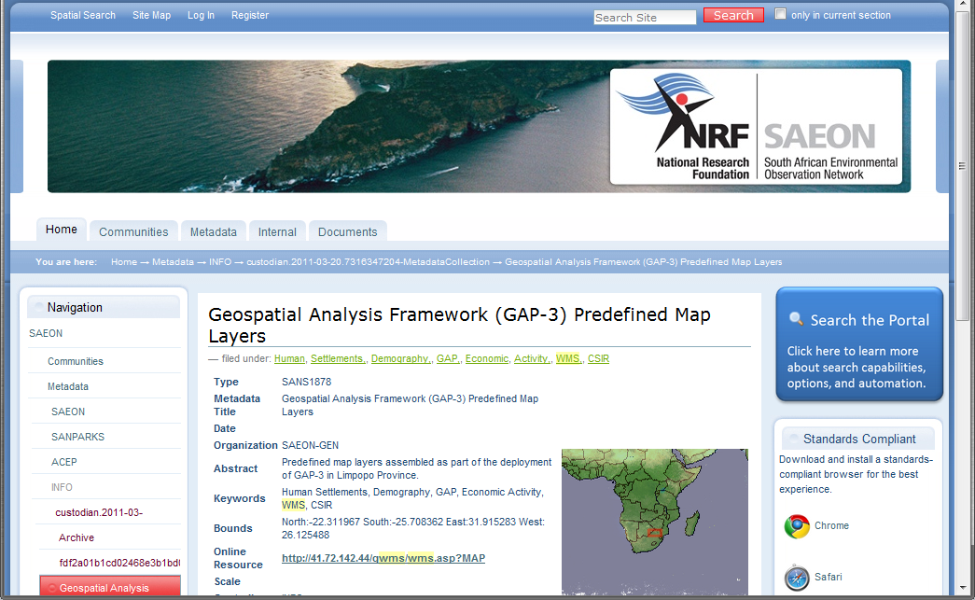
Meta-Data Repository
Multiple Standards
Multiple Custodians
Meta-Data Entry

Slide 57
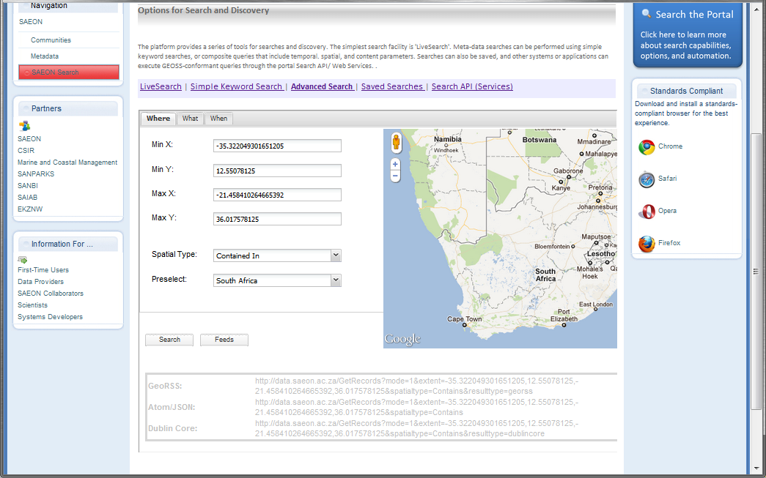
Search Interface and Result Formats
Meta-Data Entry
Multiple Formats

Slide 58
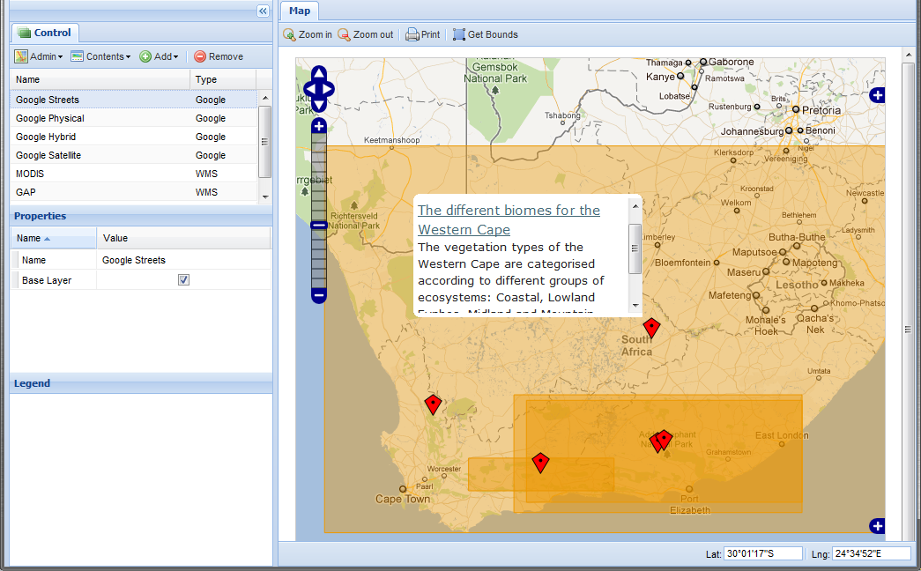
GeoRSS SEARCH Piped to Map Client

Slide 59
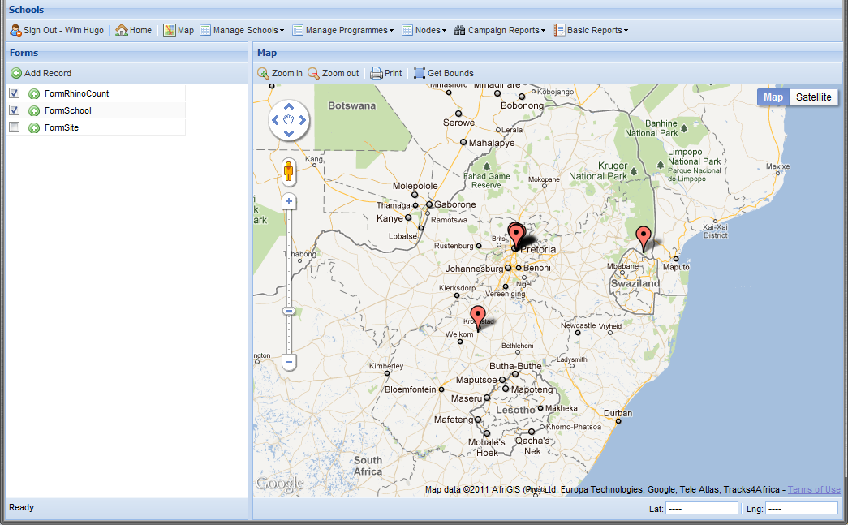
Non-Spatial Representations of Data
Data captured by Schools Program directly to WFS
Mediated HTTP calls to Google Charts

Slide 60
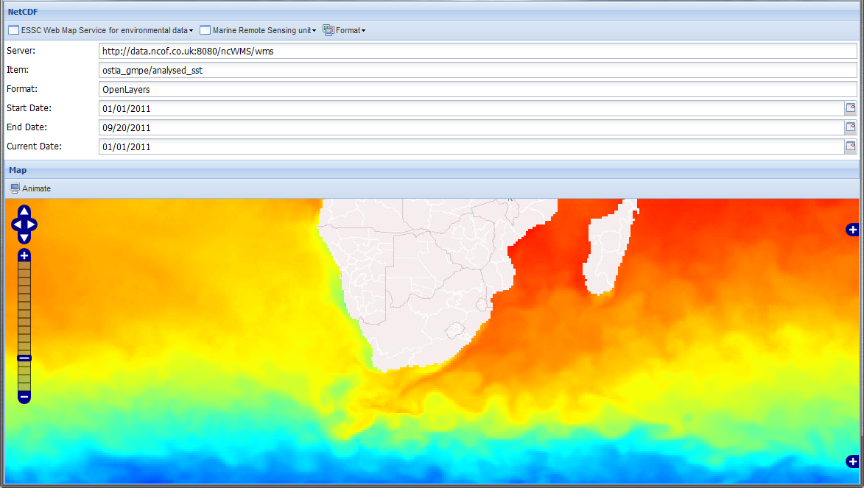
NetCDF Integration

Slide 61
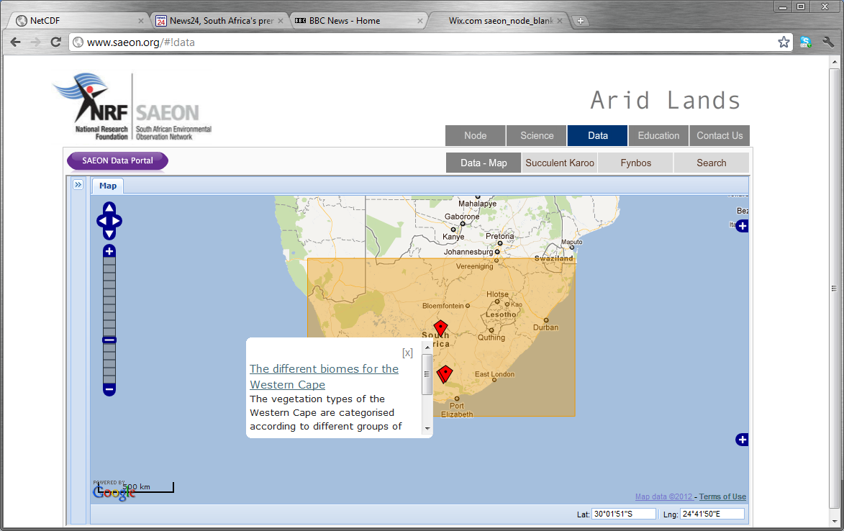
Embedding in Other Platforms

