Slide 1
GeoBON Workgroup 9 Some Thoughts on Indicators and Integration with WG8
“All Hands” meeting – Asilomar
December 3rd, 2012
Wim Hugo, SAEON

Slide 2
Goals
Allow re-usable services to be combined in a number of configurations to support indicator discovery, definition, visualisation, and subsequent action.
Allow the role of modelling and automation to be constructively defined in support of actions and decisions based on observation science.
Allow service standards that are well established to form the basis of a set of Indicator Definition Standards

Slide 3
Outcomes
Globally directed Targets only have to be published once (MDG, CBP, …), and can be re-used many times in many indicators at many scales.
Observations can easily include data streams from outside the organisation, data does not have to be duplicated. Same applies to Events and Limits.
Standard treatment of Context – allowing comparisons, baselines, external information, etc. to be collated.
Persistence (i.e. storage) of Indicators – allowing re-use at different scales and coverages (different temporal, spatial, and semantic coverages).
Growth of a family of client applications that allows a rich suite of visualisation tools for indicators to be available, based on a common interface for indicator definition.
Emergence of Publish and Subscribe services in respect of Alerts and Escalation.

Slide 4
Elements of Indicators
Measured variables/ observations – the Indicator
Place these into Context – or orientation
No decision without a Target or a Goal and Limits
Decisions mean little without Action
Target/ Limits
All or any of these can be based on a model
Actual
Models can be simple (statistical values, filtered values) or complex.
Decision
Context

Slide 5
Modified OODA Loop
Monitoring and Evaluation Process Model
Observe
Orient
Decide
Act
M&E Application
Indicators
(Observations)
(Measures)
Context
(Events)
(Baselines)
(Comparisons)
Goals
(Targets)
Decision Support
(Limits)
(Escalation)
(Alternatives)
Modelled Values
(Simulation)
(Extra/ Interpolation)
(Selection/ Aggregation)
Based on concepts developed by John Boyd: http://en.wikipedia.org/wiki/OODA_loop

Slide 6
Services
GetCapabilities
Lists the indicator services available from a given endpoint
IndicatorDefinition
Meta-data
Author, Title, Organisation, Abstract, Publication Date, …
IndicatorService(s)
WxS, SOS, NetDCF-HDF, EcoGRID, GBIF, …
PLUS Generic Service for all other sources
IndicatorSpecification
See overleaf
AlertService
Invoke if observed values, or a function using elements as arguments (observation, target, …) exceeds a limit

Slide 7
Need for an Indicator Specification Standard
Allows specification of each indicator element (observation, context, target, …)
Allows coverage to be defined (temporal, spatial, ontological, …)
Allows distributed resources to be combined in an indicator definition
Allows limits, themes, and alerts to be defined
Allows presentation styles and aggregation decisions to be persisted
Candidates:
OGC Web Context Document – extend
New standard (Indicator Definition, Indicator Data Service)

Slide 8
Clients
Standardised clients can read indicator definitions and render as composite charts, tables, maps, with animations and data download capabilities.
Clients can be (but need not be) based on standardised components (Google Charts, OpenLayers, InfoVis, …)

Slide 9
Standards
OGC Sensorweb Enablement Specifications – many synergies and could be re-used or extended.
OGC Web Context Document Specifications – can be extended to define and specify indicators.

Slide 10
Example
Chart View

Slide 11
Example: Presentation
The majority of indicators will probably be presented with the Cycle (Time) dimension as the category axis.

Slide 12
Example: Presentation
In many cases, a second dimension (such as Locality (Provinces) or Instrument) will be used to provide an aggregate view with some stratification or additional context.
In many cases, a second dimension (such as locality, taxonomy, or Instrument) will be used to provide an aggregate view with some stratification or additional context.

Slide 13
Example: Presentation
Baseline
The Baseline provides context w.r.t. historical performance or a minimum level of performance. It is usually independent of dimensions such as time

Slide 14
Example: Presentation
The Target, on the other hand, could change with time (and possibly with other dimensions)
Baseline
Target

Slide 15
Example: Presentation
Baseline
Target
Event
Events may explain sudden changes in performance or targets, or both.

Slide 16
Example: Presentation
Additional context may be required – such as an assessment of performance of peers, a globalaverage, etc.
Baseline
Target
Event
Context

Slide 17
Example: Presentation
Exceptional
Acceptable
Actionable
Baseline
Target
Event
Context
Limits and Alerts provide immediate judgment or decision support on performance

Slide 18
Towards a Standard
Technical View

Slide 19
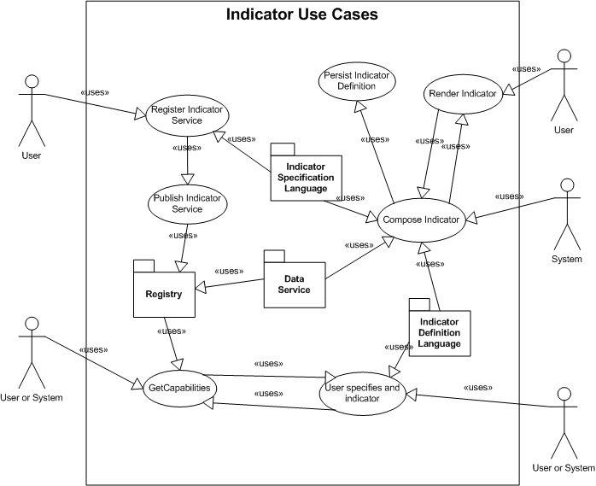
Workflow

Slide 20
Conceptual Model: Indicator
idl: indicator
idl: metadata
dc: contributor
dc: title
dc: abstract
dc: pubdate
dc: creator
isl: indicatordef
isl: role
isl: source
+
isl: indicatordef
isl: presentation
+
isl: indicatordef
isl coverage
+
isl: aggegation
+

