Slide 1

SAEON Data Portal Revision
SRS 336.3.14.1
Wim Hugo, September 2010

Slide 2
Rationale
Current portal layout reflects functional capabilities for acceptance tests and is not aimed at any specific user community.
Redesign needs to focus on three specific user communities
  SAEON Data Managers
  Communities of Practice
  Casual or General Users
Technical functions need to be de-emphasised and made accessible only to administrative users.
Specific enhancements in terms of search interfaces, meta-data presentation and data download facilities are required ⁽¹⁾.
(1) Work has been completed on improved data download and search interface functions – user interfaces to be confirmed. Meta-data presentation will require RFP and subcontracted development.

Slide 3
Design Considerations
A portfolio of data-driven template pages have been developed for node web site creation.
These pages integrate seamlessly in the corporate and data portals and should be used maximally for any new data portal content.
Page types are
  Multiple Topic Page (can rotate between topics if needed)
  Single Topic Page
  Multiple Listing Page (can be linked to portal services)
Sites such as GBIF and NBII were used as examples of site structure and content.
Page design (styles) need to be toned down – see Alternative 2 for an example.

Slide 4
Adjusted Site Layout

Slide 5
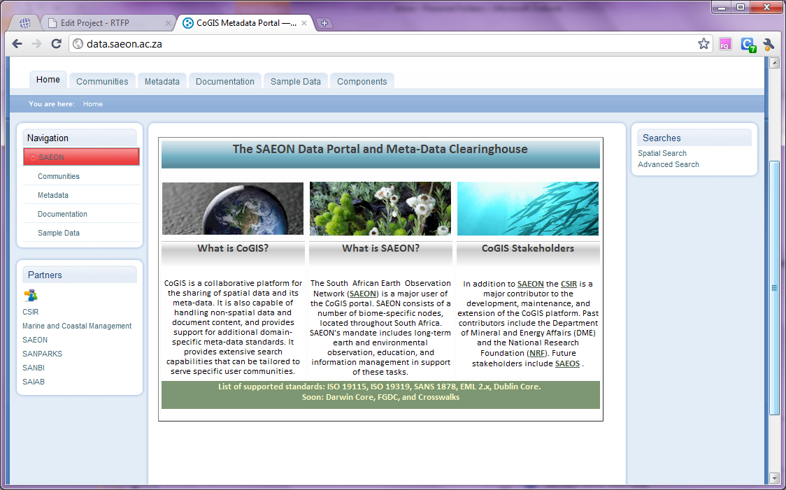
Existing Landing Page
B: This portlet will remain, with improved tooltips.
A: Replace with a custom portlet that links to important topics.
C: Reserve for static pages, such as documentation and tutorials, API information . Etc.
D: Change the home content page to link to immediate benefits for casual users.
E: Continue to use for important search actions, but extend to add more tailor-made results too. Add actions.

Slide 6
Revised High-Level Site Map
Home Page
About
Tutorials
Meta-Data
Tools
Themes
Predefined Searches/ Simple Search
Summary Search Result (List)
Harvesters
Meta-Data Repositories
Content Tools and Uploads
Advanced Search Page
External Meta-Data Sources
Meta-Data Listings
Single Theme Page
Detailed Meta-Data View
Summary Search Result (List)
Data Preview
Meta-Data Management
External Site Links
Bold Outline: Available to All Users

Slide 7
Revised Portlets: (A) Navigation
Portal Use Instructions
This should be close at hand and prominently displayed
Should be aimed at specific user roles
First-time users need to be introduced to the benefits of registration
Data providers need to understand how their typical concerns will be addressed
Scientists need to know how to search for data and obtain it
Systems developers need to know how to link to the portal and automate its functions
Information for …
First-Time Users
Data Providers and Custodians
SAEON Collaborators
Scientists
Systems Developers
All portlet entries must be supplied with a fairly comprehensive tooltip – say 100-150 words. Mouse-over must provide an immediate sense of what’s to follow

Slide 8
Revised Portlets: (B) Partners
Links to Partner Sites
Names of major Co-Sponsors
Names of Node host organisations
Major initiatives too?
  SADCO
  ASCLME
  Etc…
List to be confirmed by SIMSC
Sites open in a new window
Partners
CSIR
DEA Coasts and Oceans
SANPARKS
SANBI
EKZN Wildlife
SAIAB
SADCO
All portlet entries must be supplied with a fairly comprehensive tooltip – say 100-150 words. Mouse-over must provide an immediate sense of what’s to follow

Slide 9
Revised Tabs: (C) Alternative Views
Themes
Tutorials
Alternative Tab Views
Meta-Data
Tools
About
Each should contain a custom landing page similar in design to the home page.
These are alternative views of the portal and are not all visible to all users (see User Roles later in the document).
Home: standard landing page (All users).
Themes: links to and discussion of important data collections by theme (All users).
Meta-Data: A summary of meta-data holdings and links to individual repositories (Logged in users).
Tutorials: a series of how-to slide shows or videos (All users).
Tools: a series of tools and tutorials to assist content providers with their tasks (Logged in users that are content providers). Includes
  Creating and using predefined searches,
  Creating and embedding pages from templates,
  Creating maps,
  Creating tables and charts,
  Creating campaigns and capturing data directly to the SAEON spatial data repository.
About: A roadmap on future development, non-technical overview of architecture, summaries of guidelines on meta-data management, data formats, SAEON data policy, etc.

Slide 10

Revised Landing Pages: (D.1) Home
Finding data is the most likely use for the majority of visitors, hence the home page should concentrate on that aspect..
These links can rotate slowly through lists of predefined searches together with a linked image.
Welcome to the SAEON Data Portal
Enter a keyword for a quick search:
The SAEON Data Portal provides access to data through a meta-data repository aggregated from collaborators, partners, and linked sites. We currently house 15,617 meta-data records from 17 providers.
Find data by Region
Find data by Biome
Find data by Data Set
Click here to search for data in a given region. Predefined results are available for South African Provinces, sub-Saharan Africa, and the main ocean regions around Southern Africa.
SAEON assembles data for long term preservation and is structured into biome-specific nodes. Click here to find data sets for each individual biome.
The SAEON Data Portal assembles data from a large number of providers and networked organisations. Click here to find specific contributions.
See data for: Limpopo Province
See data for: Fynbos Biome
Latest: SANHO
The SAEON Data Portal supports a range of popular meta-data standards, and allows searches across multiple standards. We currently support EML 2.1.x, SANS 1878, ISO 19115/19319, Dublin Core, and FGDC. Extensions to follow: Darwin Core

Slide 11
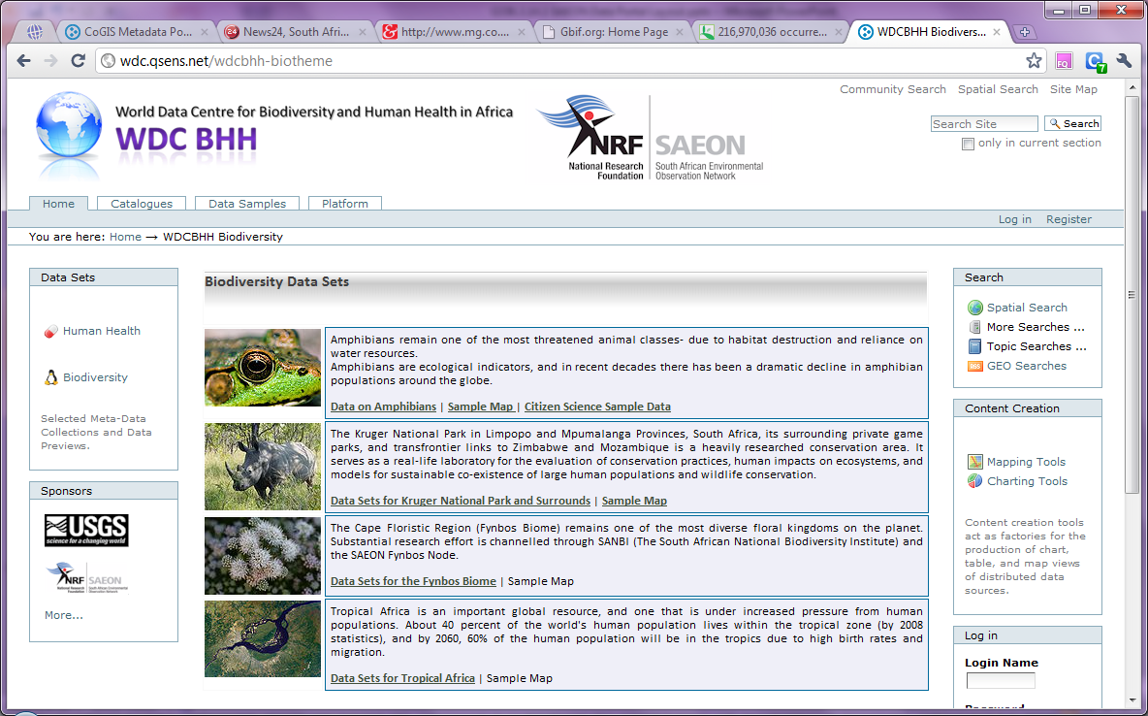
Revised Landing Pages: (D.2) Themes
SAEON can showcase themes and point out important data sets this way. Can link to node project pages – see examples later on. This is value addition: leading users to specific data sets that are more important
Important SAEON Themes and Initiatives
These are examples only and content must be provided by node data managers and personnel. The content can be served from data - making updates simpler and in some cases automatic.

Slide 12

Revised Landing Pages: (D.3) Tutorials
For most users, the initial tutorial should probably focus on search capabilities. We can place all our slideshows and tutorials on YouTube (or similar) as videos.
How to …
:
… Search for Data in the SAEON Data Portal
Other Tutorials
Benefits of Registration
Uploading Data and Linking to Meta-Data
Guidance for Data Providers
Creating Good Meta-Data
SAEON Data Policy
..etc.
The SAEON Data Portal supports a range of popular meta-data standards, and allows searches across multiple standards. We currently support EML 2.1.x, SANS 1878, ISO 19115/19319, Dublin Core, and FGDC. Extensions to follow: Darwin Core

Slide 13
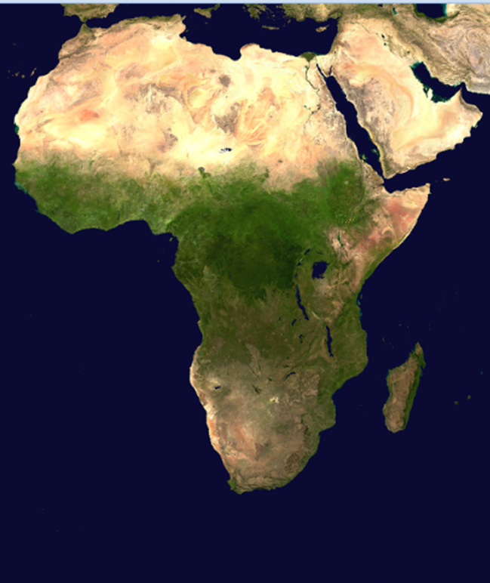
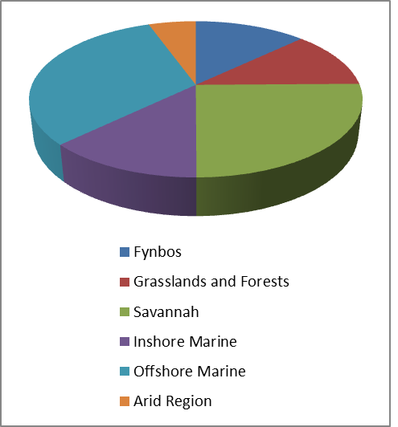
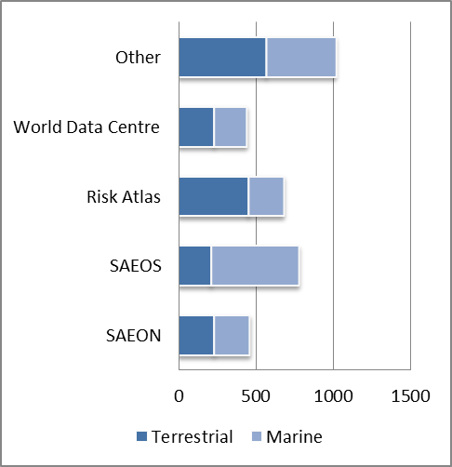
Revised Landing Pages: (D.4) Meta-Data
Meta-data statistics are of interest to sponsors and providers too. We can add metrics from site usage data
The SAEON Meta-Data Repository
The SAEON Data Portal provides access to data through a meta-data repository aggregated from collaborators, partners, and linked sites. We currently house 15,617 meta-data records from 17 providers. The repository covers the whole of sub-Saharan Africa and surrounding ocean regions, with particular emphasis on Southern Africa.
Meta-Data By Region
Meta-Data by Biome
Meta-Data by Initiative
214
212
874
457
145
The SAEON Data Portal maintains a meta-data repository that is shared between different initiatives. All initiatives contribute to the same meta-data repository and contributions are mutually searchable. Click here to view individual repositories.

Slide 14


Revised Landing Pages: (D.5) Tools
This is only available to users marked as content providers. The purpose is to provide tools and examples so that content providers can compose maps, charts, and tables using data sources available in the portal, and are able to embed these resources in template-based pages.
Content Provision Toolkits
The SAEON Data Portal provides toolkits for the creation of content: maps, charts, tables, and pages based on templates. The maps, charts, pages, and tables can be linked to live data sets. Read more about the Application programming Interfaces available to do so through GeoRSS and ATOM/ JSON.
Creating Maps
Charts and Tables
Content Pages
Users can create maps in a variety of ways:
Start with a predefined backdrop and add to it:
Search for map data and build on it:
Preview a Web Map Service
Test Online Map Services
Users can create tables and charts from Web Feature Services.
View Web Feature Data Services
Example: Create a Chart
Example: Create a Table
Example: Create a Motion Chart
Content pages can easily be made from data-driven sources..
A single theme page
A listing page
Creating portlets
Data-driven APIs:
GeoRSS and Atom/ JSON
The SAEON Data Portal also provides a Data Capturing facility that can be used to capture field data in a user-definable, map-based interface. This facility can be used for Citizen Science projects.

Slide 15
Revised Landing Pages: (D.6) Documentation
These documents are designed to assist users and providers and are supplementary to the tutorials.
Useful Documents
Creating Quality Meta-Data
Guidance for meta-data providers. Read about using controlled vocabularies, the minimum content of a meta-data record, the standards that are available and what they’re good for, and which software to use if you want to create your own meta-data repository. Conventions and suggestions about good practices in respect of meta-data provision.
Managing Data and Data Collections
Guidance for data providers. Options in respect of data formats, what to use for specific domains and types of data, appropriate software, conventions, and discussion of the SAEON Data Policy. How to provide additional terms and conditions.
Portal RoadMap
Guidance for systems developers and integrators. A discussion of the portal architecture, the future development programme, machine interfaces, and specifications for services and portal tools.
Etc …

Slide 16
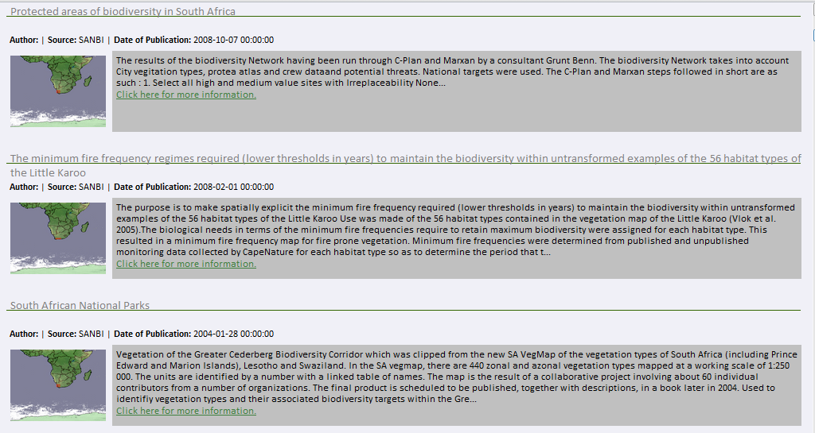
Revised Search Results: Meta-Data Listings
Listings need to be more concise. More information can be obtained by linking to a full meta-data record. By analysing the online resources offered with each record, we can attempt to distinguish links to websites, data downloads, and/or automatable previews.
Search Result
SANBI Website | Preview | Download
Etc …

Slide 17
Revised Portlets: (E) Searches
Links to Predefined and Custom Search Tools
Custom Search (Advanced Search)
Predefined search results for a number of dimensions
These are always up to date
Links to flagship project data sets
  ASCLME and ACEP
  Tierberg
  Jonkershoek
  Etc..
Find Data
Custom Search ….
By Region
By Biome
By DataSet/ Provider
By Theme
SAEON Flagship Projects
All portlet entries must be supplied with a fairly comprehensive tooltip – say 100-150 words. Mouse-over must provide an immediate sense of what’s to follow

Slide 18
Revised Portlets: (E.1) Actions
Additional Actions Available to Logged-In Content Providers
Actions
Upload Meta-Data
Upload Data and Content
Upload Meta-Data
Upload Data and Content
All portlet entries must be supplied with a fairly comprehensive tooltip – say 100-150 words. Mouse-over must provide an immediate sense of what’s to follow

Slide 19
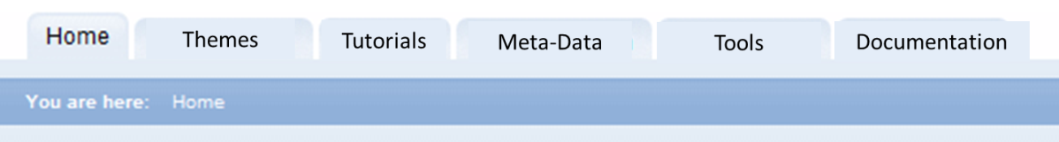
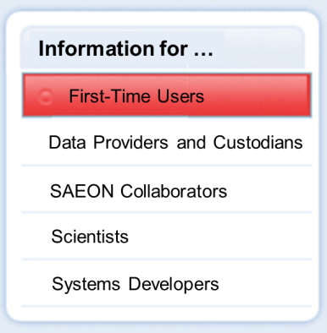
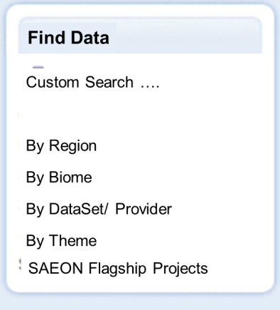
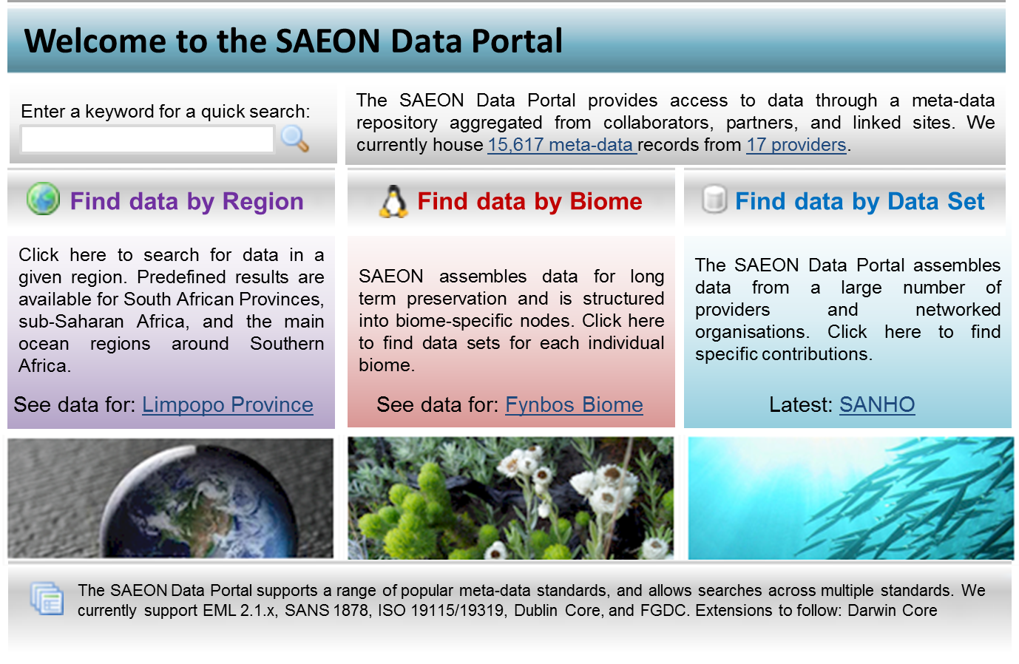
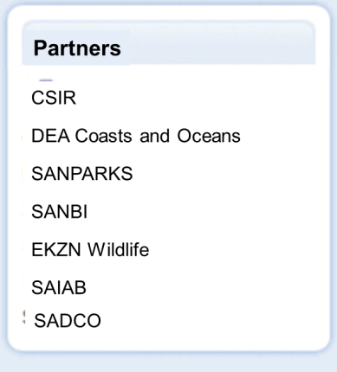
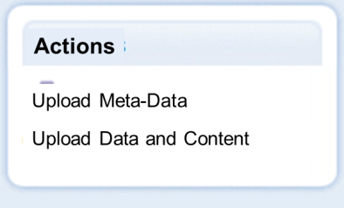
Styling: As presented above

Slide 20
Alternative Styling 1: Multiple Topic Page
This is a Heading for the Page
Topic 1
Topic 2
Topic 1 Body.
Tab contents are preloaded so that mouse-over and tab clicks display it instantly. One can slowly rotate between tabs if required.
This is a footer for the page

Slide 21

Alternative Styling 1: Listing Page
This is a Heading for the Page
Listing 1 Header
These entries link to portal services (search results, projects database, etc.)
Listing 2 Header
These entries link to portal services (search results, projects database, etc.)
…
This is a footer for the page

Slide 22

Alternative Styling 2: Multiple Topic Page
This is a Heading for the Page
Topic 1
Topic 2
Topic 1 Body.
Tab contents are preloaded so that mouse-over and tab clicks display it instantly. One can slowly rotate between tabs if required. Screen areas have subtle demarcations.
This is a footer for the page

Slide 23
Alternative Styling 1: Listing Page
This is a Heading for the Page
Listing 1 Header
These entries link to portal services (search results, projects database, etc.)
Listing 2 Header
These entries link to portal services (search results, projects database, etc.)
…
This is a footer for the page

Slide 24
User Roles

Slide 25
General Users
These users are the general scientific community and need not log in.
Use Cases:
  Searches for data using a graphical user interface and receives a summary meta-data listing.
  View extended meta-data records on demand.
  Download automated data sources on demand, or gain access to instructions to obtain meta-data.
  Download meta-data if required.
  View theme pages and links to important data collections, documentation, and meta-data collections. Summary views of important resources (contributors, scope of meta-data records available, etc.). See ‘Resource Pages’.

Slide 26
SAEON Collaborator
Usually a member of a ‘Community of Practice’.
Usually contributes one or more data sets and attendant meta-data records.
Typical use cases:
  Upload a data set to the portal and manually create a linked meta-data record for it.
  Upload a data set to the portal and link it to a meta-data record maintained in an operational meta-data repository.
  Maintain a meta-data record and a linked data set in a different environment and upload the meta-data record to the SAEON Data Portal.
  Maintain a meta-data record and a linked data set in a different environment and expose this to a harvester with the assistance of a SAEON Data Manager.
  Store predefined searches in Favourites for re-use.
  Upload data and documents for selective collaboration (i.e. published to a specific community or set of users.)
  Use cases associated with ‘General Users’.

Slide 27
SAEON Data Manager
Typical role that manages one or more repositories on behalf of SAEON.
Highly likely that these users will also manage operational meta-data repositories in MetaCAT, GeoNetworks, or other similar applications.
Use cases:
  Able to create repositories, repository information pages, and harvesters associated with the repository.
  Can create and maintain one or more theme pages linked to predefined searches and map/ chart/ table representations of important data sets.
  All use cases associated with other user roles

Slide 28
Membership
Users can typically self-register in the portal. After doing so, these users have very limited privileges: restricted to editing content and adding items to their own personal work areas.
An extended registration page allows:
  Portal to gather more information from users.
  Allow users to select and agree to one or more ‘Conditions of Use’ documents. In concept, one can exist for each Custodian.
  Allow user accounts to be queried through a service in respect of whether conditions of use have been agreed to.
User statistics need to be collected:
  Pages visited
  Data downloads
  Login statistics
  Location and affiliation of users
Controlled Vocabularies and Lookups:
  Some object relationships are not strongly enforced, but data quality can be improved through drop-downs and controlled vocabularies.
  These can be configured in the portal and must be used as input for drop-downs and selectors.
  Specific examples: lists of organisations (weakly enforced) and types of organisation (more strongly enforced).

