Slide 1
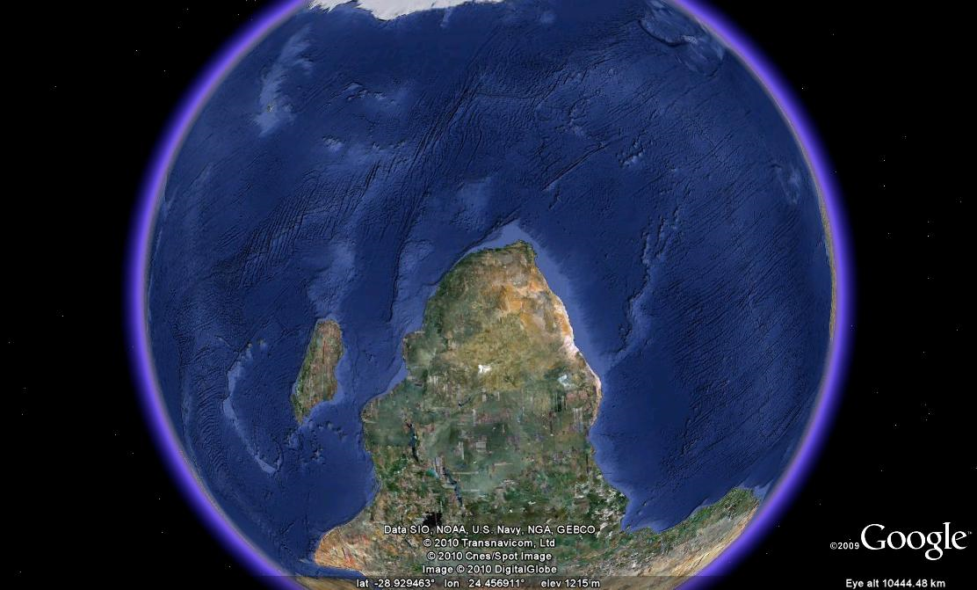

Slide 2
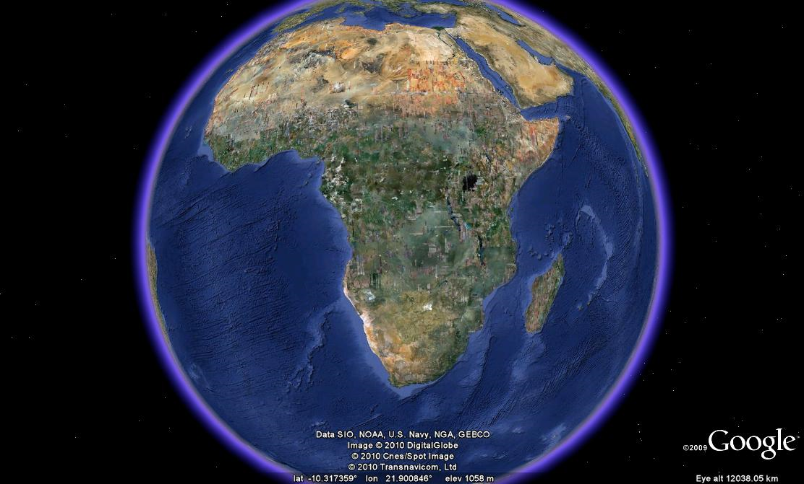

Slide 3
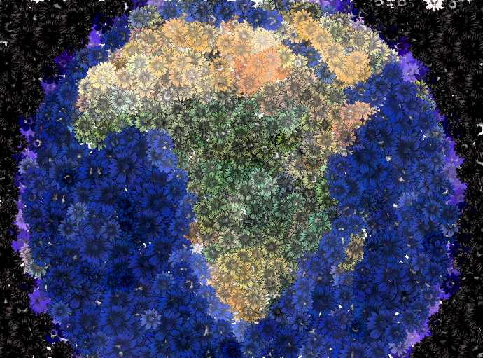
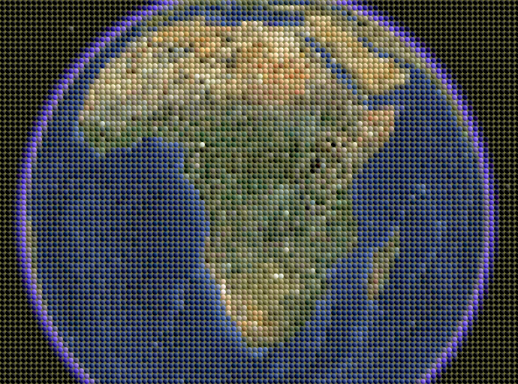

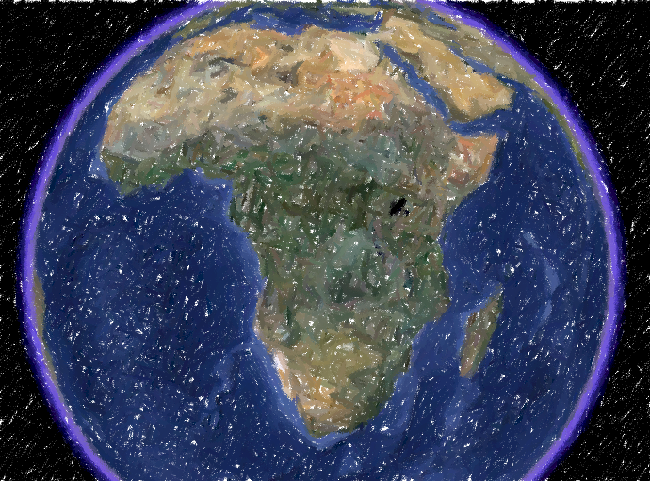

Slide 4

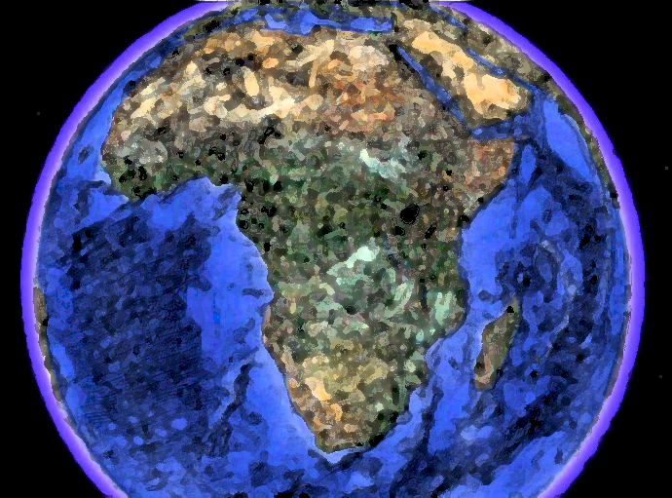
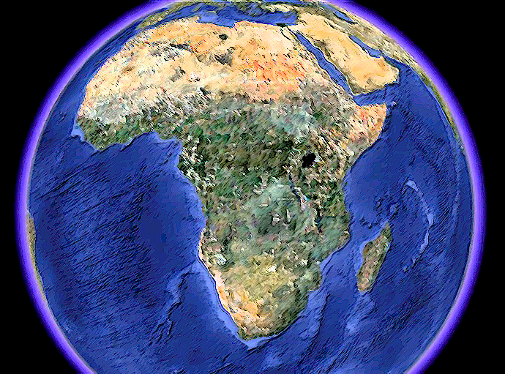
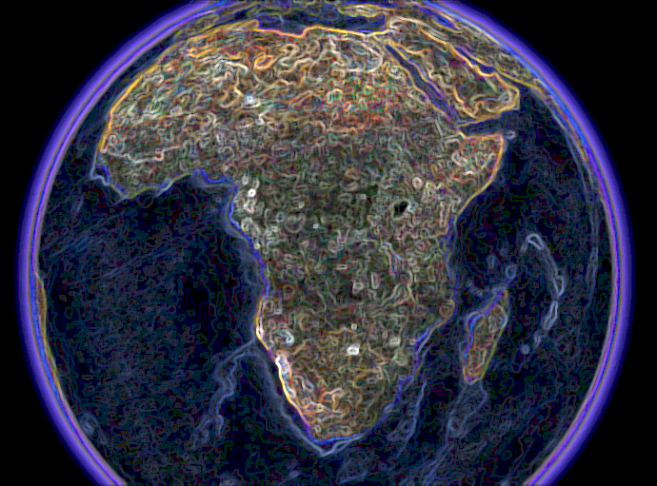

Slide 5
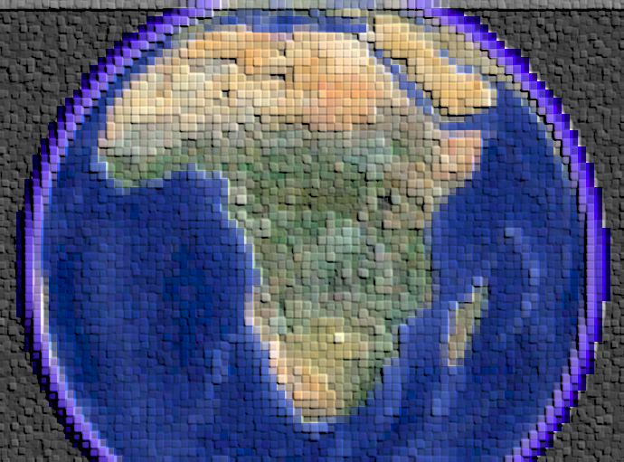

Slide 6


Slide 7


Slide 8


SOUTH AFRICAN EARTH
OBSERVATION SYSTEM

Slide 9
SOUTH AFRICAN EARTH
OBSERVATION SYSTEM

Slide 10



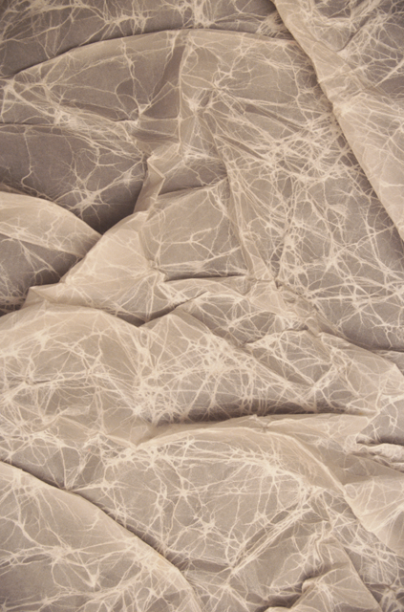


Societal Benefit Areas …
Catalogues
GEOSS Services
Data Samples
Platform Architecture

Slide 11
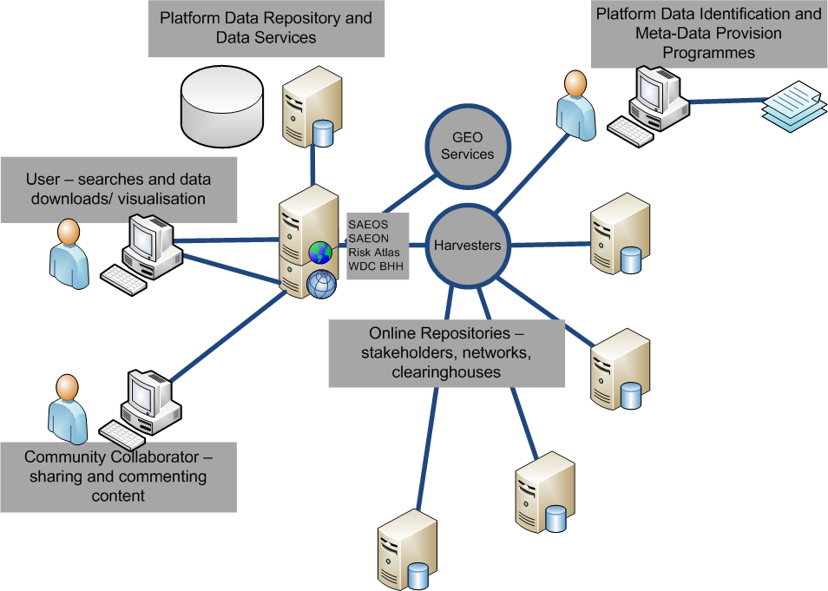

Slide 12
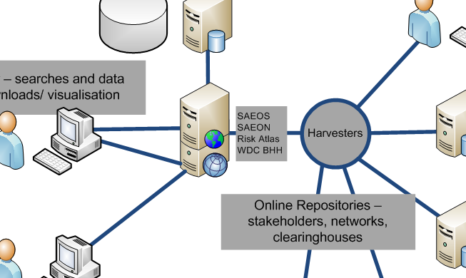
Platform Architecture

Slide 13
Beta Version

Slide 14


Slide 15


Slide 16


Slide 17


Slide 20


Slide 21


Slide 22


Slide 23


Slide 24


Slide 25


Slide 26


Slide 28


Slide 29
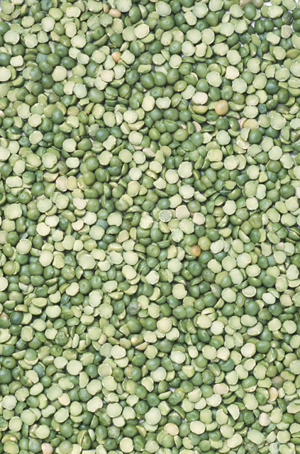

Slide 30
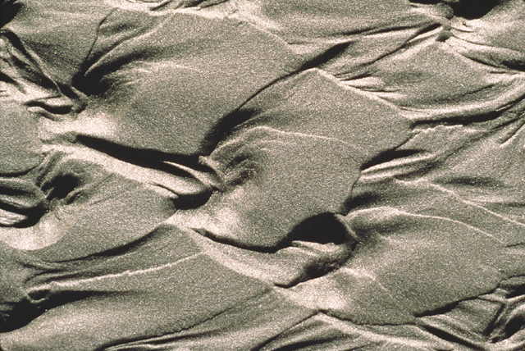

Slide 31


Slide 32


Slide 33


Slide 35


Slide 36


Slide 37


