Slide 2

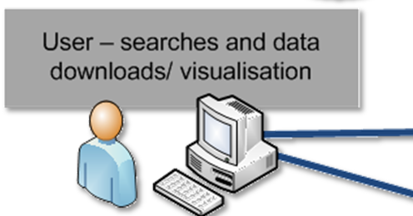
SAEOS (The South African Earth Observation Strategy) directly supports the access to and visualization of data dealing with the societal benefit areas identified by GEO.
Funded by the Department of Science and Technology (DST), a platform is being created to serve as a centralised 'catalogue of catalogues', providing access to a growing array of scientific data and knowledge in and about South Africa.
Through strong partnerships, and in collaboration with the South African Environmental Observation Network (SAEON), SAEOS provides both a sustainable technical platform and long-term data and preservation of such data.
Societal Benefit Areas …

Slide 3

SAEOS (The South African Earth Observation Strategy) directly supports the access to and visualization of data dealing with the societal benefit areas identified by GEO.
Funded by the Department of Science and Technology (DST), a platform is being created to serve as a centralised 'catalogue of catalogues', providing access to a growing array of scientific data and knowledge in and about South Africa.
Through strong partnerships, and in collaboration with the South African Environmental Observation Network (SAEON), SAEOS provides both a sustainable technical platform and long-term data and preservation of such data.
Catalogues

Slide 4

SAEOS (The South African Earth Observation Strategy) directly supports the access to and visualization of data dealing with the societal benefit areas identified by GEO.
Funded by the Department of Science and Technology (DST), a platform is being created to serve as a centralised 'catalogue of catalogues', providing access to a growing array of scientific data and knowledge in and about South Africa.
Through strong partnerships, and in collaboration with the South African Environmental Observation Network (SAEON), SAEOS provides both a sustainable technical platform and long-term data and preservation of such data.
GEOSS Services

Slide 5
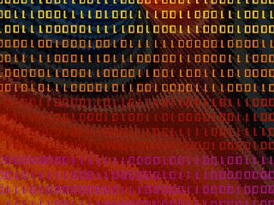
SAEOS (The South African Earth Observation Strategy) directly supports the access to and visualization of data dealing with the societal benefit areas identified by GEO.
Funded by the Department of Science and Technology (DST), a platform is being created to serve as a centralised 'catalogue of catalogues', providing access to a growing array of scientific data and knowledge in and about South Africa.
Through strong partnerships, and in collaboration with the South African Environmental Observation Network (SAEON), SAEOS provides both a sustainable technical platform and long-term data and preservation of such data.
Data Samples

Slide 6
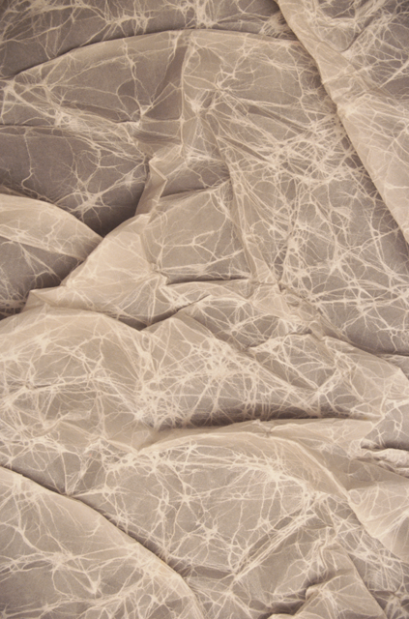
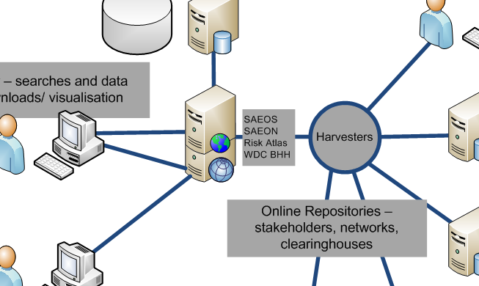
SAEOS (The South African Earth Observation Strategy) directly supports the access to and visualization of data dealing with the societal benefit areas identified by GEO.
Funded by the Department of Science and Technology (DST), a platform is being created to serve as a centralised 'catalogue of catalogues', providing access to a growing array of scientific data and knowledge in and about South Africa.
Through strong partnerships, and in collaboration with the South African Environmental Observation Network (SAEON), SAEOS provides both a sustainable technical platform and long-term data and preservation of such data.
Platform Architecture

Slide 7

Societal Benefit Areas …
Catalogues
GEOSS Services
Data Samples
Platform Architecture

Slide 8
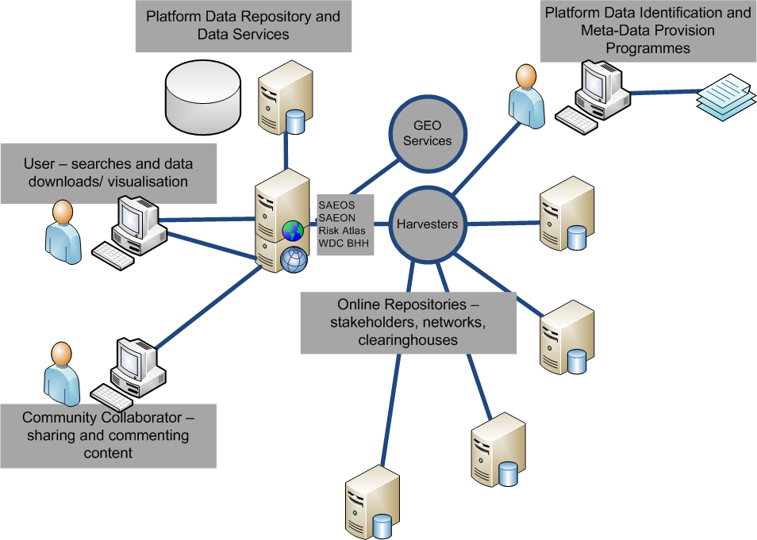

Slide 10
Platform Architecture

