Slide 1

Citizen Science Extensions to the SAEON Data Portal
SRS 336.3.8.2
Wim Hugo, 21 July 2010

Slide 2
Conceptual Overview

Slide 3
Main Use Cases
Each user or contributing organisation (for example, a school) creates a profile.
SAEON, and other similar institutions, can define one or more campaigns.
Each campaign has a unique and configurable data form definition.
A ‘Person’ profile, together with a ‘Campaign’ profile, results in a meta-data record for the combination. These are harvested automatically by the SAEON Data Portal and included into a meta-data collection for the campaign.
Contributing organisations/ persons can then capture data against one or more campaigns. This happens in a configurable map-based interface.
The data is stored in a database on a server under SAEON’s control, and automatically offers Web Feature Services (mapping data) for each campaign/ user combination. These are automatically included in the meta-data record.
Toolkits are available to create additional views of the data, including chart and table views of the same data.
The following slides provide a walkthrough of the beta version, currently being finalised.

Slide 4
User or Organisation Profile
OpenLayers Mapping Application
SAEON
Data Portal Campaign Meta-Data
SAEON
Units of Measure
User EML
Fragment
Web Context Document
SAEON
Campaigns
SAEON
Controlled Vocabulary
User WFS/ GeoRSS
Data File
GeoRSS File or Service
Simple Keyword Service
Data Capturing Page/ Dialog
Profile
Editor/ Aggregator
Composite
EML

Slide 5
Current Implementation
β-Version
July 2010

Slide 6
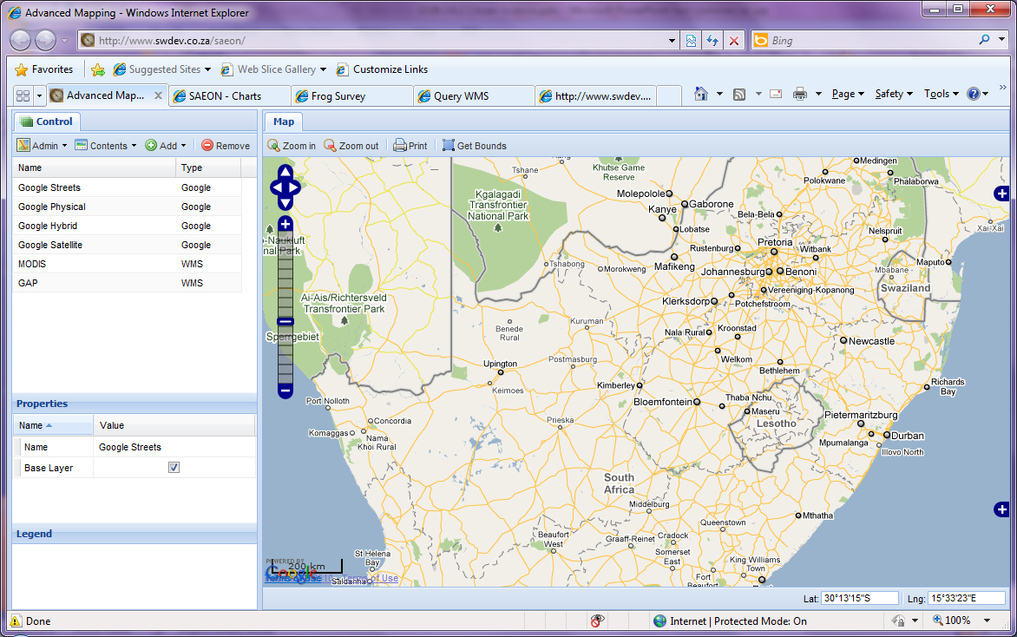
Map Client Interface
The test version adds menu entries into the standard map interface used in the SAEON Data Portal

Slide 7
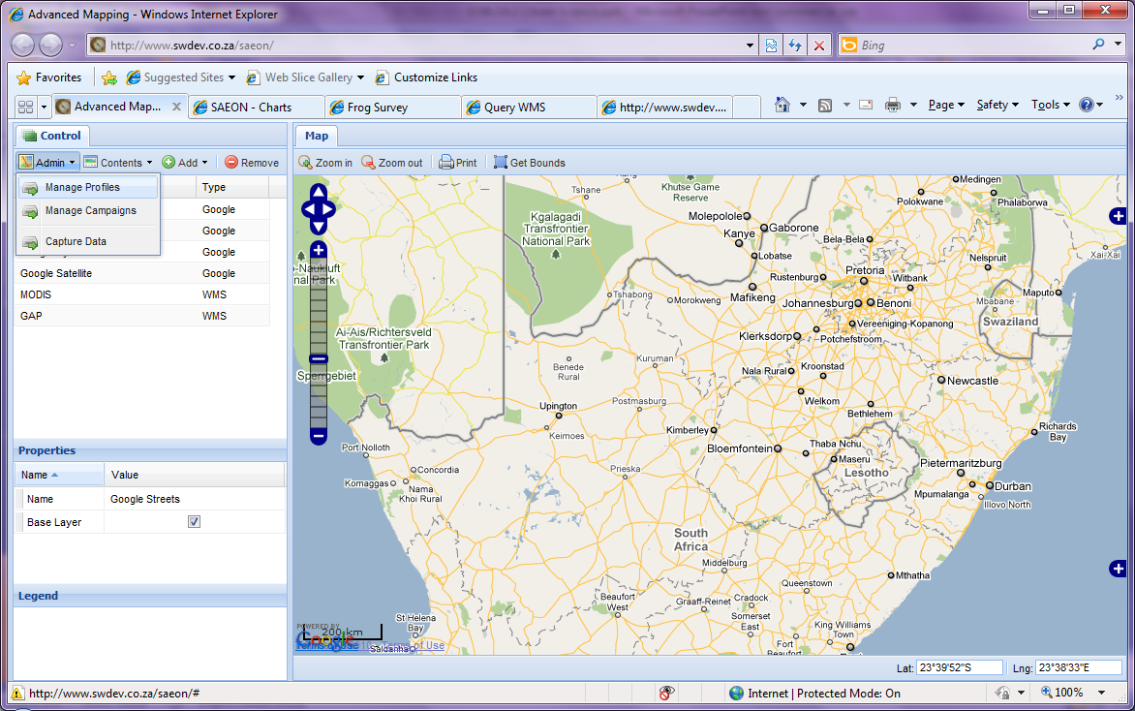
Administrative Additions
Three main functions can be tested here:
Adding/ Editing User Profiles
Adding/ Editing Campaign Profiles
Capturing Data

Slide 8
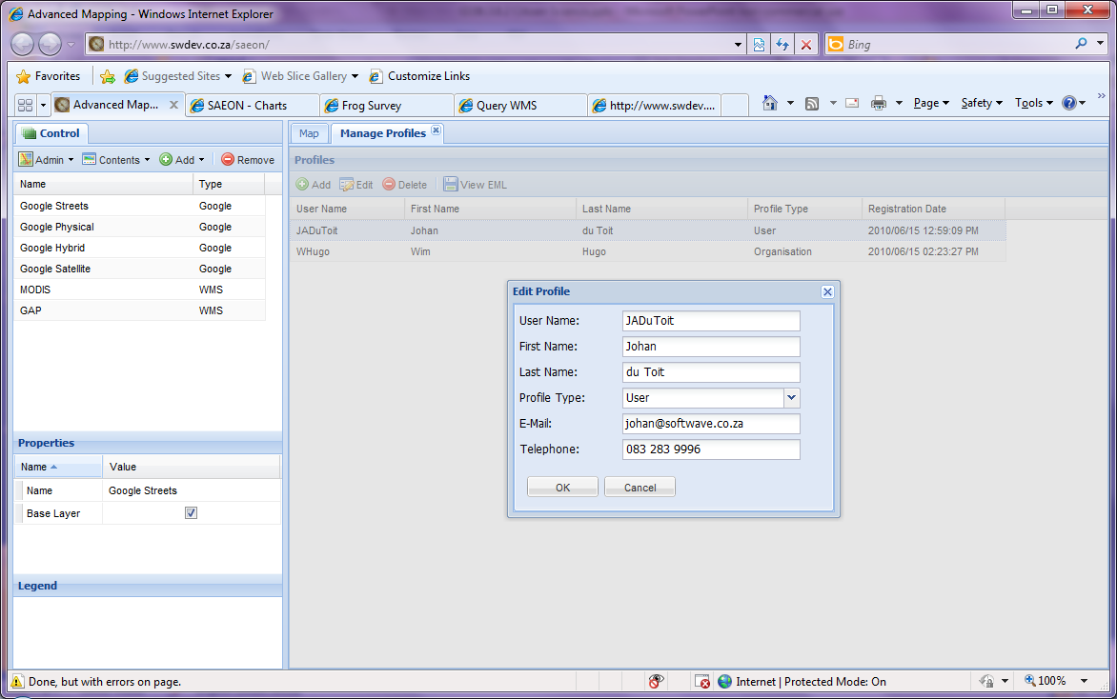
Person’s Profile
The standard user profile is based on the person/ organisation-related elements of EML – and contributes fragments to a meta-data record.

Slide 9
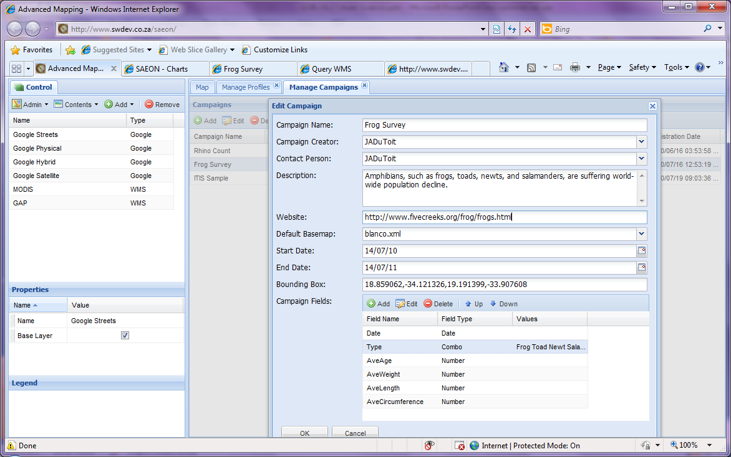
Defining a Campaign Profile
The same applies to campaigns. The additional capability is that of defining one or more ‘fields’ – essentially the form that will be used for data capturing – associated with the campaign.
Each campaign can select a unique backdrop map, with layers appropriate to the context of the campaign.

Slide 10
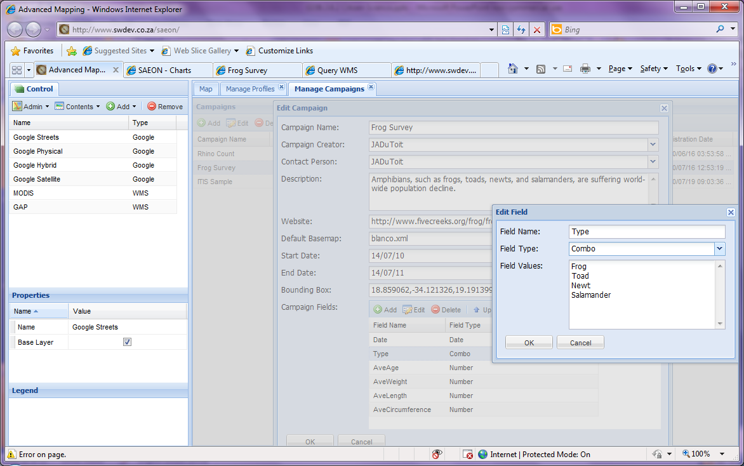
Two Levels of Controlled Vocabulary
Surveys often result in poorly defined result data. For this reason, copious use can be made of ‘drop-down’ lists and date pickers to limit erroneous data entry.

Slide 11
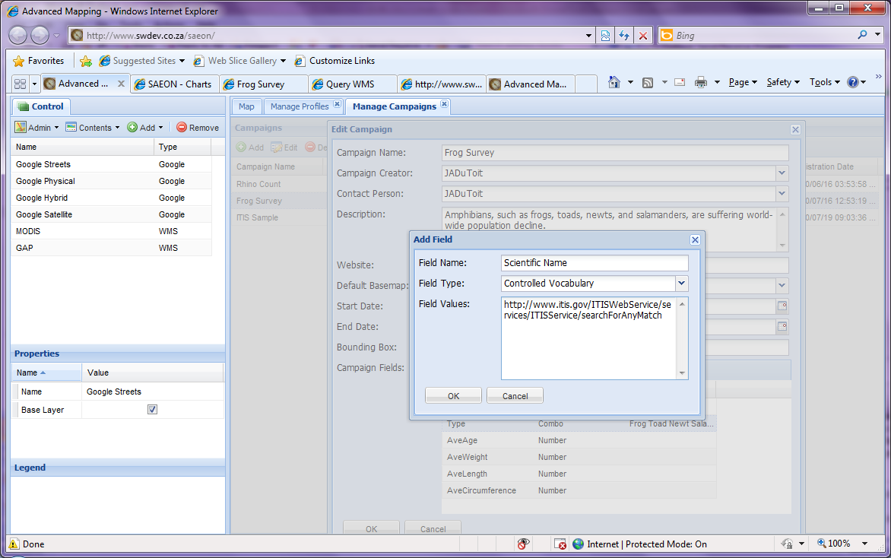
‘External’ Controlled Vocabulary Services
External controlled vocabularies, if they are implemented using interoperability standards, can also be used to guide text inputs. We are testing this with the ITIS (Integrated Taxonomic Information System) in respect of species names.

Slide 12
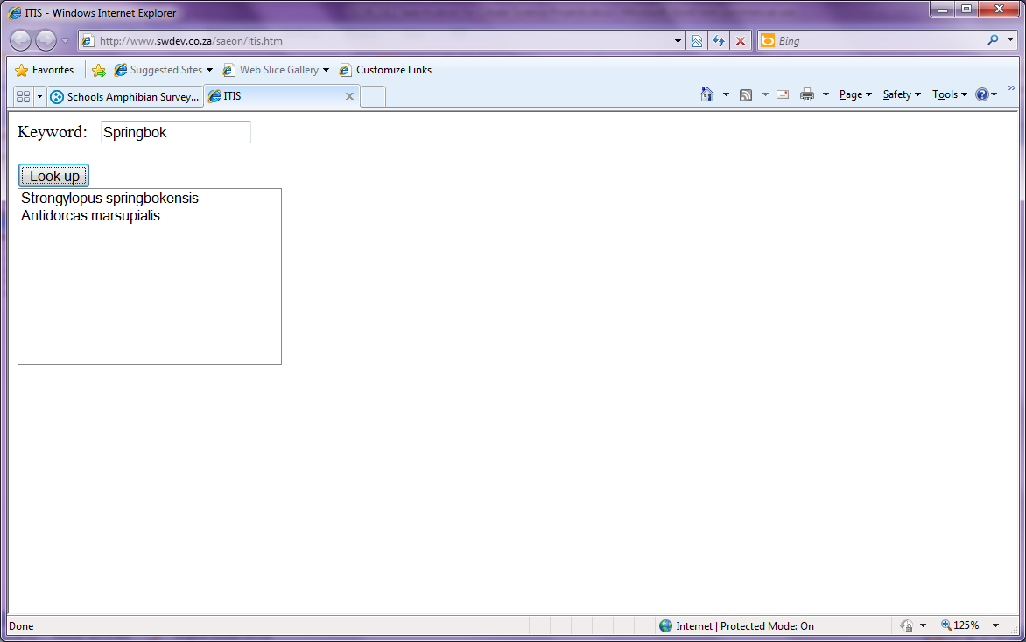
Controlled Vocabulary Service
This our test interface. It calls the ITIS service to provide species names (Scientific and Common) for terms entered by the user. The final implementation (under way) will integrate this with the form fields where text is captured if the field is designated as a ‘Controlled Vocabulary’ field
Note that a field can be pointed to any service, anywhere, as long as it meets interoperability requirements. We aim to implement at least the major standards in this respect, over time. It is also possible to store static XML files at a web address with lists particular to a campaign or organisation.

Slide 13
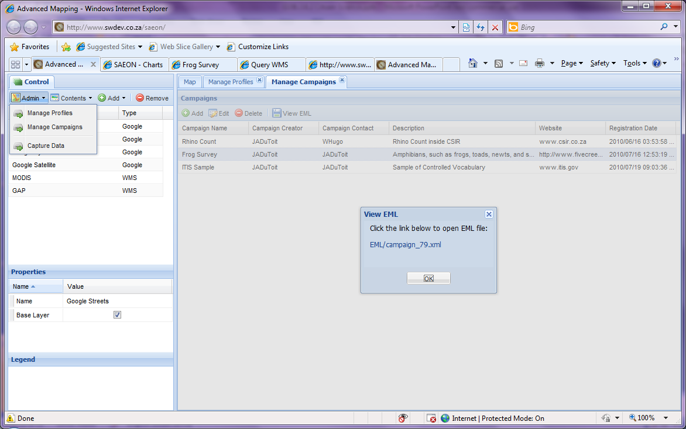
Campaigns and Persons Combine to Form EML Meta-Data Records
A combination of a campaign and a user (person or organisation) leads to a unique meta-data record. This meta-data record is updated every time the underlying data changes (for example, updating the temporal and spatial data coverage), and is based on EML (for now).
The meta-data records are directly integrated into the SAEON Data Portal, by way of automated harvesters, that synchronise periodically. Currently, the smallest interval is 12 hours.

Slide 14
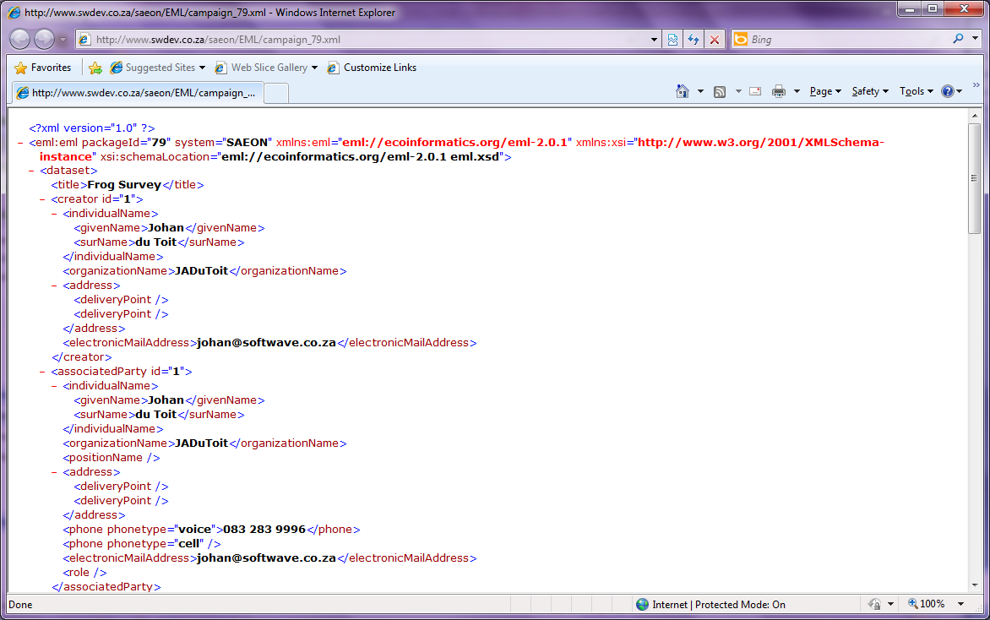
EML Example – Campaign Fragment
The EML meta-data standard is currently version 2.0.1. It is available to the user for download and further application – as illustrated here – but SAEON Data Portal users needn’t ever work with the meta-data directly – its transfer is automated.

Slide 15
Adding Data

Slide 16
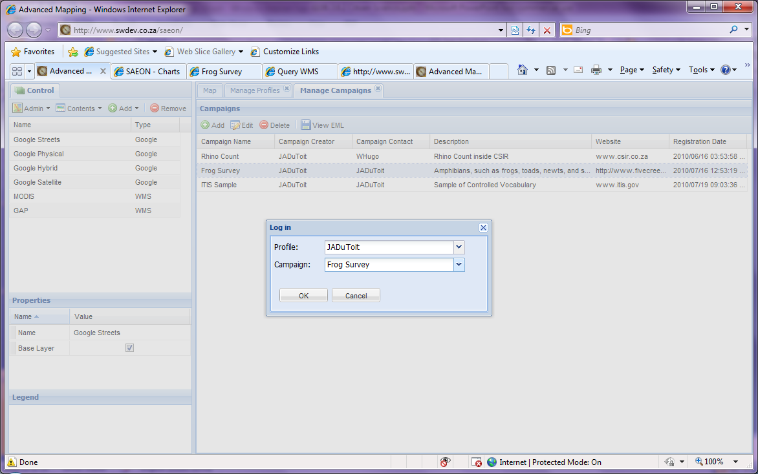
Adding Data for a Campaign
Users (persons or organisations) add data by way of selecting a campaign to contribute to.
At present, this is an open situation, but in future the campaigns available to any particular user account should and will be limited.

Slide 17
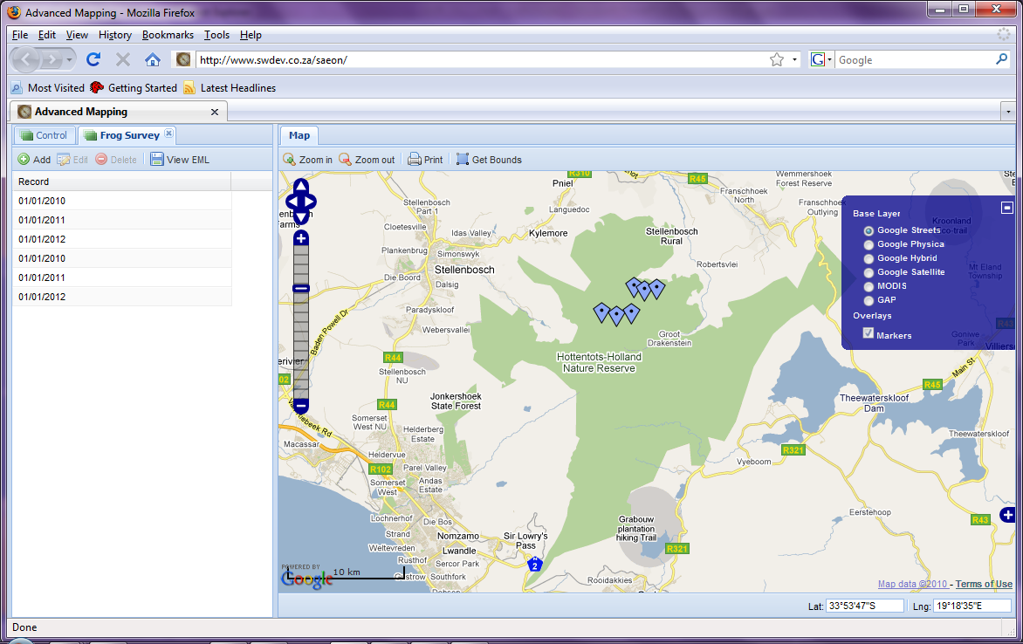
Existing Data is Displayed
Previously captured data for the combination of user and campaign is shown. The data can be edited, or a new observation can be added by clicking on the map.
We are thinking of ways to improve this – users may want to enter coordinates, for example.
All other map functions remain available, including the ability to switch backdrops and foreground layers. Note that the data layers is the ‘Marker’ overlay.

Slide 18
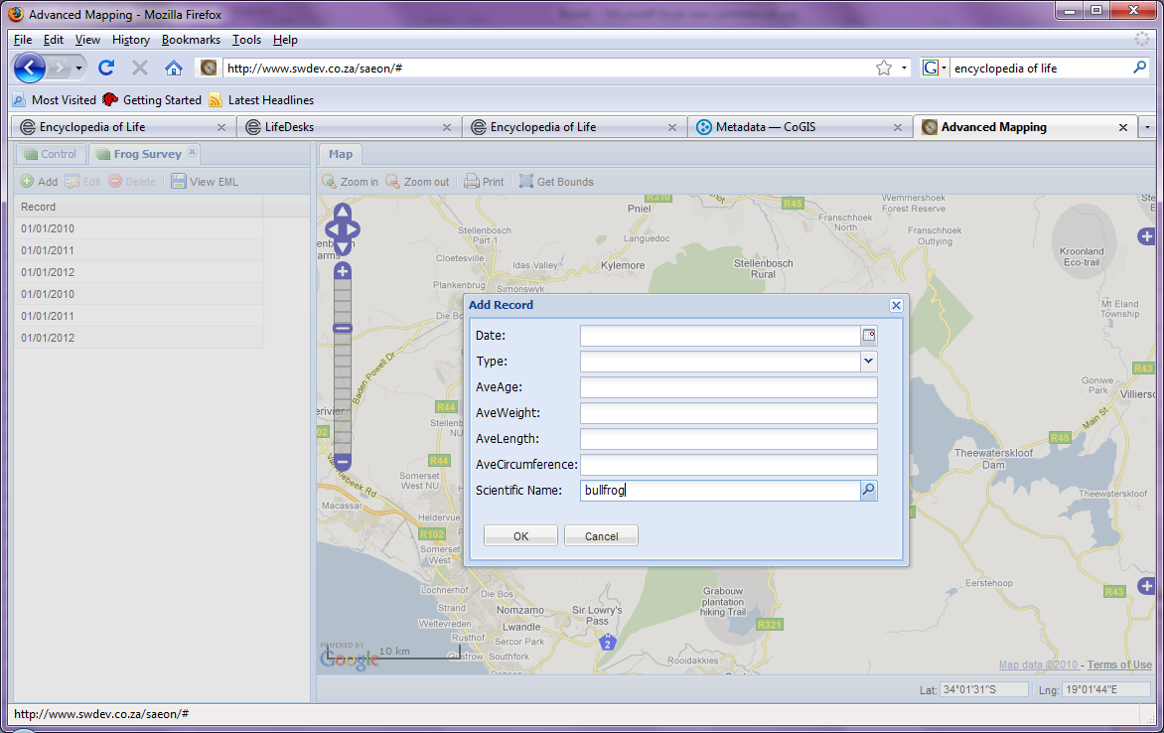
Data is Added based on Campaign Template
The data point (observation) is captured based on the form definition provided for the campaign.
Existing data points can be edited by clicking them in the map or by selecting them in the list (left-hand panel).
Note the ‘Controlled Vocabulary’ lookup, as configured earlier.

Slide 19
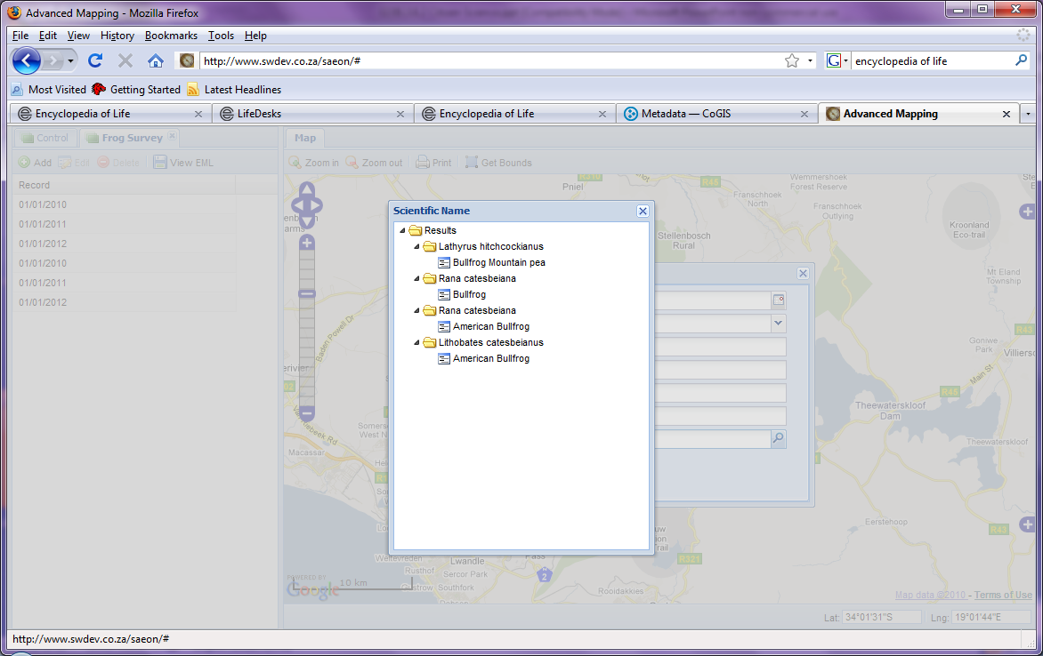
Controlled Vocabulary
Users may select any related term offered by the controlled vocabulary service for the specific field.

Slide 20
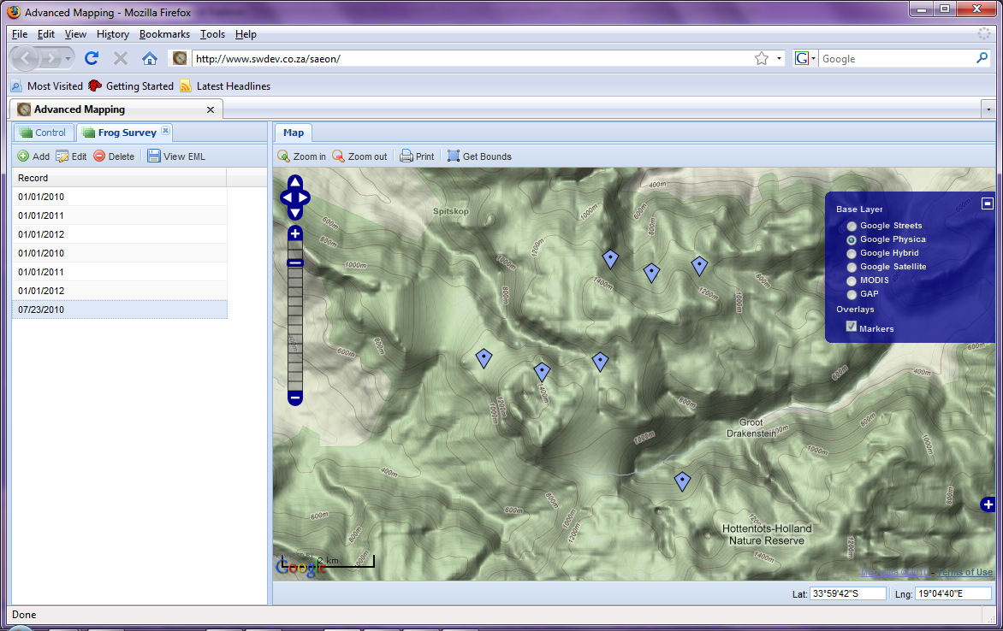
Backdrops Can be Adjusted
A new point is added, shown here at higher zoom level and with a different backdrop.
Each campaign can select a unique backdrop map, with layers appropriate to the context of the campaign.

Slide 21
Alternative Data Presentations
Data is stored in a database, and is currently served as a Web Feature Service (WFS), queryable by campaign and user account. This service can also be tabled and charted – see next slides.

Slide 22
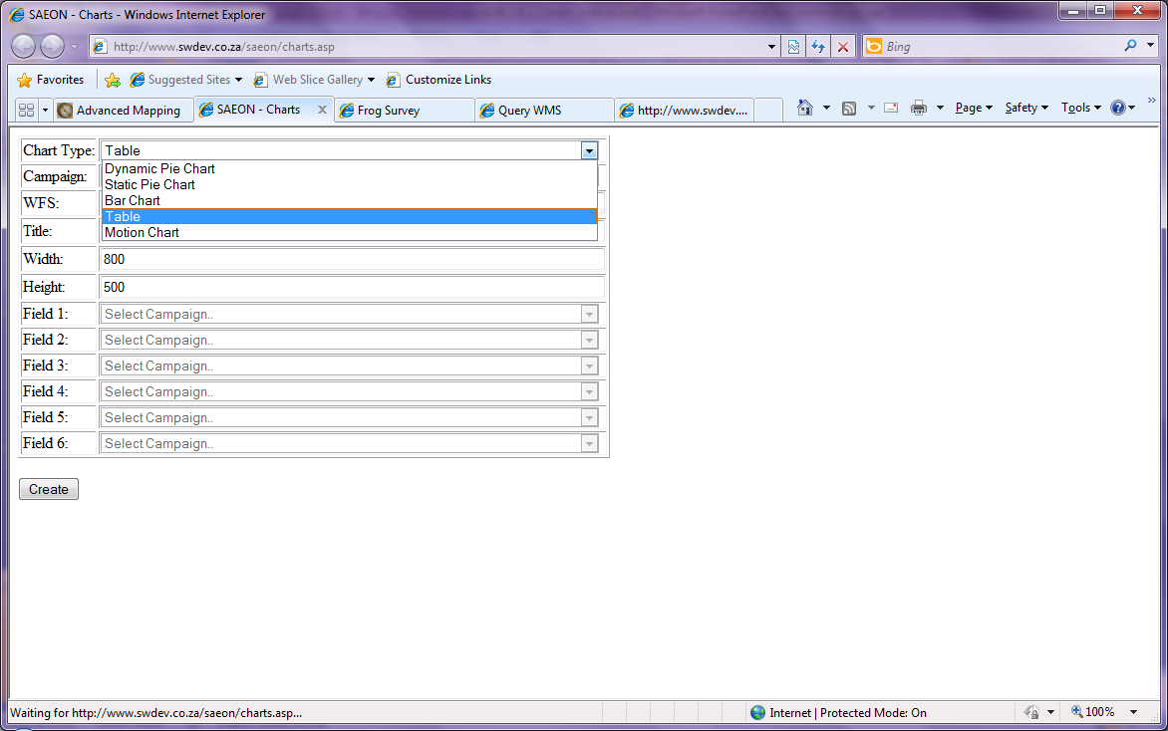
The Chart and Table Toolkit/ Factory
This example is a ‘service definition’ tool that manufactures table and chart views. Both the tool and the URL made by the service can be embedded in any site: including the SAEON Data Portal.
The tool allows a variety of output styles to be specified. We will be showing the ‘Table’ and ‘Motion Chart’ options.

Slide 23
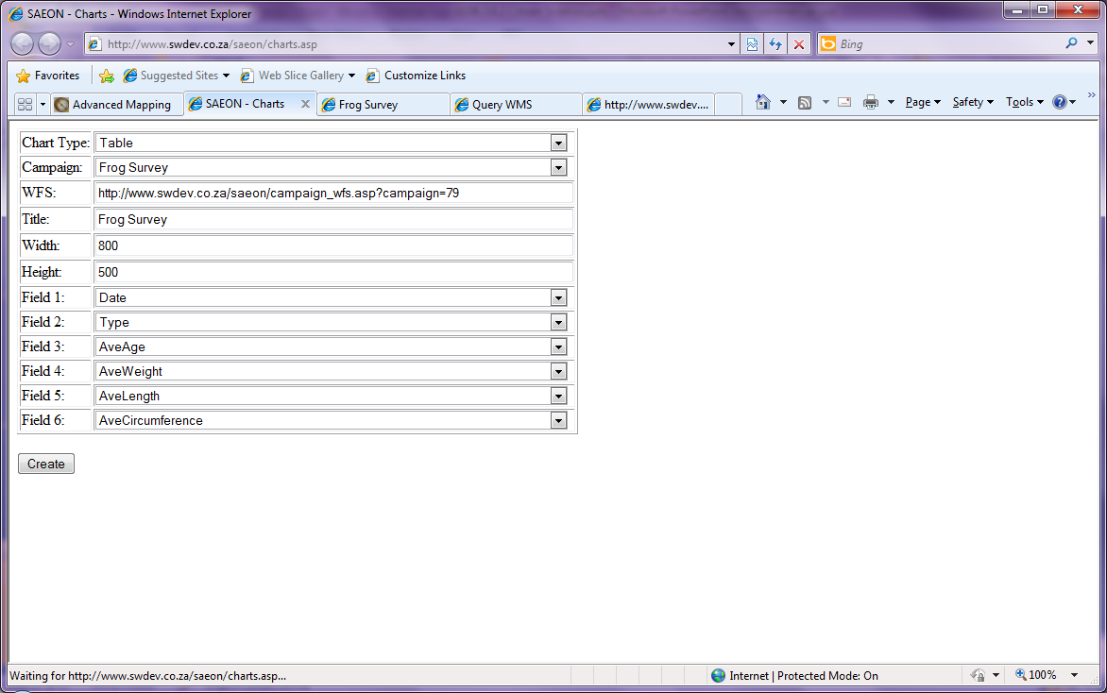
Defining a Table Result
First, a campaign is selected.
We will, in time, refine the query aspects some more: defining a spatial extent, for example, and limiting or selecting users.

Slide 24
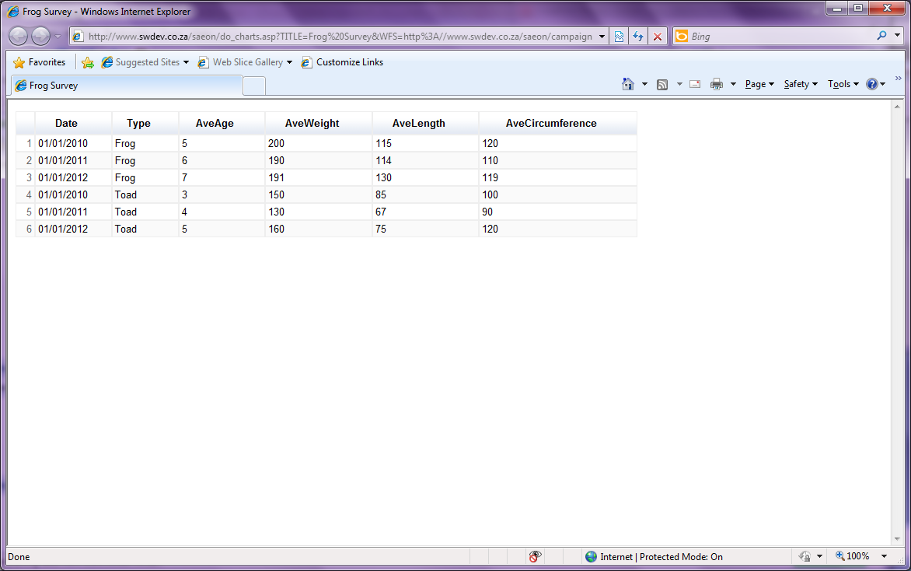
Table Result
The fields, in the order specified, are tabled in a separate web page or tab.
The URL can be copied and embedded anywhere: try the one provided here.
http://www.swdev.co.za/saeon/do_charts.asp?TITLE=Frog%20Survey&WFS=http%3A//www.swdev.co.za/saeon/campaign_wfs.asp%3Fcampaign%3D79&FIELD_1=Type&FIELD_2=Date&FIELD_3=AveAge&FIELD_4=AveWeight&FIELD_5=AveLength&FIELD_6=AveCircumference&TYPE=TABLE&WIDTH=800&HEIGHT=500

Slide 25
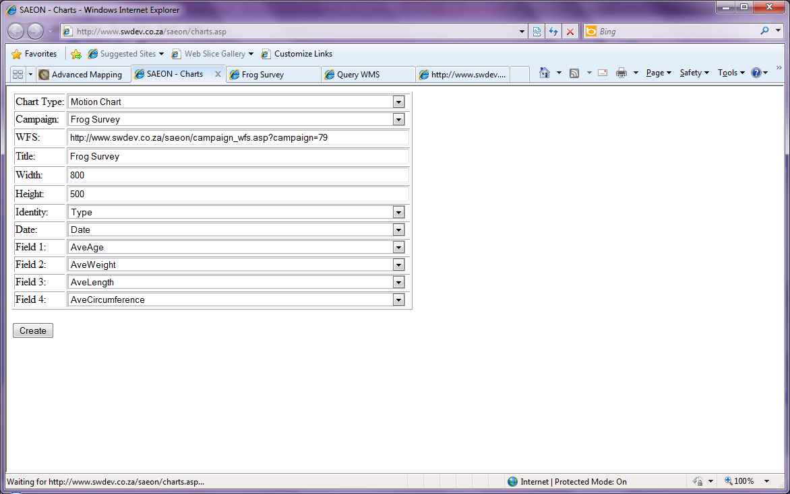
Motion Chart Example
A motion chart is a very flexible and effective way to view multidimensional data. The important aspect is the definition of a ‘Date’ variable that corresponds to some form of temporal dimension.
We will be adding some refinements as standard fields that are available, without capturing, based on the date of observation:
Hour of Day
Day of Week
Month of Year
Month and Year
This allows ‘index’ type temporal axes, as well as continuous ones.

Slide 26
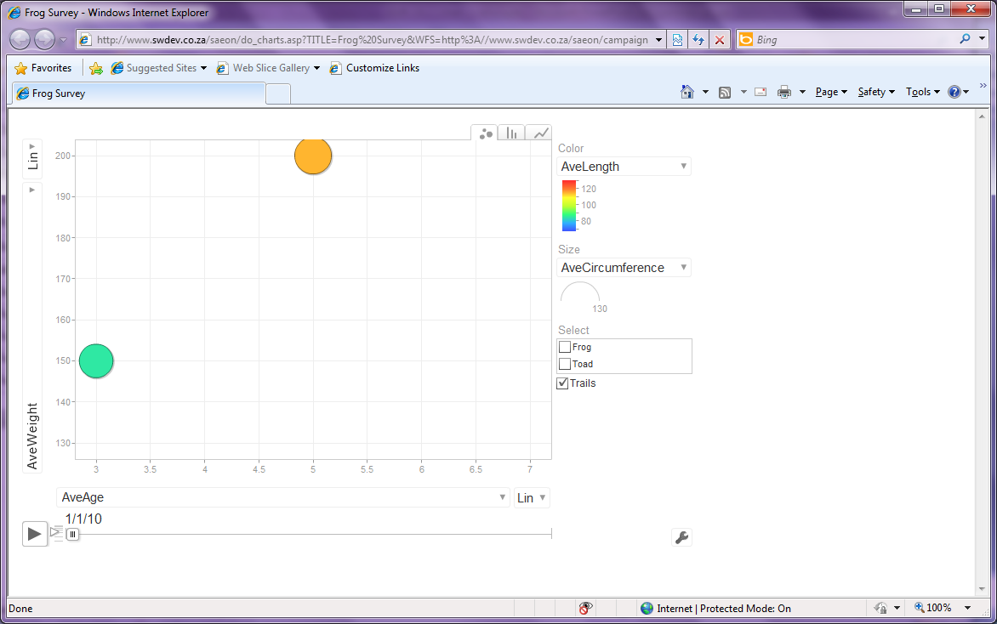
Motion Chart Example
Click here to ‘animate’ the motion chart over time. Note that the roles of other fields (category, size, colour, X and Y axes) can be redefined without going back to the tool page. The style of chart can also be altered on-screen, and individual categories can be traced.

Slide 27
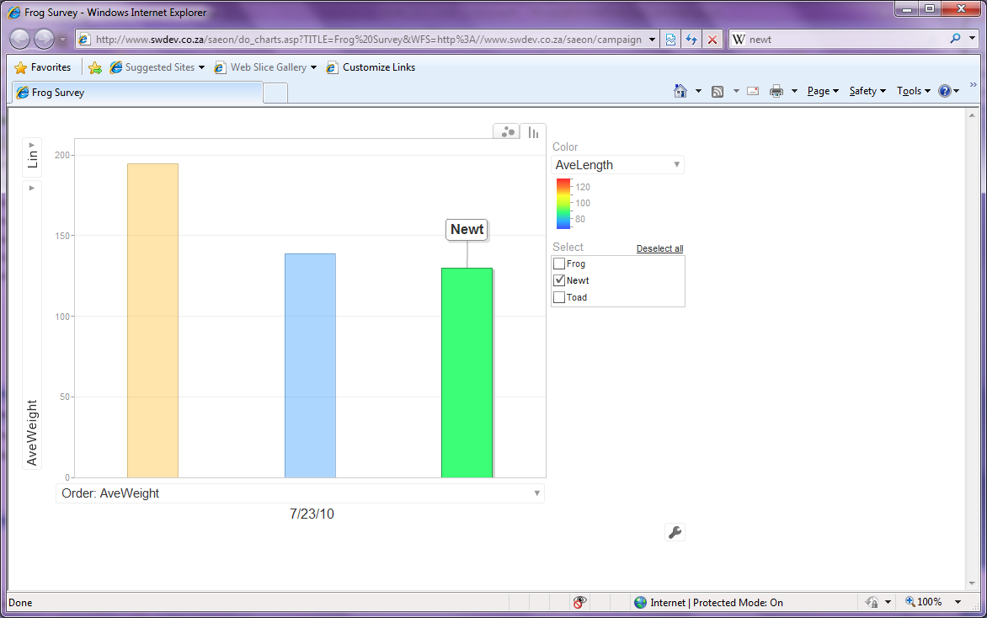
Options for Presentation
Alternative presentations of the same data.

Slide 28
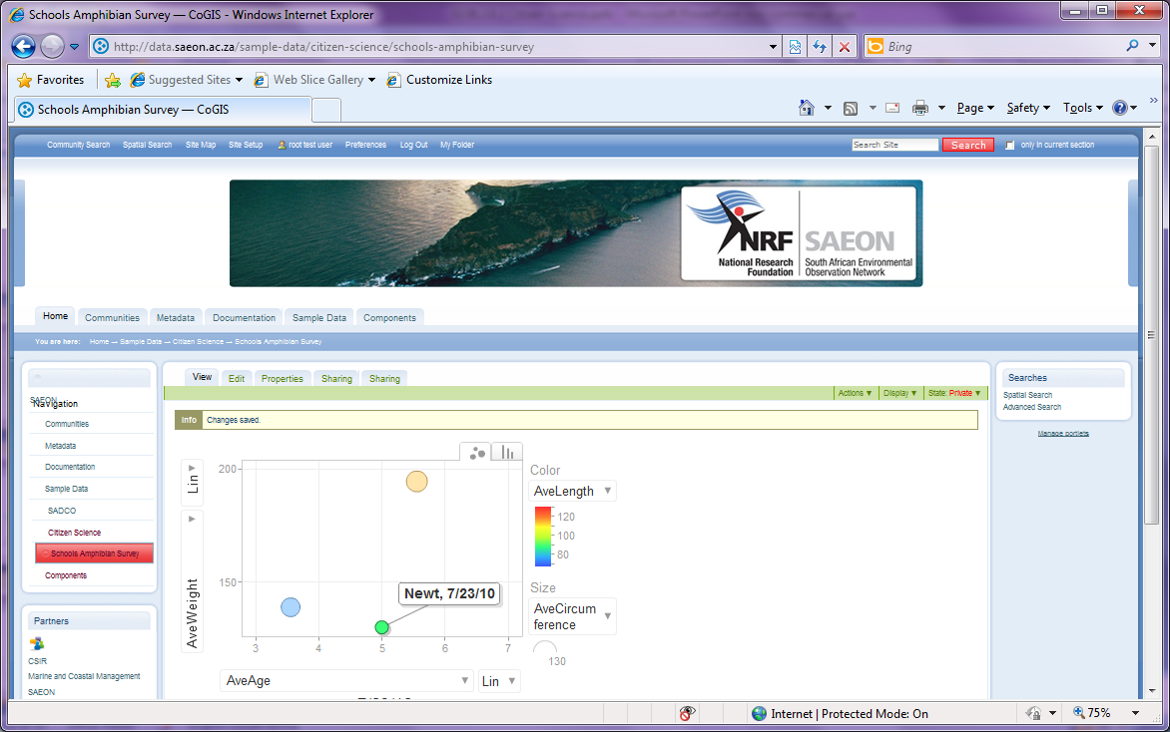
Seamless Embedding in Portals and Sites
Any view can be seamlessly embedded in the SAEON Data Portal (or any other site).
The same applies to the data capturing component (map-based).

Slide 29
Next Steps
β-version available end of July 2010 – will circulate test URLs to everyone.
Development team has opportunity to test with the Risk and Vulnerability Atlas.
Formal feedback from SAEON (e-mail to wim@saeon.ac.za)
Consolidate this and appoint the service provider to do adjustments and extensions.
A test project (such as PMB Bird Watchers) will be good.
Particularly interesting for school projects.
The facility can be used for any map-based data capture – and is obviously not limited to Citizen Science.

