Slide 1
Introduction to SAEOS
Wim Hugo
CDIO
SAEON
January 2013

Slide 2
MANIFESTO
It is possible, desirable, and in the public interest to:
Ensure that scientific data is described properly, preserved properly, and discoverable;
Once discovered, its utility, quality, and scope can be understood, even if the data sets are huge;
Once understood; it can be accessed freely and openly;
Once accessed, it can be included into distributed processes, preferably automatically, and on large scales;
Once processed, the knowledge gathered can be re-used.
… across multiple domains.

Slide 3
Background
Who are the current Stakeholders?

Slide 4
Background
SAEON and the CSIR has collaborated on GeoPortal infrastructure since 2004/5.
The list of stakeholders have grown to include DST and several additional smaller initiatives.
SAEOS and SA-GEO are an important facet of the shared infrastructure.
Recent technical developments, which is based on service-oriented architecture, has seen the emergence of loosely integrated components that are ‘glued’ together with open standards interfaces.
This means that many components can be re-used In any system and do not rely on a specific platform to work.

Slide 5
Portals and Platform
Portals: Main Stakeholders
and Initiatives
Main Shared Platform
Services
Documents
and Publications
Spatial
Data
Other
Data
SAEON Nodes and Initiatives
SAEON
SAEOS
Portal
Data Analysis and Processing
SAEOS
World Data Centre for BHH
Content Visualisation and Presentation
WDC
Risk and Vulnerability Atlas
RAVA
Meta-Data and Data Management Functions
CSIR GSDI
Data and
Meta-Data
CSIR
Meta-Data and Data Services
BioEnergy Atlas
BEA
NSIF
Application
NSIF Portal
NSIF

Slide 6
CONFLUENCE OF INITIATIVES
Science Gateway
DDL
DL
DIRISA
DL
DDA
RDI Output
Aggregation
Science Gateway
“SAEOS”
Science Gateway
“SAEOS”
DDL
DDL
DL
Quality Assurance Filters
World Data System Component
DDA

Slide 7
Context and Concepts Perspective of Earth and Environmental Sciences
MetaData
Data Standards
Automation
Mediation

Slide 8
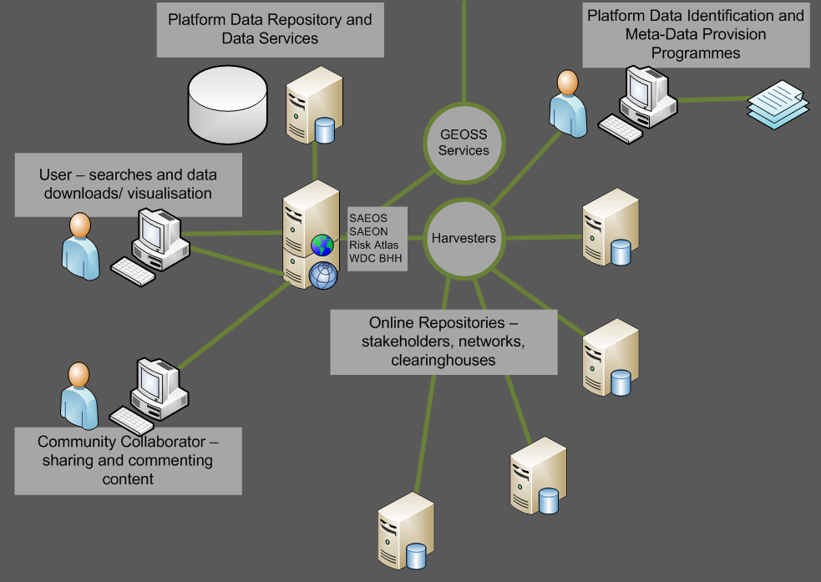
Main Use Cases DISCOVERY AND VISUALISATION
The platform is based on a shared and aggregated meta-data repository, and the meta-data repository is capable of accepting and working with a range of well-established meta-data standards.
These include Dublin Core, SANS 1878, the ISO 19115 family, EML, and FGDC. The list is likely to be extended from time to time to accommodate other standards in widespread use by a user community or new provider.
Harvesters can be used to automate meta-data acquisition from standardised providers.

Slide 9
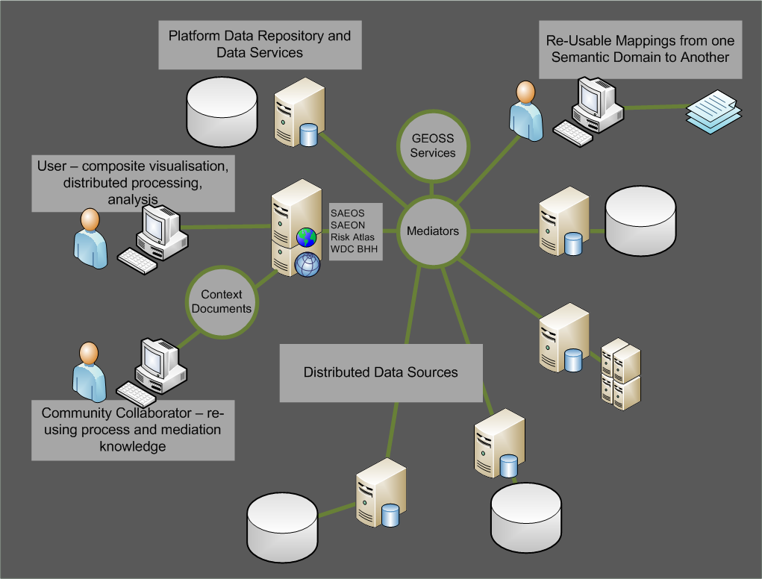
MAIN USE CASES Mediation and Collation
Mediators are required to tailor (bind) a data source or sources to a process or service.
The service can be as simple as a mapping service, and the mediation as rudimentary as renaming the layers to match the context of a map.
More advanced mediations define the linkages between distributed data sets, how data should be aggregated for analysis or display purposes, which columns to match to a charting service, and so on.
Mediations are stored in ‘Web Context Documents’.

Slide 10
MAIN USE CASES AUTOMATED PROCESS CHAINING
Distributed data sources and processes can also be chained together: in such cases, one needs to describe the process in a standardised way for future re-use.
This happens already in e-commerce systems, and it is likely that the same standards in use for automation of web commerce will be used in scientific process automation – but the jury is still out on this.
Automation and mediation rely greatly on ontologies for their efficient functioning. These are agreed dictionaries of terms, and can automate some of the mediation.
?

Slide 11
Walkthrough
Examples
Interoperability

Slide 12
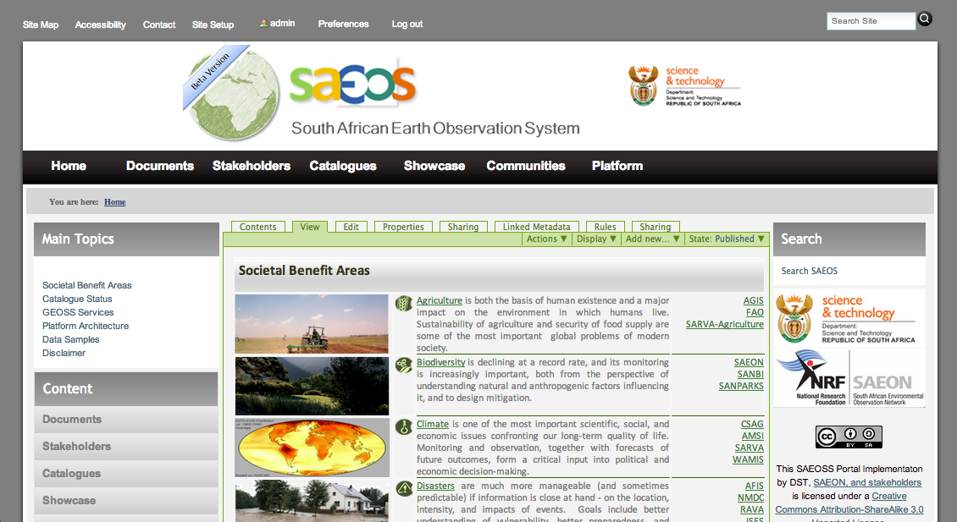
SAEOS LANDING PAGE
Societal Benefit Areas
Search for Data

Slide 13
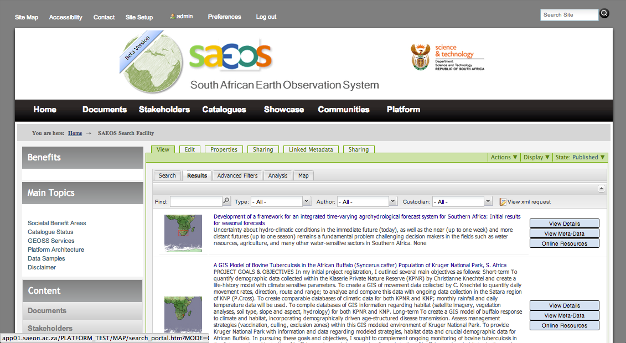
Typical Search Result (CLIMATE)
Summary Meta-Data

Slide 14
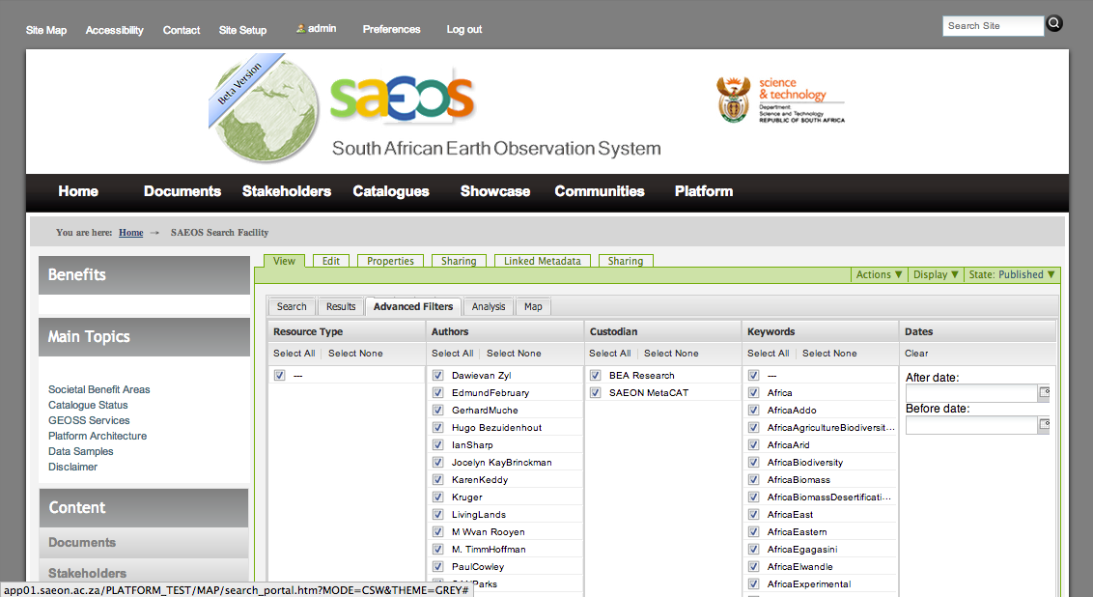
FILTERING SEARCH RESULTS
Filter by Author, Custodian, Date, etc.

Slide 15
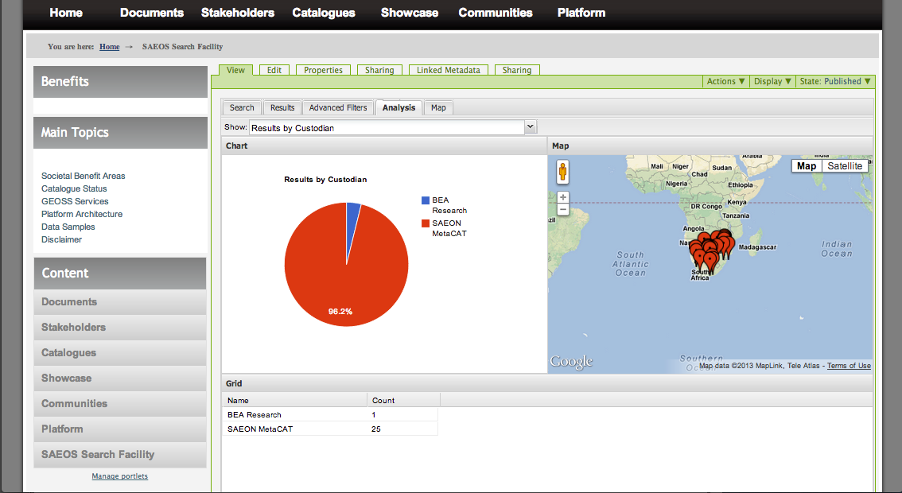
Search Result Analysis
Analysing Search Results

Slide 16
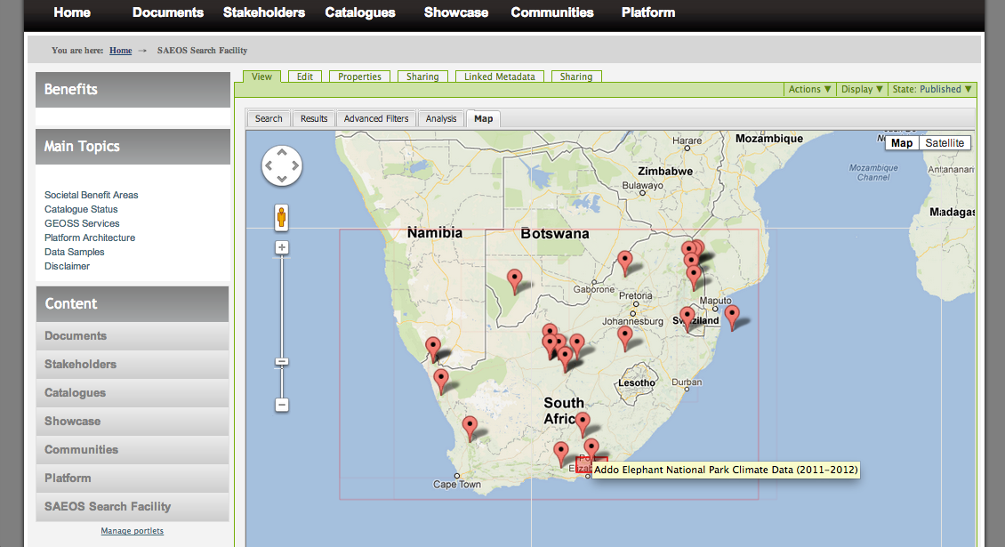
Spatial Coverage of Search Results
Analysing Search Results
Click to see detail

Slide 17
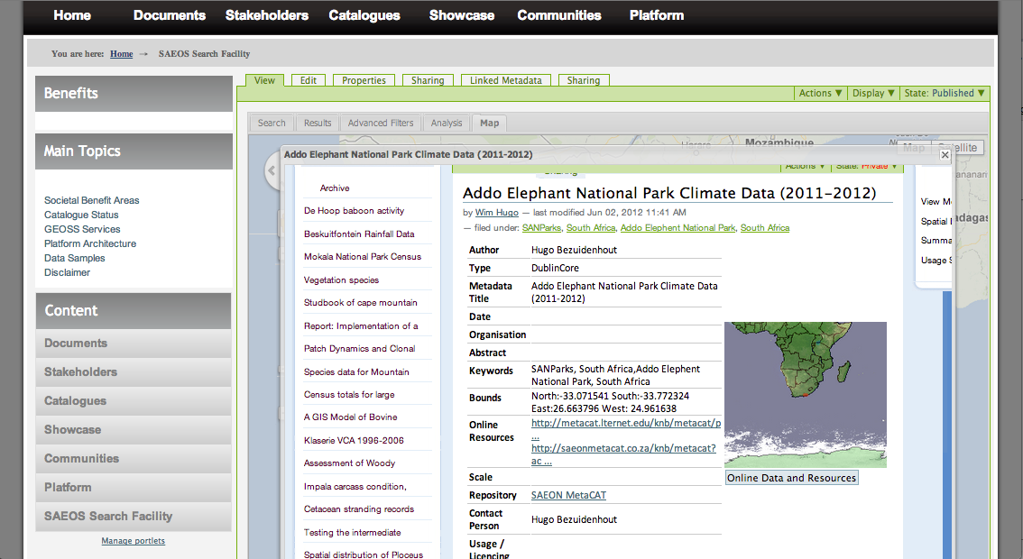
DetAILED META-DATA
Links to Contributing Site (SAEON)

Slide 18
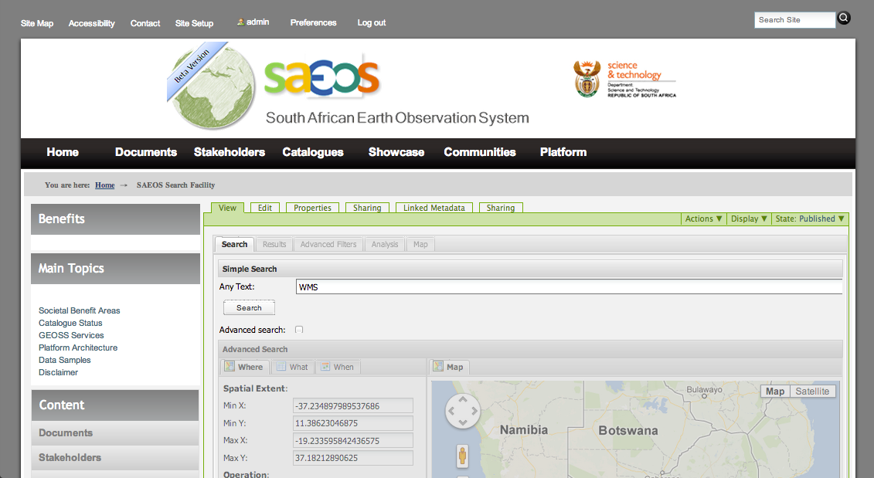
SEARCH FOR STANDARDISED DATA – e.g. WEB MAP SERVICES
WMS

Slide 19
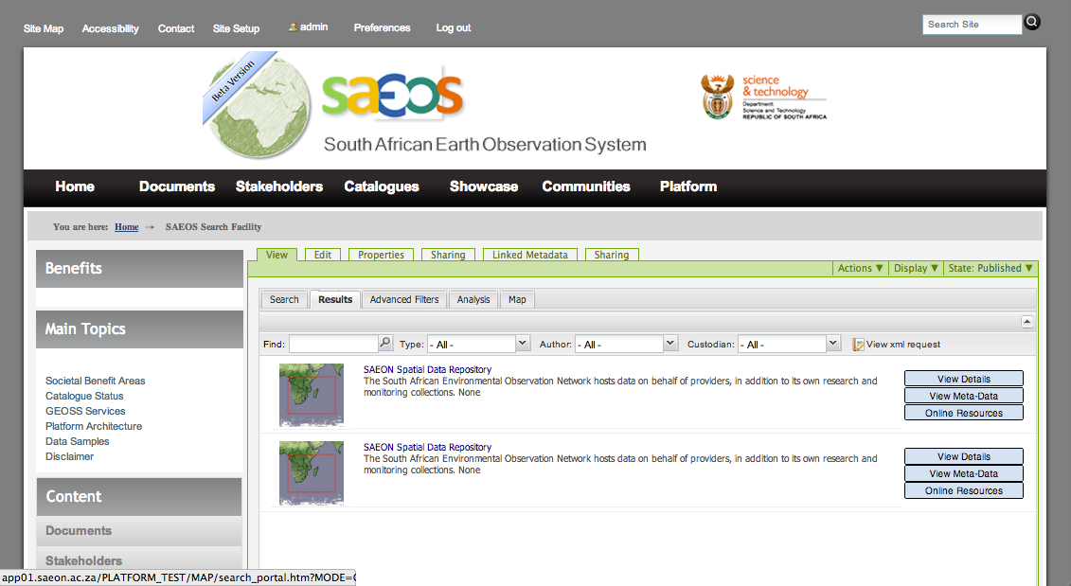
SPATIAL DATA SERVICES
Click to see detail

Slide 20
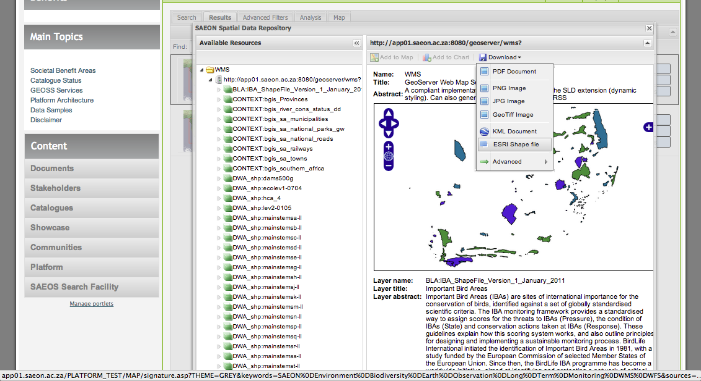
PREVIEW OR DOWNLOAD
Download formats and options
Layers available from service

Slide 21
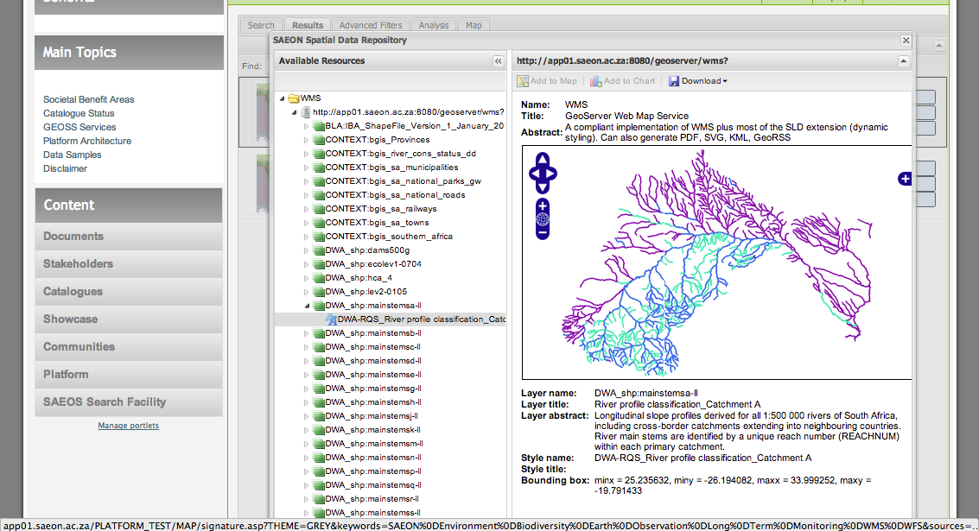
Supports Multiple Styles
One or more styles per layer

Slide 22
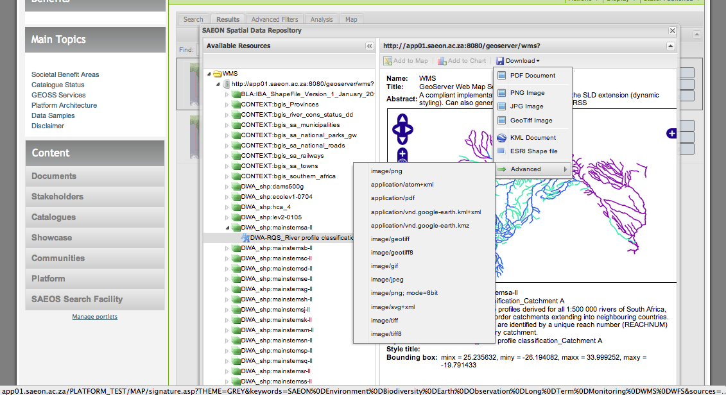
Download Options
Select an Option

Slide 23
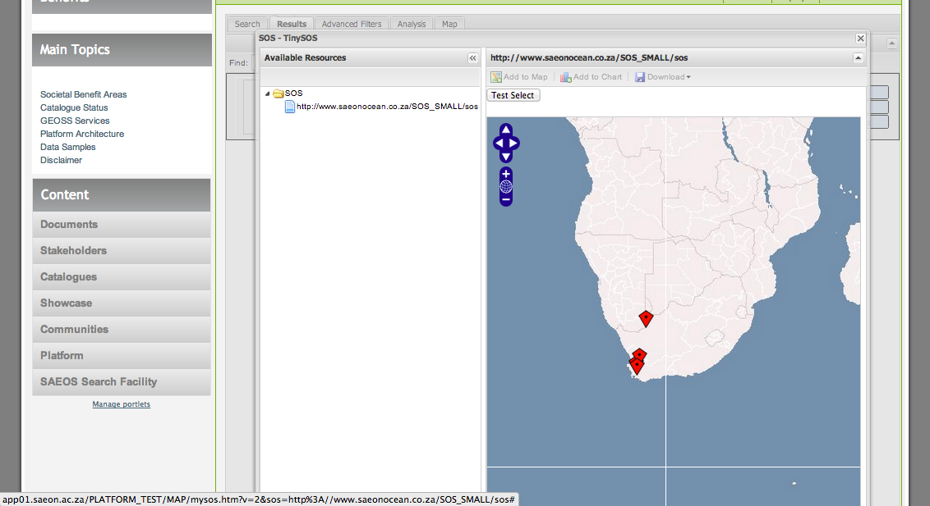
SEARCH for STANDARDISED DATA e.g. Sensor OBSERVATION SERVICES
Click to see detail

Slide 24
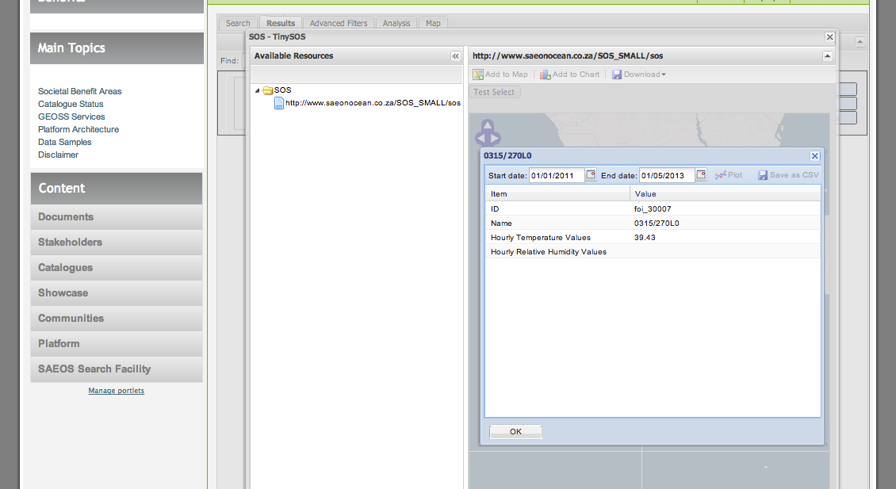
CLICK A FEATURE …
Select start and end dates
Latest values for observed phenomena

Slide 25
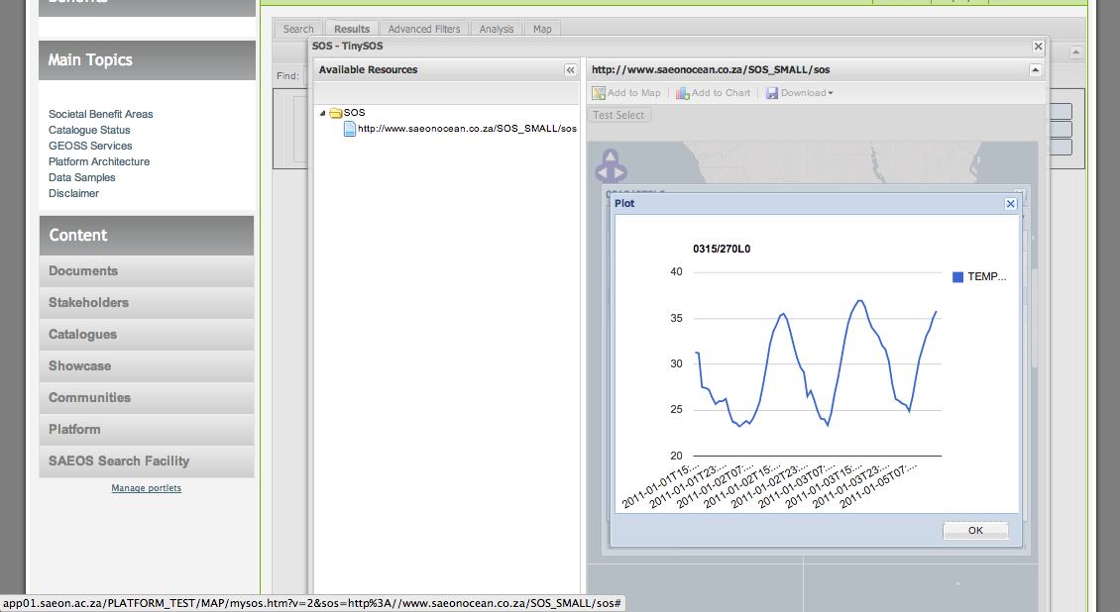
TIME SERIES DATA

Slide 26
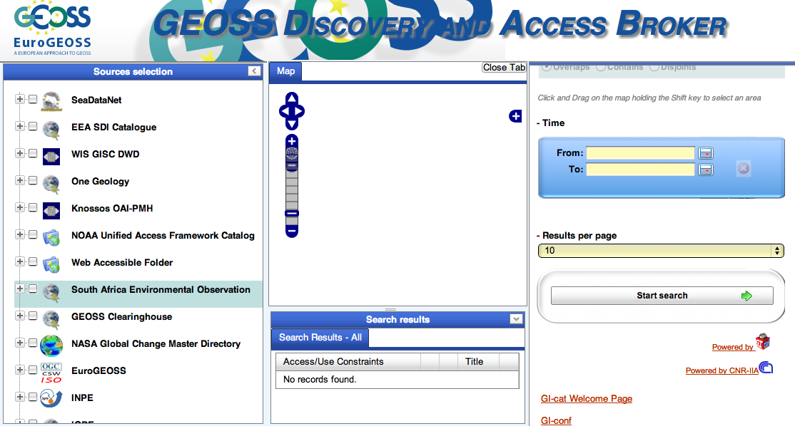
GEOSS BROKER Integration
SAEOS
CS/W
EndPoint

Slide 27
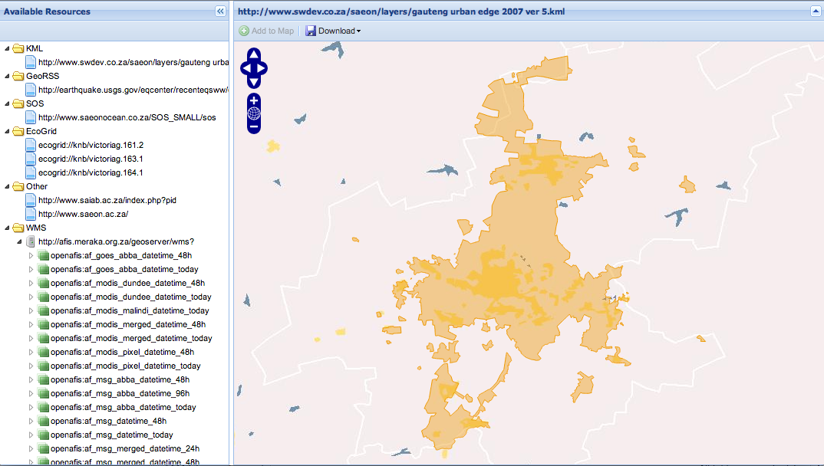
Process standardised data services

Slide 28
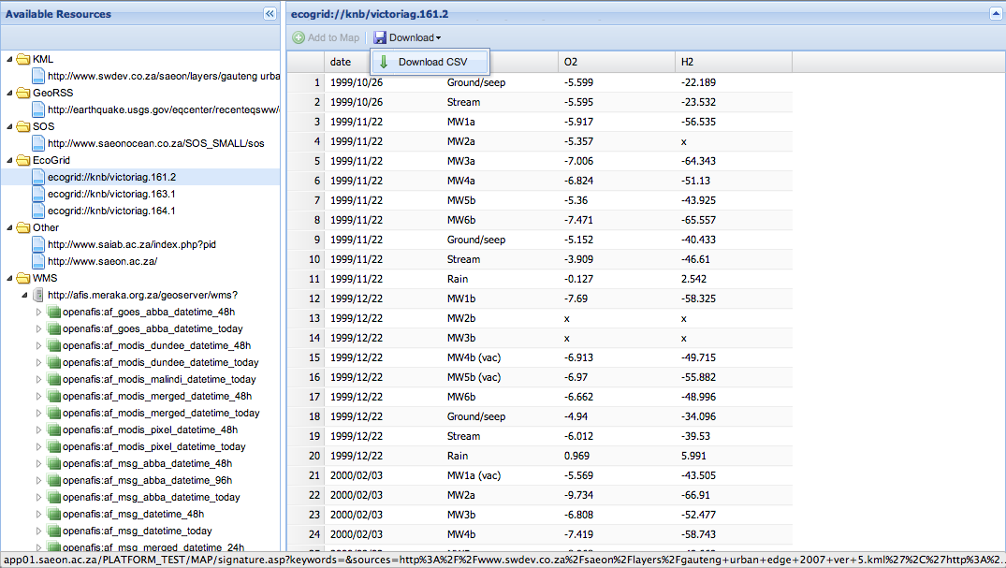
EcoGrid (Table) Data

Slide 29
Invitation(s)

Slide 30
Data Providers
Engage with us through NEOSS
Council for GeoScience
SADCO
SANSA
Meraka-WAMIS
Guidance Document: please e-mail me at wim@saeon.ac.za

Slide 31
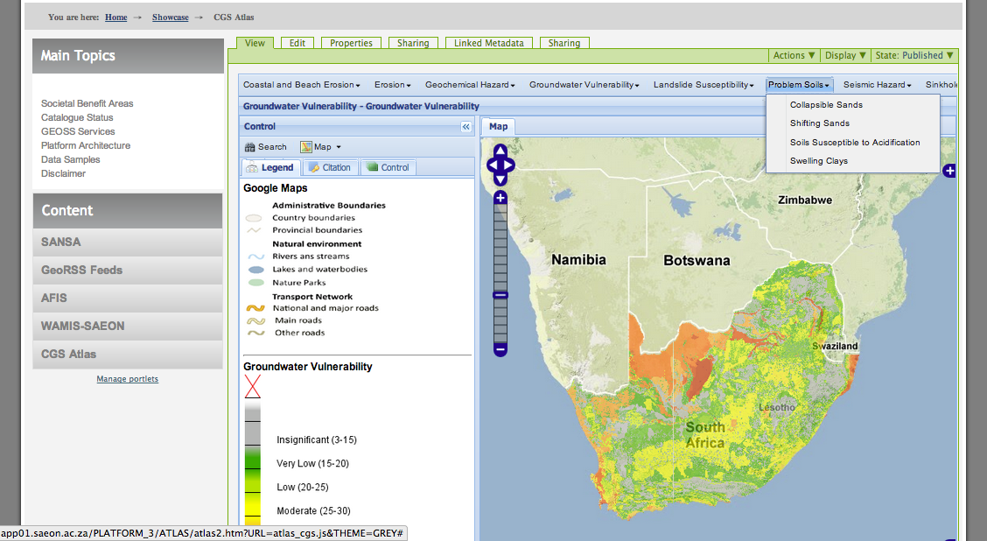
SHOWCASE: ATLAS COMPONENT

Slide 32
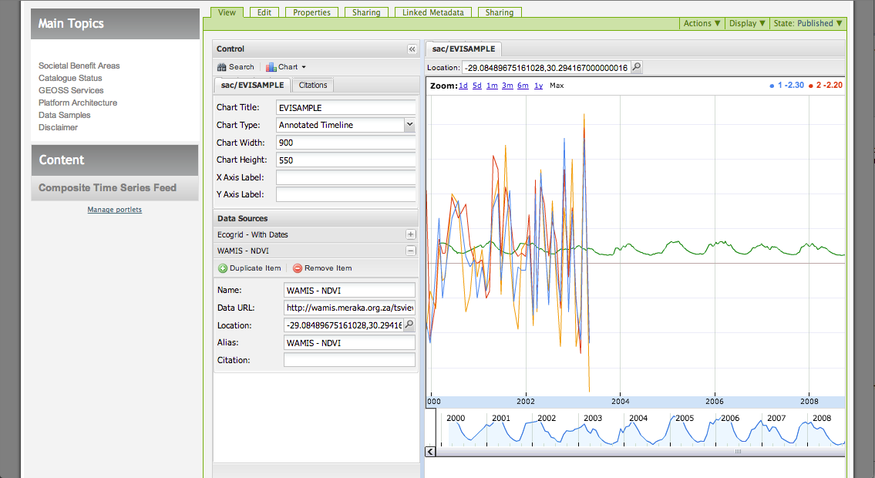
SHOWCASE: WAMIS TIME SERIES – COMBINED WITH SAEON TIME SERIES

Slide 33
COLLABORATIONS
Detailed ‘Technology RoadMap’ available on request
Combines development of the shared platform and DIRISA
Main Themes
Extended visualisation clients for standardised data
SOS, NetCDF, HDF-4, GRIB, etc.
Non-spatial visualisation
Knowledge and soft data visualisations
Analysis tools for data exploration
Linking Citations, Usage Statistics, Usability and Quality Assessments
Web Processing Services and Links to Search Facilities
Improved Search Capabilities for Large Collections
Hosting, Serving, and Querying Large Data Sets
Extended, Liberalised Meta-Data and Knowledge Networks
Improved Page and Theme Toolset
Adapters for Automated Harvesting from RDBMS
Configurable Systems for Crowdsourcing and Citizen Science

