Slide 1
The RESEARCH DATA ALLIANCE
Maturity Model Approach
WG: Repository Audit and Certification
Wim Hugo – ICSU-WDS/ SAEON

Slide 2
Problem Statement
How do we make an objective assessment of a complex, multi-faceted evaluation?
Will someone else reach the same conclusion?
How do we know where we are in terms of performance, and how do we account for multiple sets of objectives and criteria for compliance?
What do we need to do to improve?
https://www.icsu-wds.org/news/wds-related/a-maturity-model-for-digital-data-centers

Slide 3
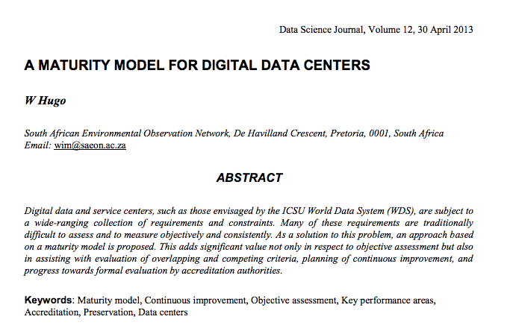

Slide 4
Maturity Models
A set of structured levels that describe how well the behaviours, practices and processes of an organization can reliably and sustainably produce required outcomes.
  a place to start and ‘join the club’
  the benefit of prior experiences
  a common language and a shared vision
  a framework for prioritizing actions.
  a way to define what improvement means for your organization.
Useful as
  a benchmark for assessment
    Qualitative metrics
  As an aid to understanding
  For comparative evaluation.
http://www.sei.cmu.edu/cmmi/start/

Slide 5
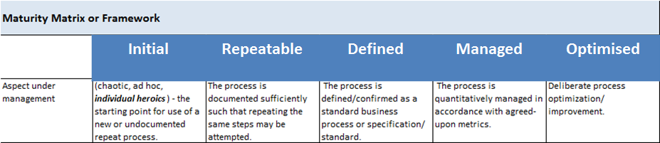
Maturity Matrix
With increased maturity comes increased concretisation of
  Goals and objectives (governance, steering, planning, …)
  Commitment (political support, institutional frameworks, …)
  Ability (resources, capacity, funding, sustainability, …)
  Measurement (M&E, reporting, quality assurance, …)
  Verification (audit, accreditation, peer review, …)

Slide 6
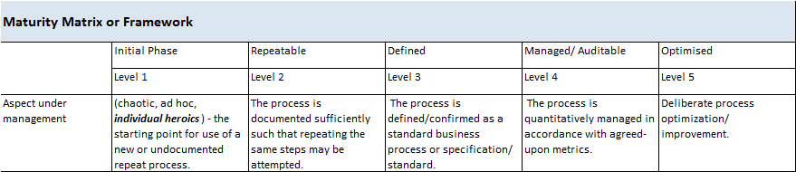
Alternative Classifications/ Scales of Maturity
Ignorance | Awareness | Adoption | Implementation | Management | Continuous Improvement

Slide 7
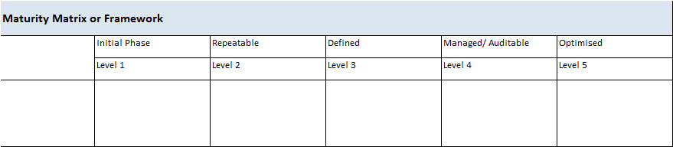
Scope of Management
Populated from an ‘Objective Hierarchy’, KPA’s, etc.

Slide 8
Objective Hierarchy …
WDS
Governance
Networking & Sharing
Policies and Procedures
Infrastructure

Slide 9
Objective Hierarchy …
WDS
Governance
Vision &
Planning
Oversight
Science Committee
Mandate
Tech Steering
Committee
…
Network of Experts
…
Networking & Sharing
Expertise
Network of Experts
…
…

Slide 10
… or Objective Graph
WDS
Governance
Vision &
Planning
Oversight
Science Committee
Mandate
Tech Steering
Committee
…
Network of Experts
…
Networking & Sharing
Expertise
Network of Experts
…
…

Slide 11
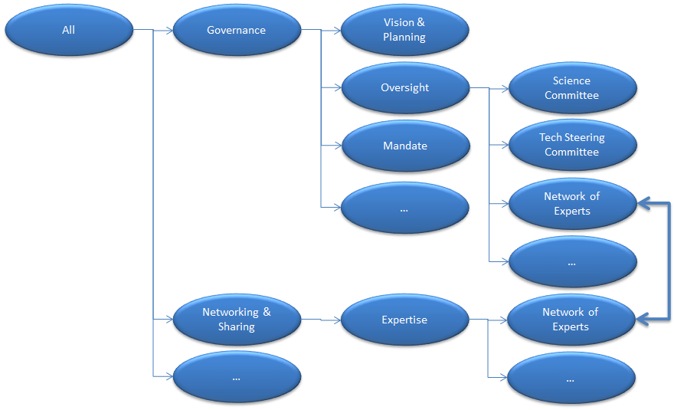
Large and Complex Matrix …

Slide 12
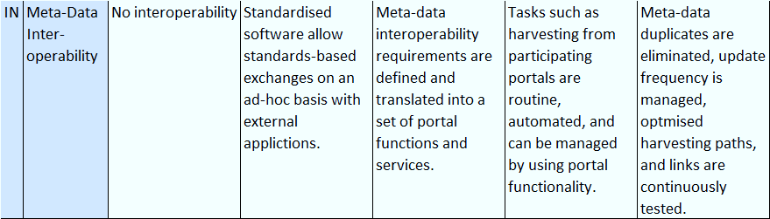
… each with Metrics
Supported by relevant user requirements, specifications, standards, and reference implementations.
“Good” or “Best” practice

Slide 13
Current Performance

Slide 14
Self-Assessment
‘WDS’
‘DSA’
‘NESTOR’
‘OAIS/ TRAC’
‘ISO’
…
Limited Impacts
‘GEOSS’ (Technology)
‘APA’ (Preservation)
…

Slide 15
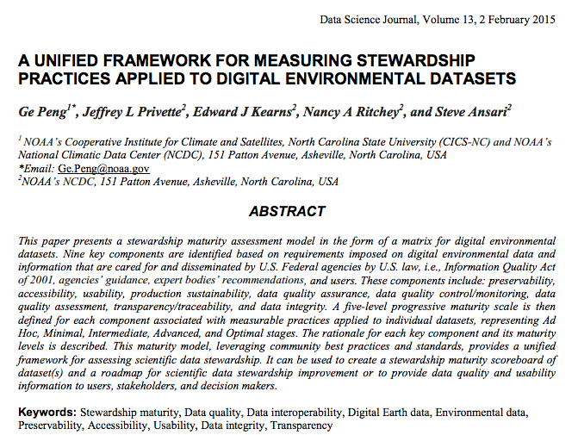
Limited Impact or Scope
https://www.jstage.jst.go.jp/article/dsj/13/0/13_14-049/_article

Slide 16
Milestones and Goals
Use Matrix to Develop Milestones for Continuous Performance Improvement

Slide 17
Quality Assurance
Extent to which I am meeting my Own Goals
‘Internal Audit’

Slide 18
Audit
External Measurement Against Published Criteria
‘Audit’ & ‘Accreditation’

Slide 19
Immaturity Model …
0 : Negligent
  The organisation pays lip service, often with excessive fanfare …
-1 : Obstructive
  Also known as ‘Stupid’.
-2 : Contemptuous cf. Lunatic
  While processes exist, they are routinely ignored …
-3 : Sabotage
  Actively undermining all and every effort of management … faking their own performance and those of others …
Some Organisations Celebrate Reaching Level 0
http://www.grisha.ru/cmm/cimm.htm

Slide 20
☺
?

